Slide 1
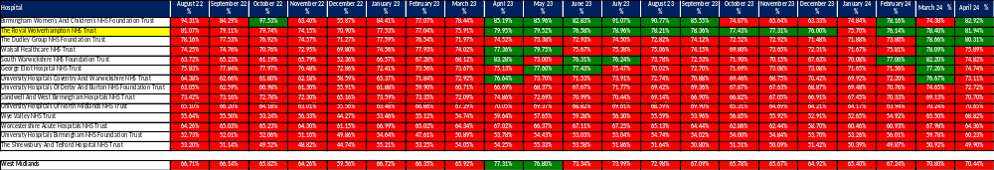
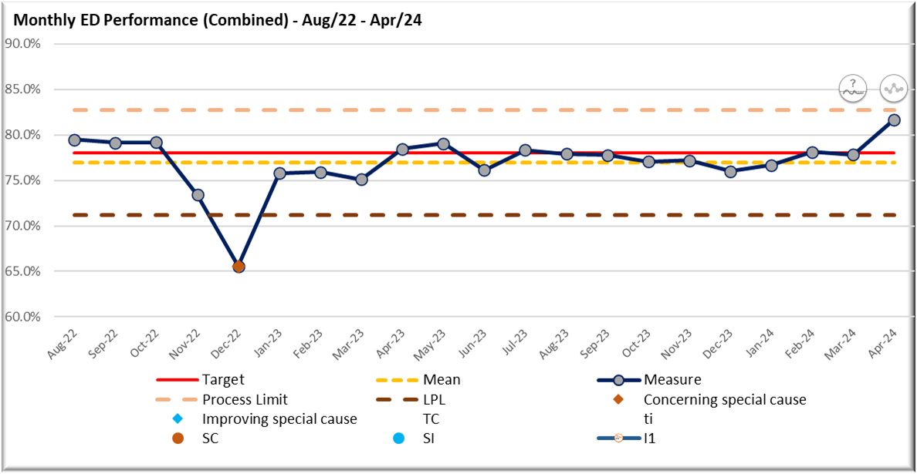
Consistently maintaining the national target of 76% of patients being admitted, transferred, or discharged within four hours
Emergency Services Team
Background
Over the last 4 years, urgent and emergency services have been through the most testing time in NHS history with a perfect storm of pressures impacting the whole health and care system but causing the most visible problems at the front door.
Despite best efforts, problems discharging patients to the most appropriate care settings, alongside the demands of flu and COVID peaking together, has seen hospital occupancy reach record levels. This means patient ‘flow’ through hospitals has been slower.
As a result, patients have had to spend longer in Emergency Departments and waiting longer for ambulances. Hospitals are fuller than pre-pandemic, with 19 out of 20 beds occupied; up to 14,000 beds are occupied by someone who is clinically ready to leave; and the number of the most serious ambulance call-outs has been at times up by one third on pre-pandemic levels (NHS England, 2023)
To support this, the delivery plan for recovering urgent and emergency care services (published in January 2023) set out a number of ambitions. One of which being;
Patients being seen more quickly in emergency departments: with the ambition to improve to 76% of patients being admitted, transferred or discharged within four hours by March 2024, with further improvement in 2024/25.
Project Aim
To consistently maintain the national target of 76% of patients being admitted, transferred, or discharged within four hours.
What did we do?
Clinical audit - the team undertook clinical audits to identify specific barriers and delays in patient journeys and developed an action plan to mitigate them.
Housekeeping of IT systems – Administrative validation of breaches occurs on a daily basis which helped to identified technical issues that prevents clinicians discharging patients in a timely fashion
Training of SDEC team in triage process - Therefore patients can be redirected to SDEC prior to triage reducing time in department and overcrowding of ED triage queue
Implementing a front triage escalation process meaning that at peak times in activity – particularly walk-in, staff resource can be redeployed to mitigate triage queues.
Rapid Assessment and Treatment (RAT) in ED - rapid assessment and treatment is the initiation of investigations and treatment as determined by a team including senior decision-makers
The Push model creating ED capacity - the Push Model continues to be fully operational across Medicine, whereby patients are moved directly to a base ward from either ED or AMU at set times to create much needed capacity. This has resulted in ambulance handover times being much lower than those prior to the implementation of the model.
ARC - the Ambulance Receiving Centre, continues to act as additional ambulance offload capacity to reduce the number of over hour ambulance delays and support with patient flow overall
More collaborative working between ED/SDEC/UTC – ensuring patients are seen by the most appropriate and effective service first time.
What was the outcome?
The Trust is currently one of around twenty organisations within England routinely meeting the 76% 4-hour performance target.
Emergency Services Team

