Slide 1
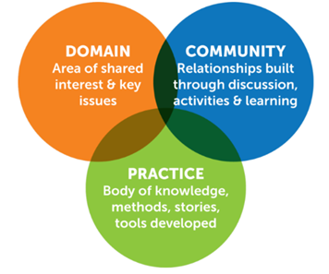

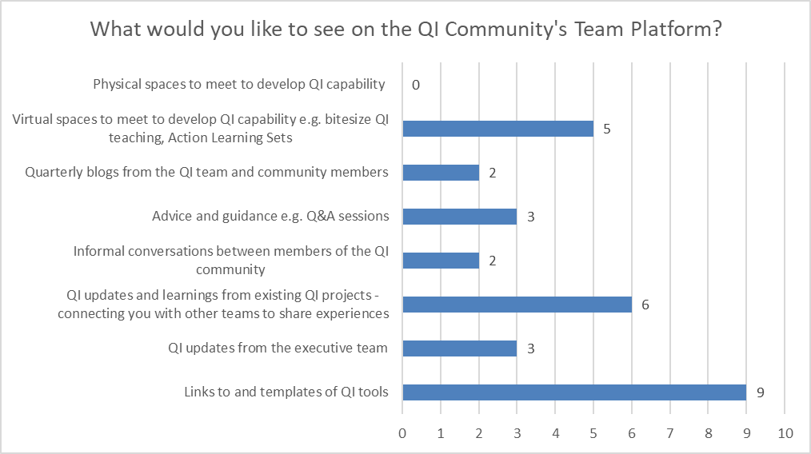
A24-103
Developing a Quality Improvement Community of Practice
Katy Cook, Quality Improvement Programme Partner
Claire Hill, Quality Improvement Development Manager
“Communities of practice are groups of people who share a concern, a set of problems, or a passion about a topic, and who deepen their knowledge and expertise in this area by interacting on an ongoing basis.” – Etienne Wenger, Cultivating Communities of Practice: A guide to Managing knowledge
The Opportunity: Community of Practice
The Quality Improvement Community of Practice was launched on 5th July 2023. The community provides a virtual space to share knowledge, ideas, ask questions and support continuous learning in QI for colleagues across Walsall and Wolverhampton.
Benefits
Shared purpose and ownership of QI
Spread change and measure impact of QI
Continuous engagement and communication
PDSA Cycles
Stakeholder events to gather views
Community of Practice developed based on findings of PDSA 1
Community of Practice platform launched
Co-design & delivery of micro-teach sessions
Successes:
Online platform
37 colleagues attended bespoke training
251 members
Walsall & Wolverhampton Quality Improvement Team
Next steps:
Facilitate further microteach sessions
Cultivate the community and encourage connections
Support the community towards self organisation

