Slide 1
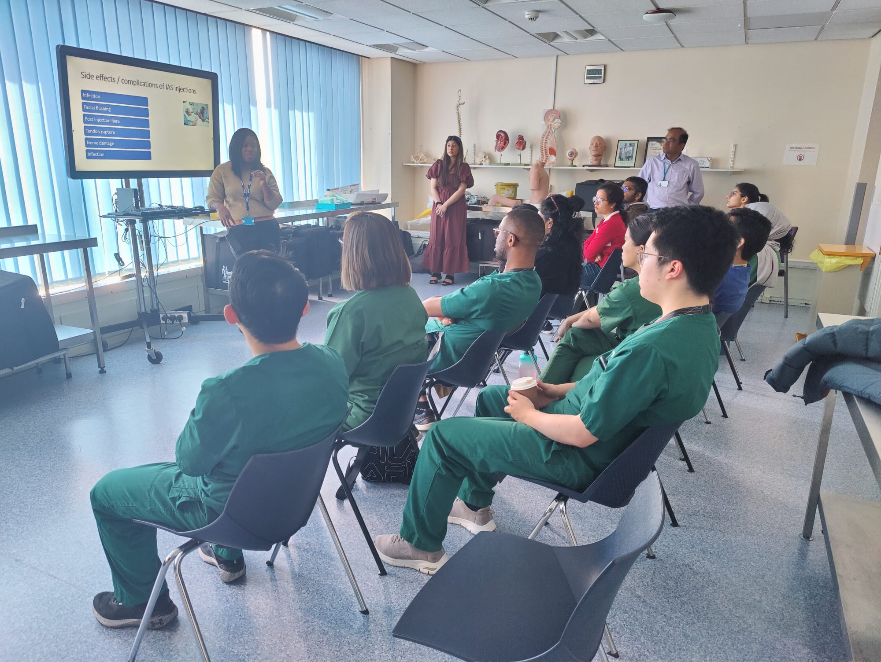
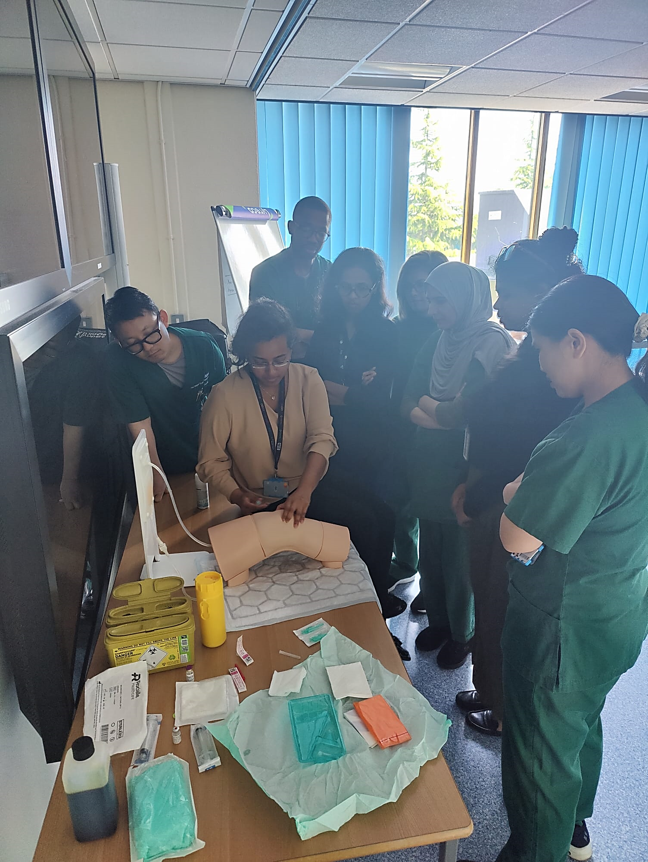
A24-102
STANDARDISING THE ADMINISTRATION OF JOINT INJECTIONS ACROSS THE WOLVERHAMPTON NHS TRUST
- A SERVICE IMPROVEMENT PROJECT IN RHEUMATOLOGY
Dr. Hirushi S. Jayasekera (Project Lead), Dr.Tamaraudubamo Agunbiade, Dr. Ajibade Adenitan,
Dr. Saima Almas, Dr. S. Venkat Chalam (Project Supervisor)
BACKGROUND
The Rheumatology Junior Doctors’ forum (JDF) highlighted that doctors were keen to perform steroid injections but limited by individual levels of experience, confidence and access to guided learning opportunities. There is a clear gap in knowledge around decision making on when/ when not to inject and type of steroid to use. Upskilling doctors in this area showed potential to enhance service development by reducing patient waiting lists and improving professional competency.
AIM:
RESULT HIGHLIGHTS:
To standardize the practice of joint injections across the Trust by empowering doctors with the skill-set, knowledge and confidence required for safe practice in line with Trust values and guidelines
Experience with Joint Injections:
50% were novice at joint injections amongst which 0% had ever injected a shoulder.
Confidence in Consenting Patients:
Pre-Course: Only 14.29% strongly agreed to have confidence. Post-Course: 100% confidence in consenting
Understanding Medications for Joint Injections:
Pre-Course: 64.29% had only heard medication names, 28.57% unsure of evidence-based practice. Post-Course: 100% confidence rate
Confidence in Deciding if Safe to Inject the joint:
Pre-Course: 42.86% were not confident in making these decisions, post course 100% improvement (42.86% strongly confident, 57.14% confident).
METHOD:
Doctors’ Survey
Gather insight into gaps in knowledge
Ask target audience what they wanted to learn
Recruit Teachers/ Registrars
Consultant insight and guidance
PDSA Discussion, Fish-bone analysis & Course Design
Regular MS teams meetings on Target development
Room booking, Adverts, Sponsors & Equipment
Run Course itself
Feedback to gauge
Post course Discussion- Feedback analysis,
Rheumatology Departmental Meeting Presentation
IMPROVEMENT RADAR
IMPROVEMENT RADAR:
CONCLUSION:
The post-course survey results show a marked improvement in confidence and competency regarding joint injections. All participants reported increased confidence in consenting patients, deciding the safety of injections, and understanding the use of IA steroids. The course was unanimously considered to have upskilled their competency in performing joint injection.
100%
RHEUMATOLOGY

