Slide 1
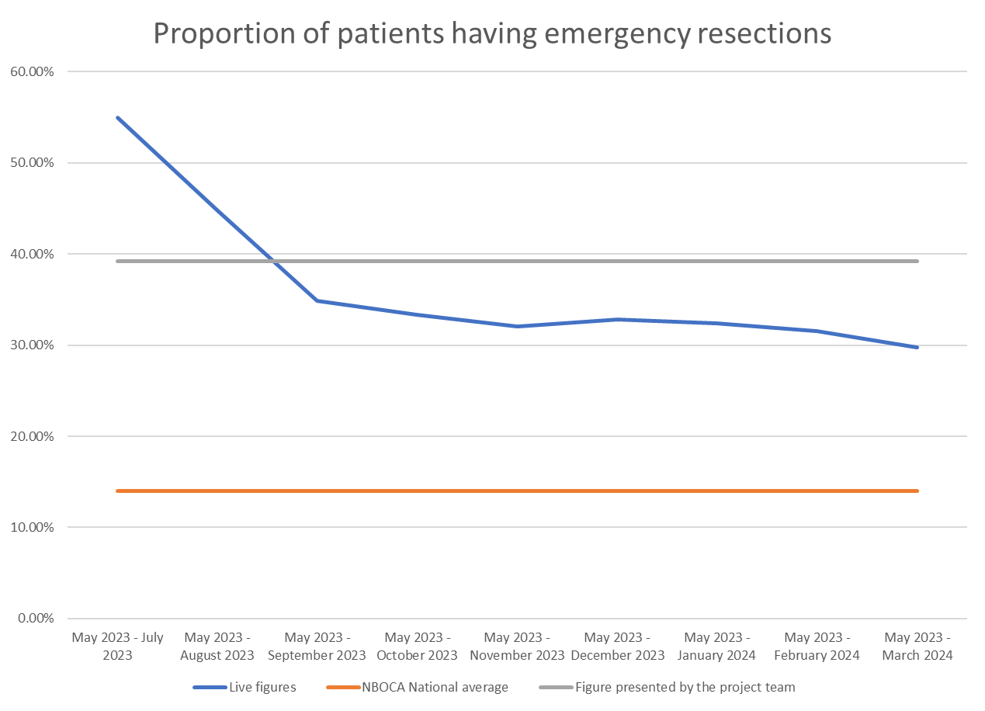
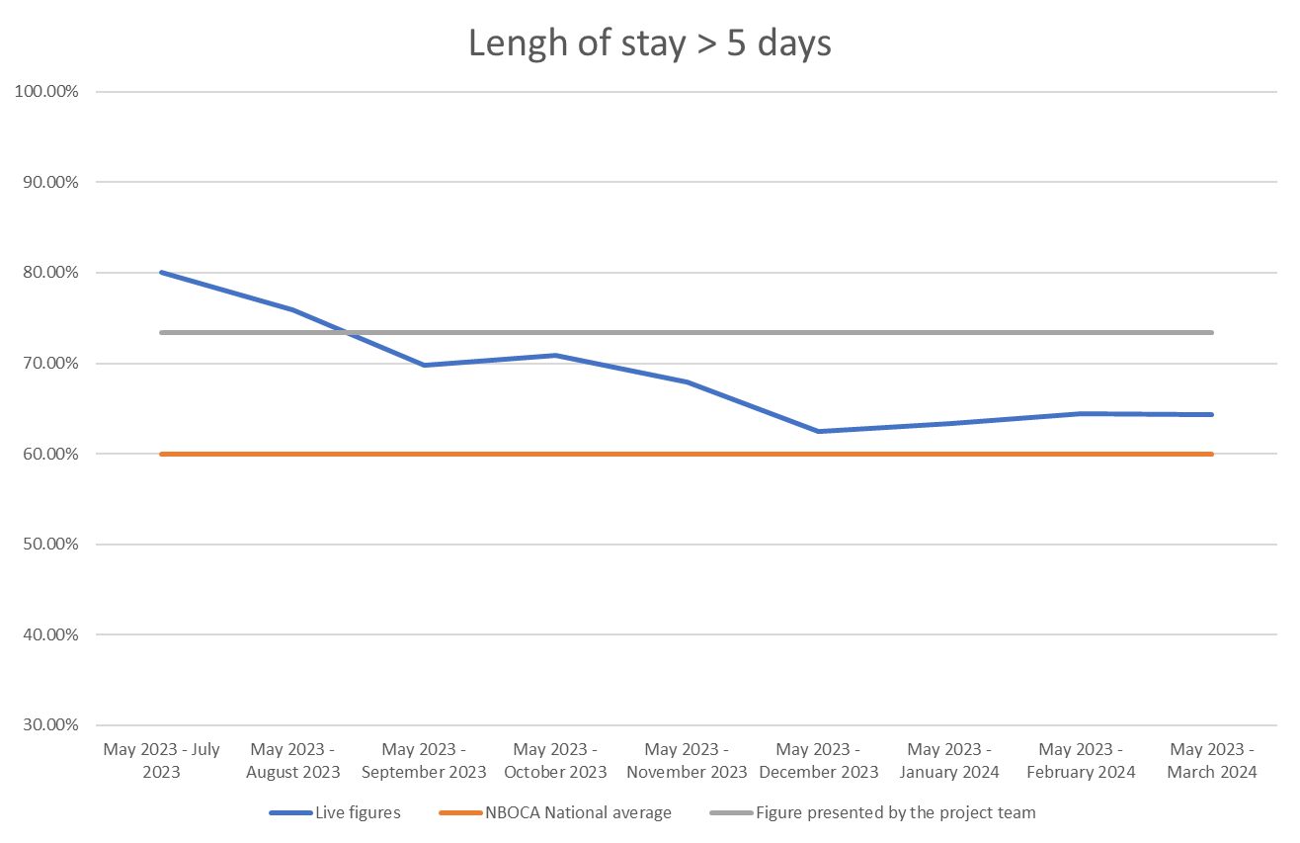
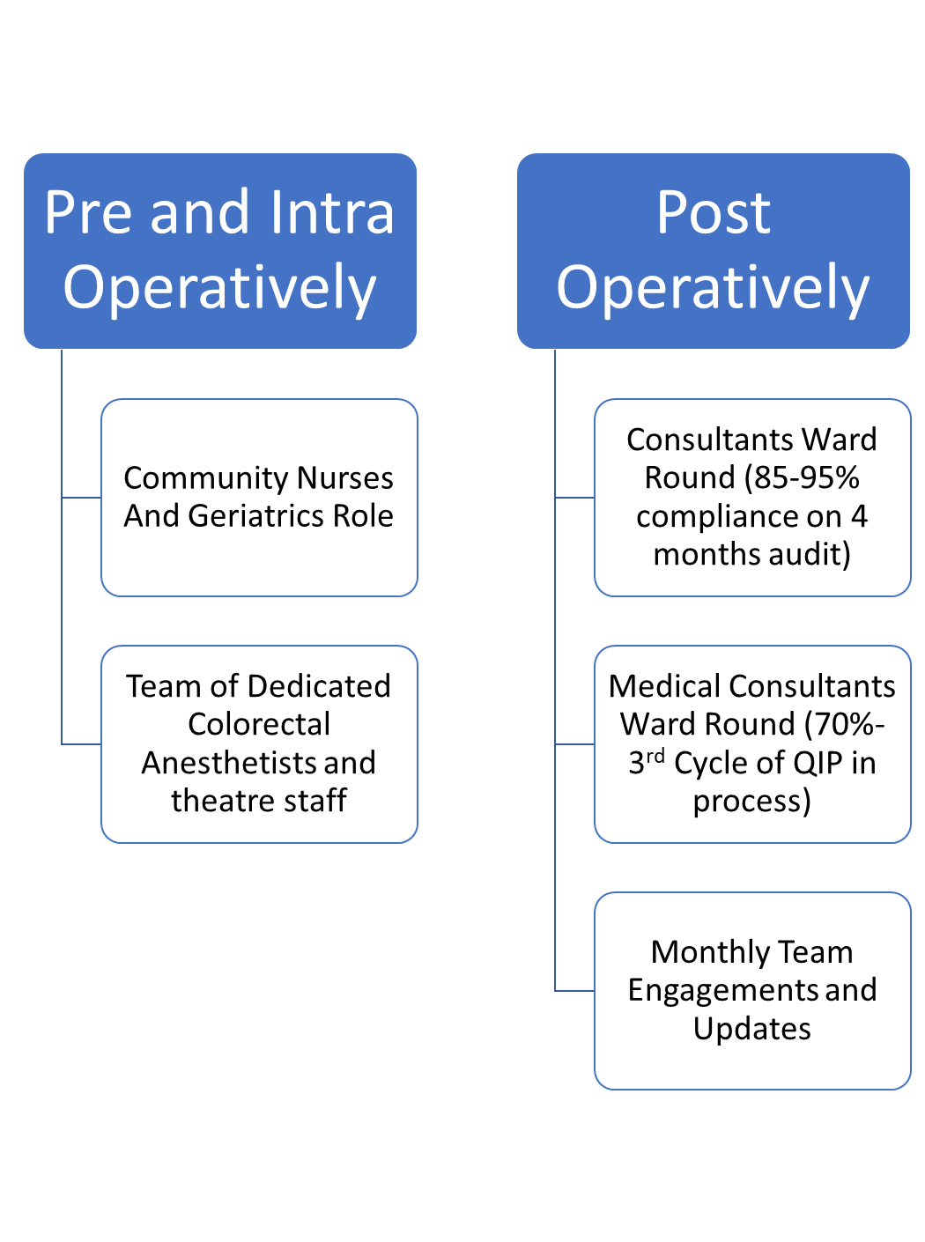
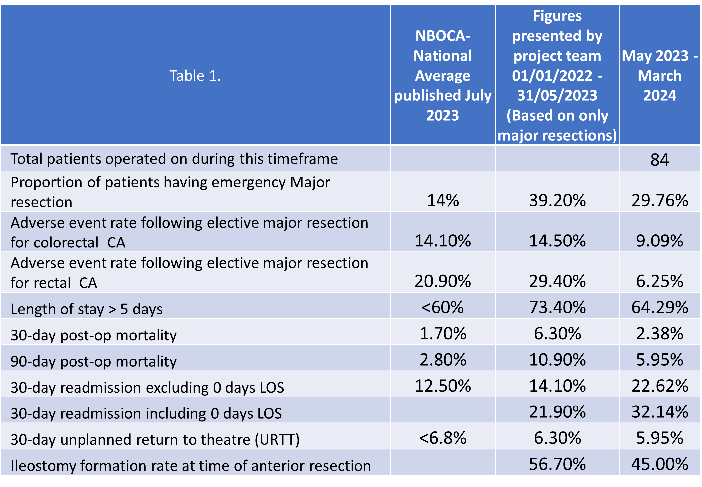
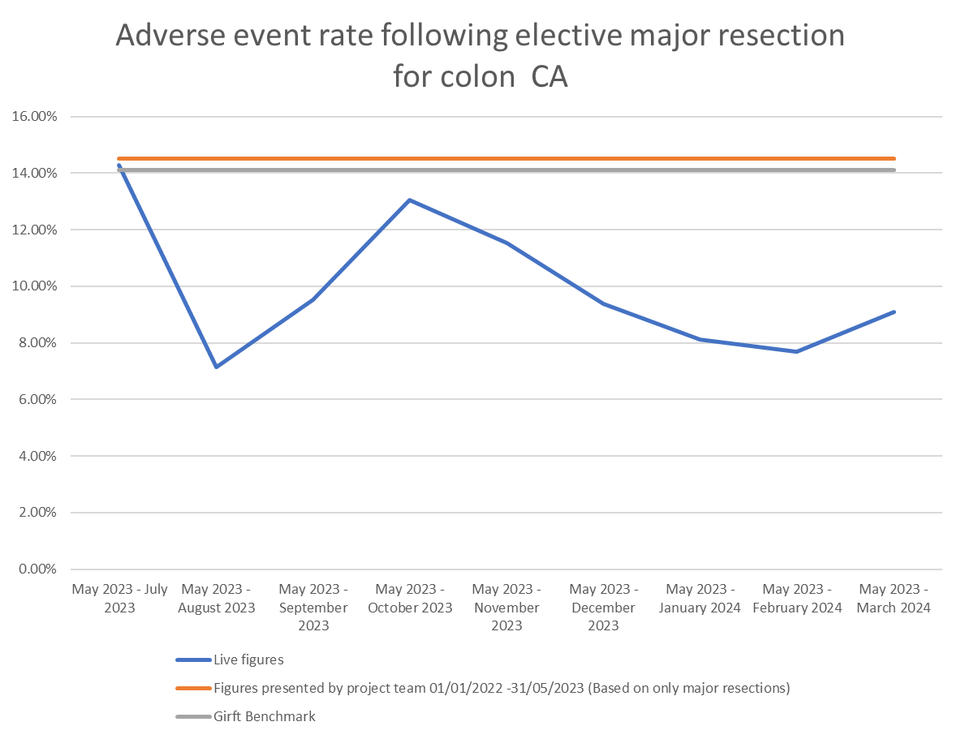
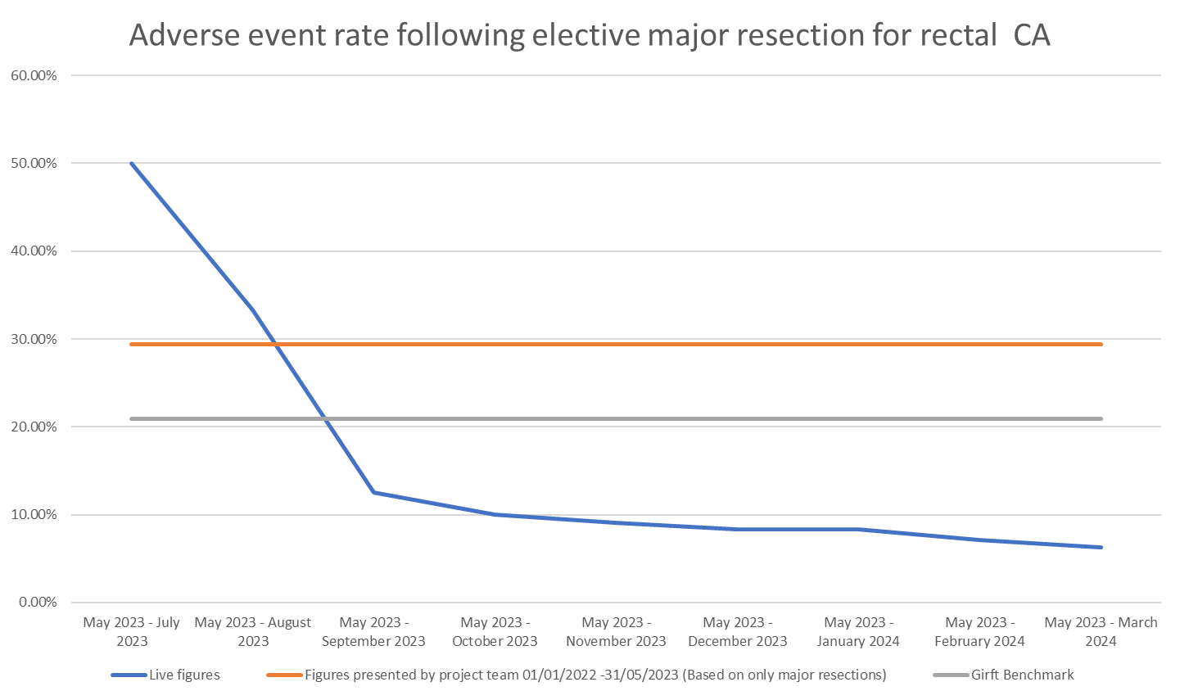
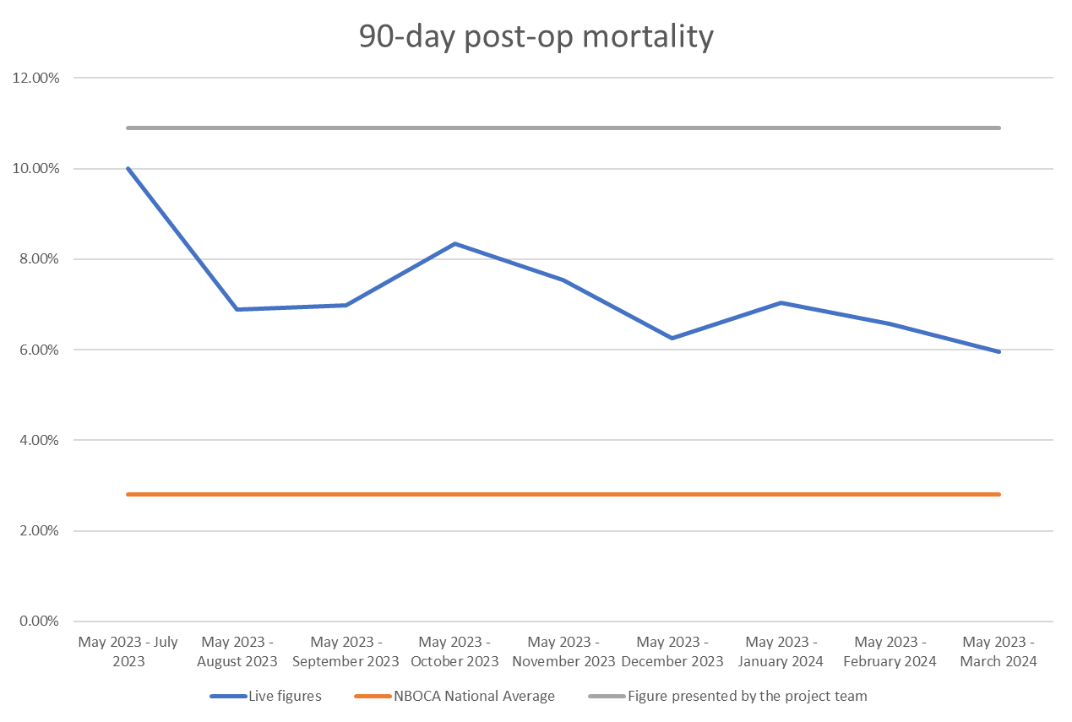
A24-099
Colorectal Surgery Improvement Project
Nifasat Farooqi/SpR, Angelina Lee/F2, Tom Anthony, Farhan Javed/Spr, Naseem Warraich/Consultant, Muhammad Tayyab/ Consultant, Colorectal Team/ Walsall Healthcare NHS Trust
Background and Objectives
Colorectal services at Walsall were identified to have some poor outcomes as per NBOCA ( National Bowel Cancer Audit). We looked at multiple processes from patient entry / referral from GP to hospital services till their discharge and follow ups. We identified multiple areas which potentially were contributed to these outcomes. Colorectal Improvement Project was launched to rectify the whole process. The aim of this study is to assess the outcomes in colorectal surgery patients after implementing “The Colorectal Improvement Project”.
Methods
Multiple QIP projects were started to address the issues with the service.
Data was prospectively collected as the processes were being implemented.
Data included all patients with colorectal cancer operated between may 2023 until March 2024. We compared our results with NBOCA National average and our previous data. Table 1.
Proportion of patients having emergency resection rate increased to 30%
Length of stay >5 days
Results
In the study period, 85 colorectal Cancer Surgeries were performed. Prior to the introduction of the colorectal initiative bundle, the overall adverse events rate for colon was 14.5% and for rectal cancer was 29.4%, This rate fall down to 9.09% and 6.25% respectively. During the improvement and implementation period of 11 months, the overall rate of adverse events and mortality fell 6.25% and 5.95% respectively. The details of overall data is in Table 1 and Figures
Adverse events rates for colon ca decreased to 8-9% as compared to NBOCA 14%
Adverse events rates for rectal ca markedly decreased to 10% as compared to NBOCA 30%
90-Day post op mortality decreased to 6%.
Conclusion
Reduction in the rate perioperative adverse events was achieved by adopting a comprehensive colorecatl improvement project. This was complemented by a process of continuous measurement and evaluation. The process resulted in reduction of adverse events, return to theatre and mortality in a short time.

