Slide 1
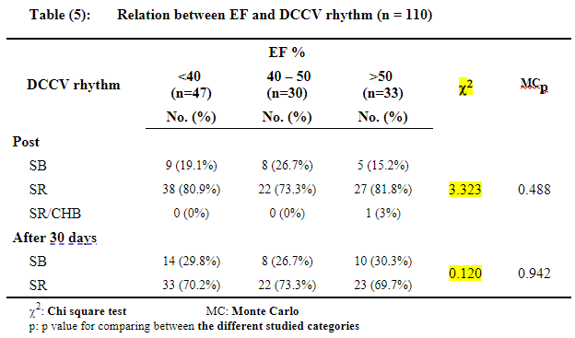
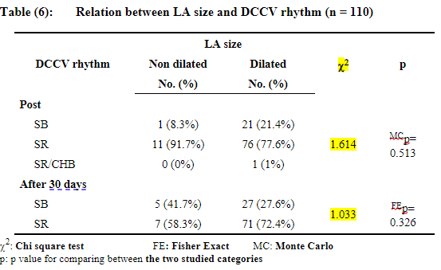
A24-098
Aggressive rhythm management in patients with Atrial Fibrillation/Flutter is safe and feasible with use of amiodarone and conscious sedation cardioversion irrespective of LV function or atrial size.
Lucy Bomphrey MBBS Clinical Teaching Fellow, Ahmed Hagagg MRCP Specialty Doctor in Cardiology, Jayne Lewis RCN, BSc (Hons), NMP Specialist Cardiac Arrhythmia Nurse, Louise Sanbrook RCN, Dip (He) Specialist Cardiac Arrhythmia Nurse, Ibrahim Mahmoud MRCP Specialty Doctor in Cardiology,
Rumi Jaumdally MD FRCP Consultant Cardiologist
Picture to go here
Introduction
There is considerable debate regarding the restoration of sinus rhythm (SR) in patients with heart failure and Atrial Fibrillation/Flutter (AF)¹
Data suggests left ventricular systolic dysfunction (LVSD) and adverse left atrial (LA) remodelling are poor predictors of success.
Whilst amiodarone improves and maintains SR² , this has not been specifically studied in LVSD cohorts.
In a cohort of patients with LVSD and early persistent AF undergoing nurse-led use of amiodarone and DC cardioversion (DCCV), we analysed the outcome of achieving SR and impact on LV and LA size and function.
Method
Prospective review and analysis of eligible patients having a documented diagnosis of AF within 1 year and LVSD over the period of June 2020-February 2021.
A protocol for short term use of amiodarone (<1 year) and direct oral anticoagulants (DOAC) with high energy bi-phasic synchronised DCCV under sedation and analgesia was developed and implemented by our specialist arrhythmia nurses.
We analysed the effectiveness of restoring SR post and at 90 days post DCCV, the impact of LVEF/LA size, symptoms, and clinical complication rate.
Results
Mean age was 68 (+/- 11) years with 76% males.
The main symptoms were tiredness 51%, dyspnoea 38 % with palpitations and dizziness at 25%.
All patients underwent a transthoracic echo (TTE) with the result showing LVSD:
  EF<40% (Group 1, 43% patients)
  EF 41-50% (Group 2, 27% patients)
  EF>50% (Group 3 30% patients)
97 patients (89%) had dilated LA with an indexed mean volume of 35 +/- 12 ml/m2 irrespective of LVEF.
Except for 1 patient (Group 3) who developed complete heart block, all patients reverted to SR post DCCV and at 90 days (p values 0.49 and 0.94 respectively) irrespective of LVEF.
There was no difference in patients with LA dilatation (89%) versus normal sized LA (11%) on achieving SR post DCCV and at 90 days (p values 0.51 and 0.33 respectively).
Post DCCV, the main complications were transient sinus bradycardia (3%) or hypotension (4 %) and 1 (0.9%) case of possible clinical TIA with complete resolution.
Protocol
65% were on amiodarone, 77% beta blocker/flecainide and 62% on both. 24% were on no antiarrhythmic due to ventricular rate <80 bpm with conduction disease.
DCCV was delivered using intravenous midazolam (3-13mg) and morphine (4-10mg) for conscious sedation.
110 patients with early persistent AF/Flutter were identified using our specialist arrhythmia dataset.
One patient underwent internal DCCV via an implantable defibrillator. 120 joules shock was used initially for patients with BMI <30 and 150 joules when BMI >30.
88 patients (80%) needed 1 shock,
13 patients (12%) 2 shocks and
9 patients (8%) 3 shocks with mean energy per DC shock of 155 +/- 33 joules.
All eligible patients were started on DOAC (Apixaban 67%, Dabigatran 4%, Edoxaban 10%, Rivaroxaban 19%).
One patient chemically reverted to SR and was not included in the results
A GE Model delivered synchronized DC shocks via the antero-posterior paddles
Conclusion
Our local simplified protocol allows safe, early initiation of DOAC, amiodarone and/or betablocker therapy a singular echo and consent visit.
No evidence of reduced LVEF or LA dilatation on resuming SR post DC cardioversion or at 90 days.
Aggressive restoration of SR in a cohort with LVSD is feasible irrespective of LVEF/LA size with reversion to SR and no long-term complications at 3 months.
Cardiology – Department of Medicine
References
1 Roy D et al; Atrial Fibrillation and Congestive Heart Failure Investigators. Rhythm control versus rate control for atrial fibrillation and heart failure. N Engl J Med. 2008 Jun 19;358(25):2667-77
2 Gonna H et al; The efficacy and tolerability of commonly used agents to prevent recurrence of atrial fibrillation after successful cardioversion. Am J Cardiovasc Drugs. 2014 Aug;14(4):241-51.

