Slide 1




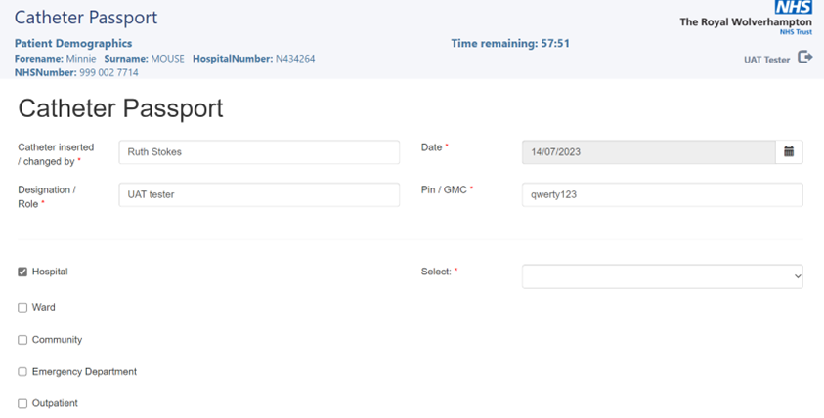
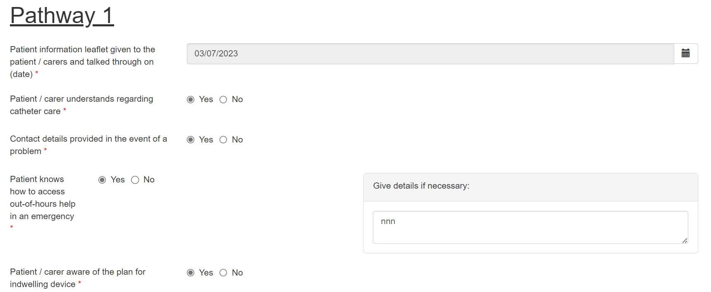
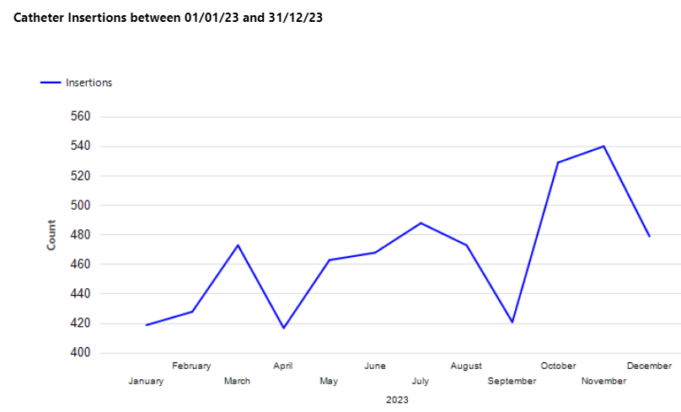
DIGITAL CATHETER PASSPORT
Urinary Catheter Working Group
THE WHY
Urinary tract infections account for around I in 5 of all healthcare-associated infection (HCAI). Almost 50% are associated with urinary catheters. Key driver for a digital tool was to manage catheters & reduce the burden of HCAI
Inappropriate use of catheters/ long term catheter use
Lack of care planning of ongoing management
Missed opportunities around trial without catheter (TWOC)
Increase in problematic catheters: results in approx. 300 additional community visits in addition to planned catheter changes
Existing paper catheter passports inconsistently used by both staff & patients
A urinary catheter
THE HOW
At RWT a Urinary Catheter & Continence Working Group was set up to look at strategies to improve patient care & safety for patients with urinary catheters
Consists of a range of healthcare professionals across various roles from both Acute & Community healthcare settings
Now aligned with WHT colleagues & has adopted a successful, collaborative approach to its aims & aspirations for reducing harm by effectively managing indwelling devices
Meets monthly & is working on many aspects of urinary catheter care with promotion of suitable alternatives to indwelling devices where possible to improve quality of life for patients with continence issues
Uses data to highlight areas of focus/trends, driving quality improvement around urinary catheters
Digital Catheter Passport developed & launched at RWT November 2023 – located on Clinical Web Portal/internal referral tab
Primary and secondary care teams to document catheter insertion/removal/update plans/record problems encountered with catheters or notable events
THE WHAT
Catheter Passport Aims
Effective care planning at point of insertion/accurate recording of the procedure undertaken for improved data availability going forward
Prompts for ongoing options e.g. Trial Without Catheter (TWOC) & long-term catheter usage
Contact details for patient & healthcare providers associated with the catheter plan & its management
Reduce the amount of long-term catheters by prompting & raising awareness
E passport to replace the referral documentation used in primary care to coordinate follow up on discharge
Working document for continuity of care & communication between a wide range of services
Collaboration across Trusts to create consistency & improve communication
Live document/auditable system
Print version for out-of-area patients for continuity of care/Business Continuity Plan (BCP)
PHASE TWO
Working towards a digital passport shared solution for RWT & WHT
Troubleshooting & Incorporating changes from learning following initial launch
Snapshots of the digital Catheter Passport
Graph below shows number of catheter insertions across RWT – catheter passport launched in November 2023 – will continue to monitor data for sustained decrease in catheter insertion
Department / Team Name
The Urinary Catheter Working Group

