Slide 1
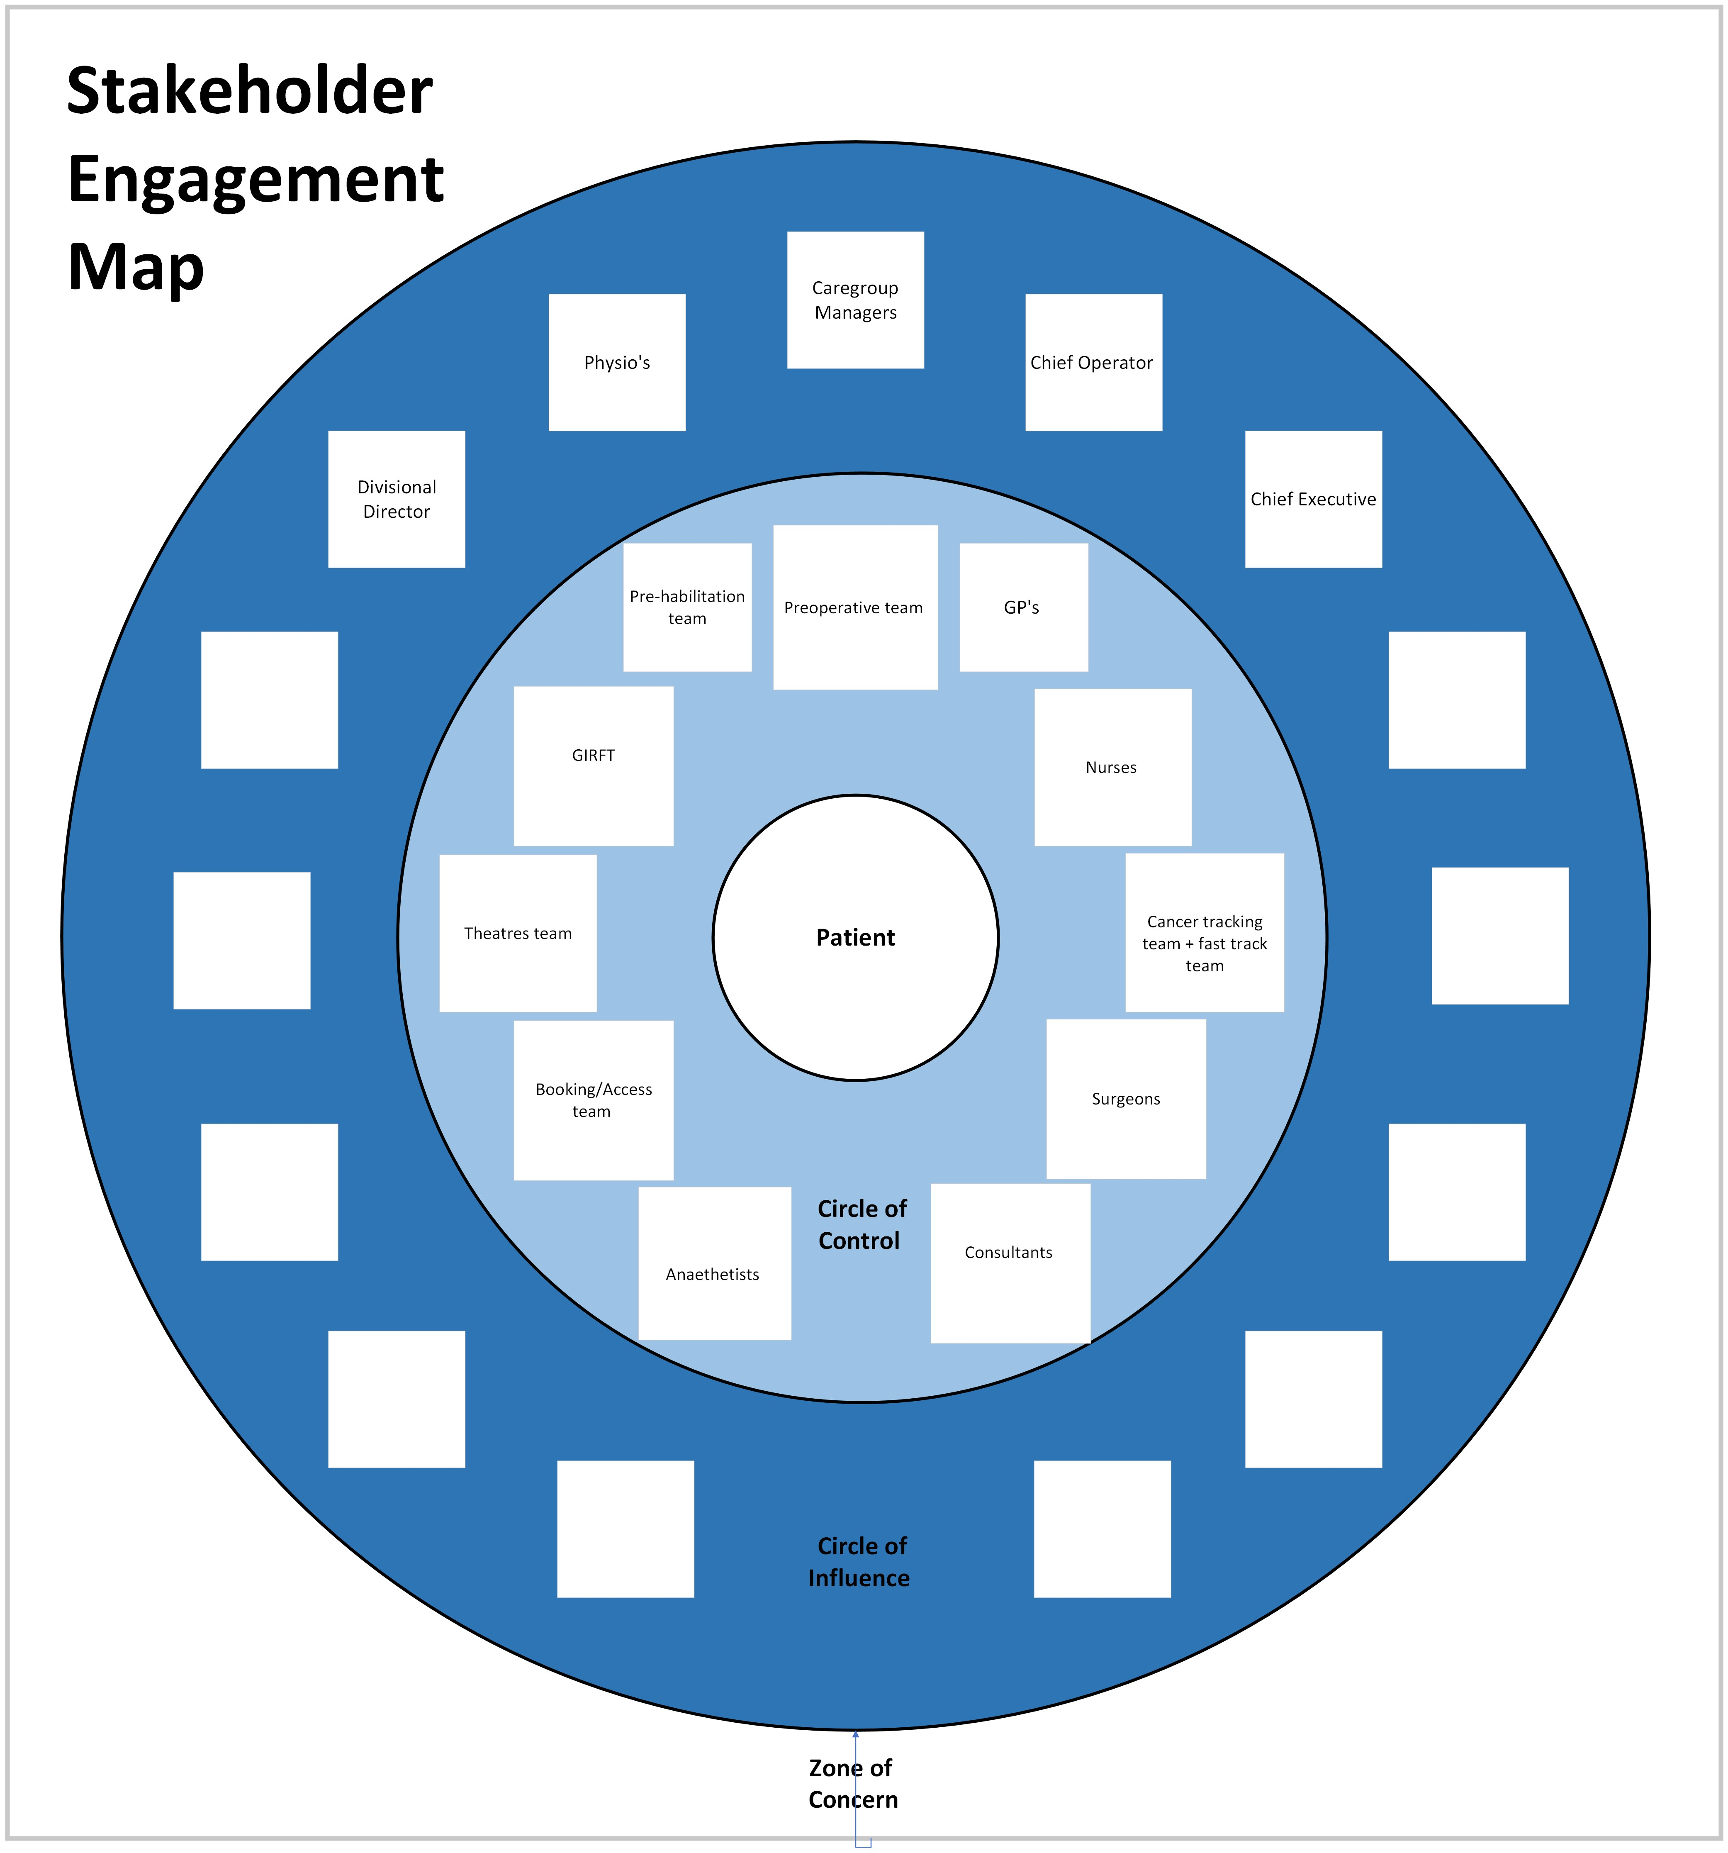
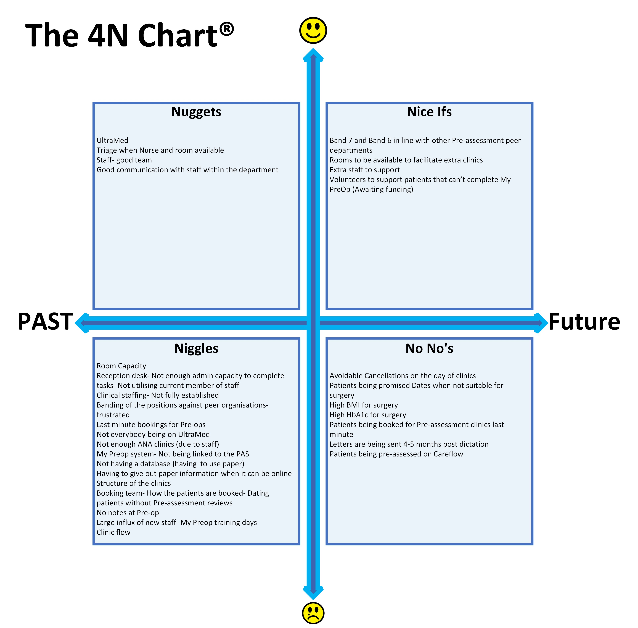
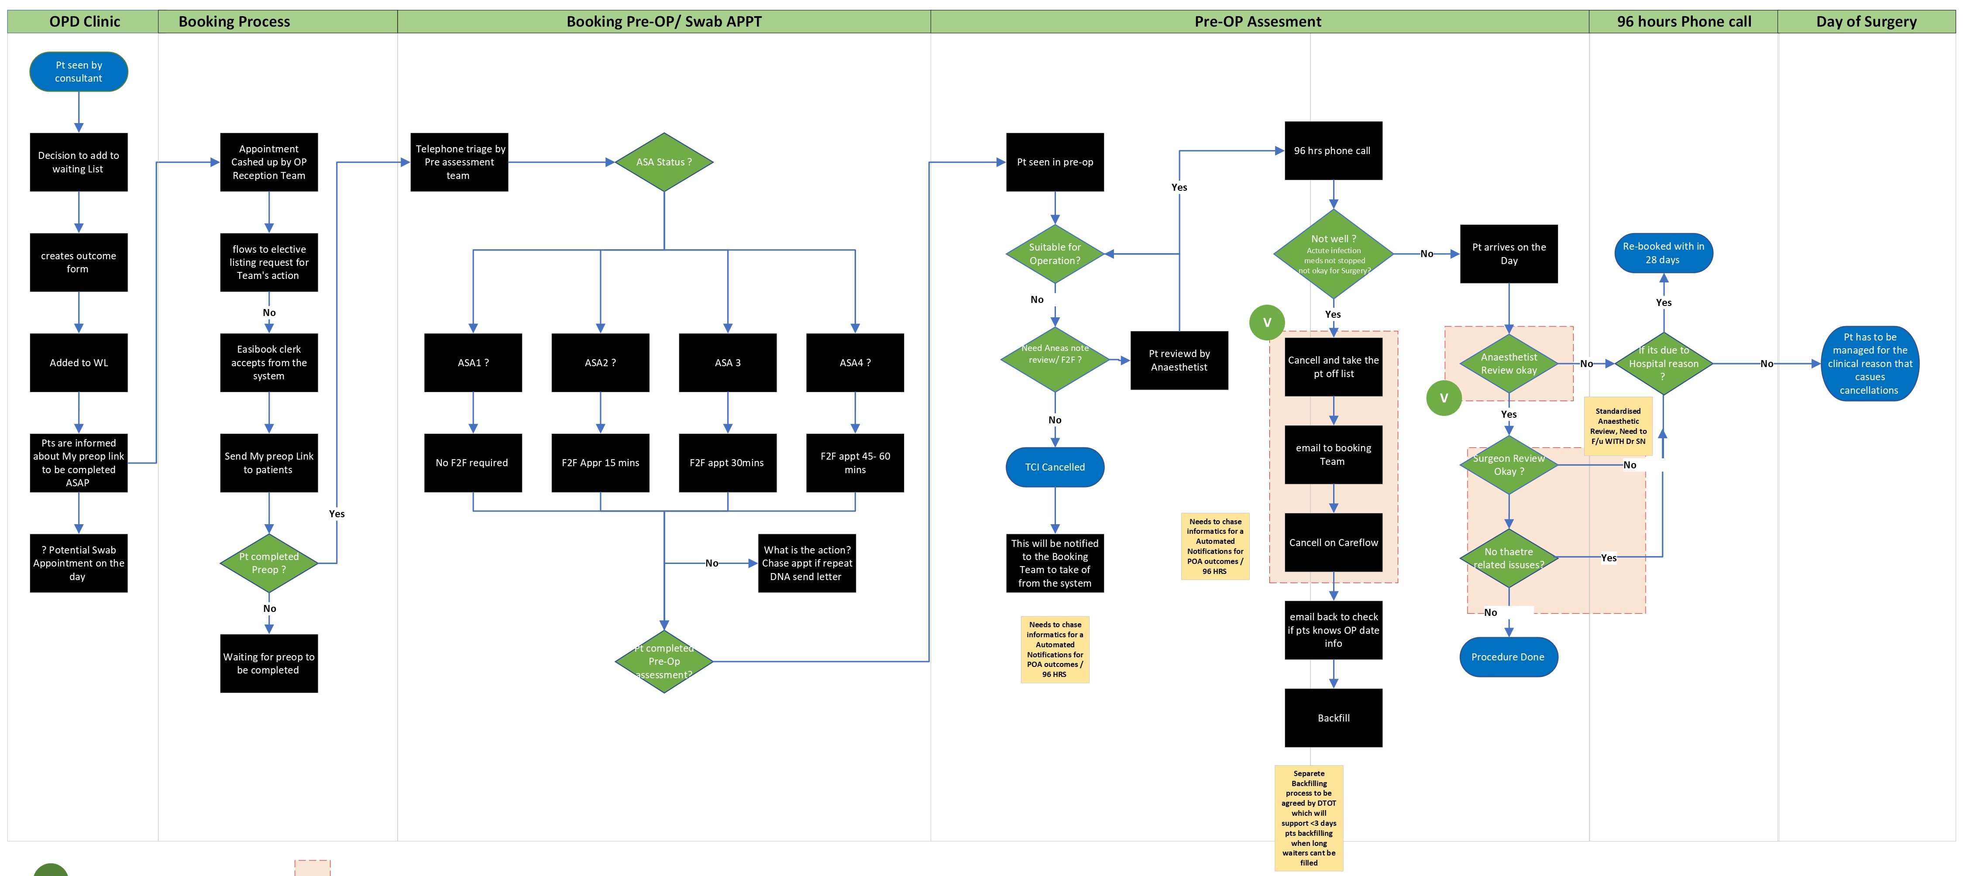

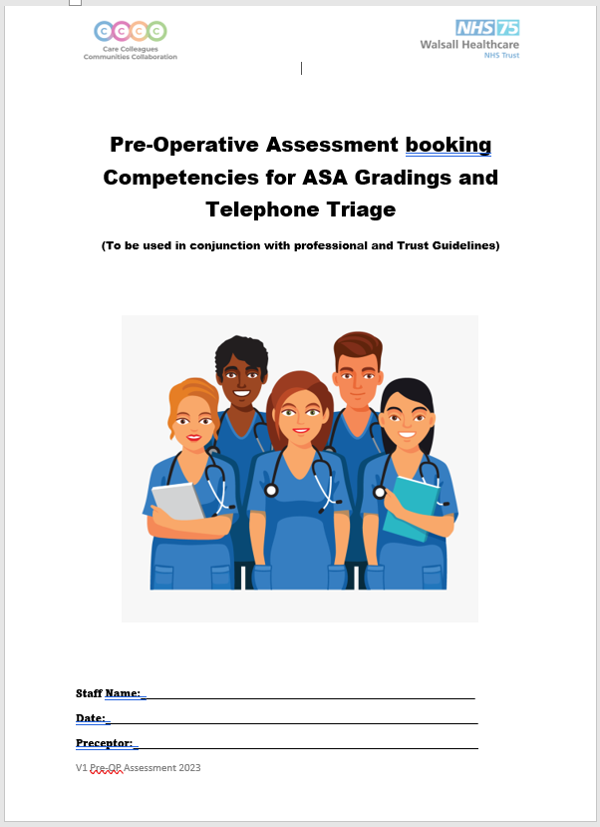
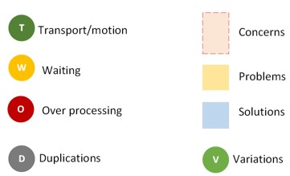


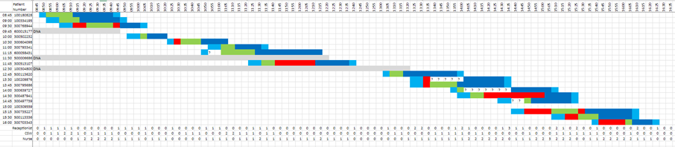
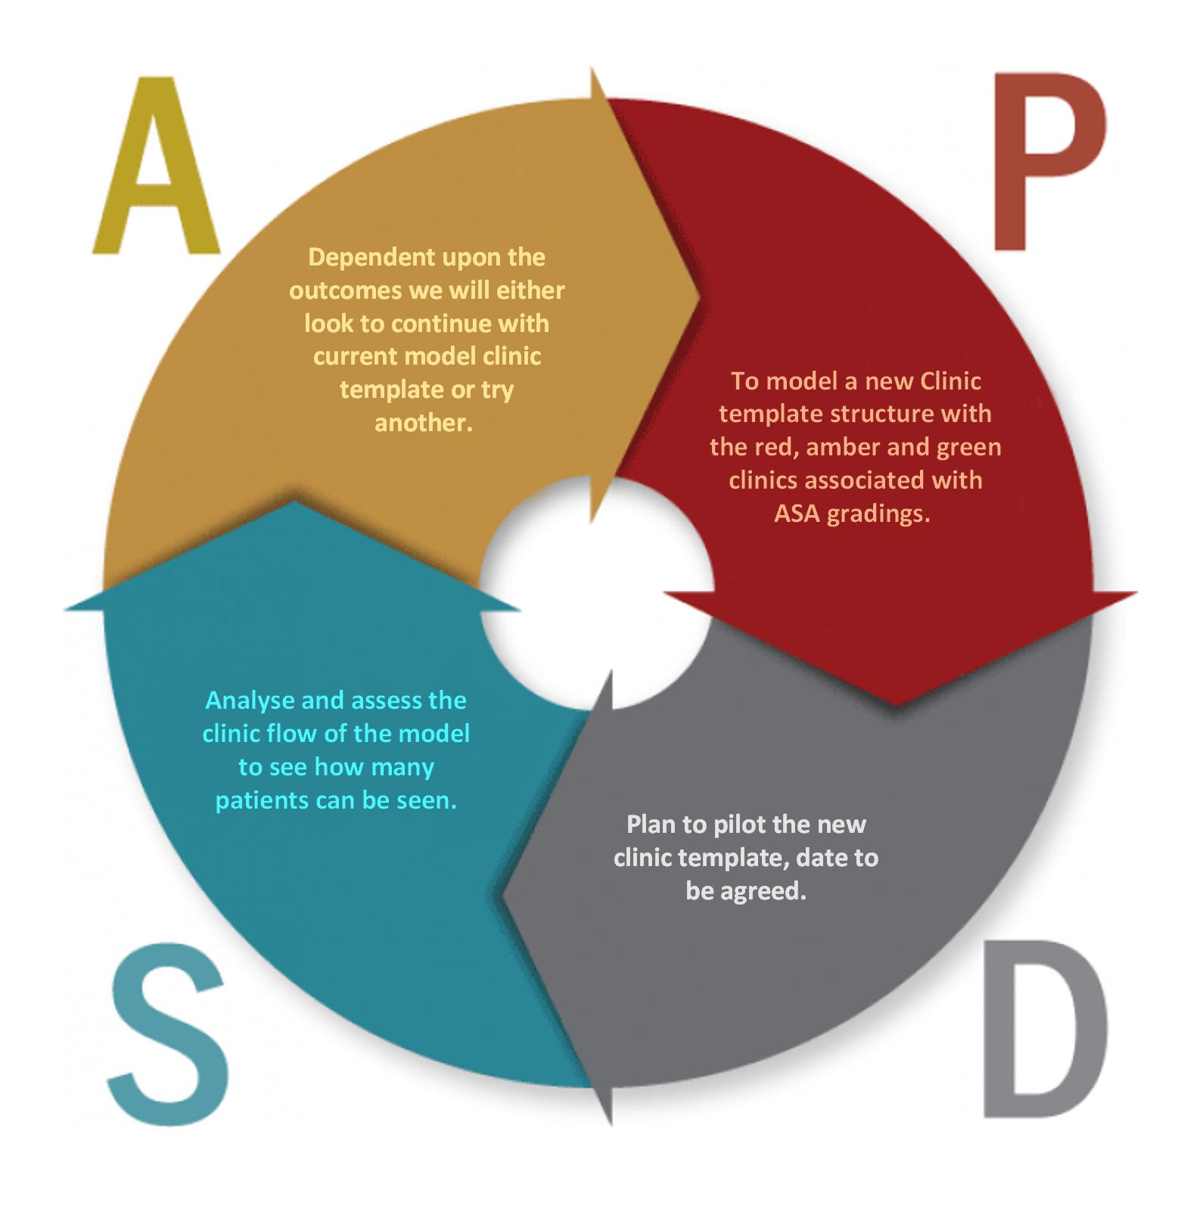
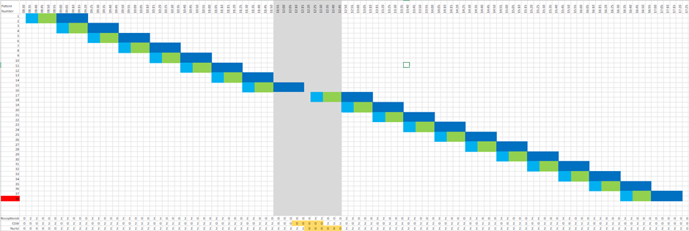


A24-096
PreOperative Assessment GIRFT alignment
Paul Forrester/ Head of Pre-assessment,
Samir Nazir / Consultant Anaesthetist,
Suzanne Priest / Caregroup Manager for TAAC,
Thomas Harper / NHS Managament Trainee
IT team
Infrastructure team - Colin Aldridge
IPC team
Background:
With the recent WHT accreditation of “Surgical Elective hub” in November 2023 with NHS England’s Getting It Right First Time (GIRFT) programme, in collaboration with the Royal College of Surgeons of England; we as a department have an integral role in establishing this. We had a list of requirements that we need to meet:
1.Patients should be screened for peri-operative risk factors as early as possible in their pathway.
2.Patients identified through a screening assessment as having risk factors for poor peri-operative or surgical outcomes should receive optimisation support.
3.All patients awaiting surgery should be contacted by their provider at least every three months to check they still want/require the procedure and health status update.
4.Patients should only be given a date for surgery after preliminary pre-op risk assessment.
5.Patients must be involved in shared decision-making to discuss the benefits, risks, alternatives, likely outcomes and recovery.
CAS cards
We are in liaison with the Business transformation team to get the CAS card to be uploaded onto the Careflow system. This will allow us to input our 96hr telephone questionnaire thus resulting in a reduction in the amount of paper being used and will provide a positive sustainability impact.
Current state process
Governance and SOPs
We have created a “Preoperative assessment training competency booklet” and recently got this ratified to ensure that we are providing our staff with the highest level of training and knowledge.
We have introduced ASA gradings telephone triage SOP to ensure that our service follows the guidance for triaging patients into the respective ASA gradings of ASA1, ASA2, ASA3 and ASA4.
SOP- We are in the process of updating the Preoperative pathway SOP to include the GIRFT recommended guidance.
Pool of patients
We have created a pool of patients for each speciality via My Preop to enable us to backfill cancelled patients at short notice to ensure that we are utilising our capacity.
My Preop integration of PAS system and System C
Patients are assessed within Preop using an electronic patient record will be generated and will be stored within Medi-viewer. We have now purchased the license for Paediatrics and this will introduce the My Preop Kids this will allow a complete streamlined pathway in a singular system that is used to Preoperative assess all patients.
Observations and modelling
We have observed our Preoperative assessment service in particular the clinic structure to understand how long it takes to see patients dependent upon their ASA gradings. This allowed us to collate data and understand the average time it takes to complete a Swab,
We have now started to move to the modelling stage whereby we have used this data to construct what out clinic structure template can look like to maximise the patient care by giving appropriate allocated time by ASA grading and the introduction of the Red, amber and green clinic.
96hr phone call and clinics-
96hour telephone calls have enabled us to prevent patients from being cancelled on the day, patients can have colds, chest infections; this also allows us to backfill at short notice within a reasonable timeframe using the pool of patients. We have now got this recorded on the Careflow system so we can monitor the activity.
Early screening assessment tool
We are in the early stages of creating an “Early screening assessment,” we already have this established within the My preop system. we are looking at how we can identify patients earlier in the pathway and get them referred out to be optimised prior to surgery; this also coincides with GIRFT requirement.
MRSA swabs
We have met with the IPC team to review the current process and SOP around the MRSA swabs; we have recognised that we do not need to MRSA swab all patients. We will re-reviewing and updating the SOP to cascade to the wider team, there will be the creation of an individual patient risk assessment for MRSA.
Future areas of working include:
As we aim to continuously improve the service aligning ourselves with GIRFT recommendations we will be focusing on a Demand and capacity modelling review and once we are fully established and in terms of process, we will look at how we can sustain the project.

