Slide 1
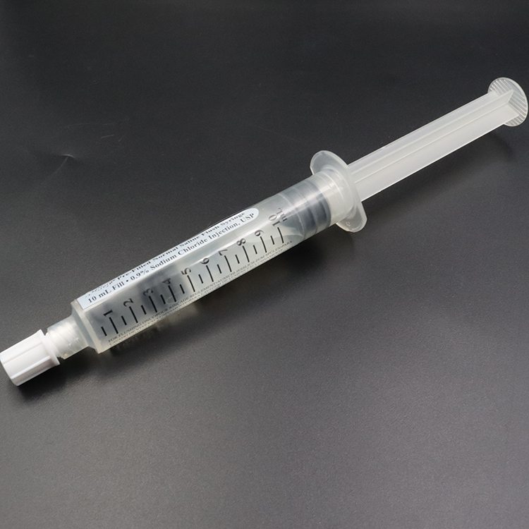
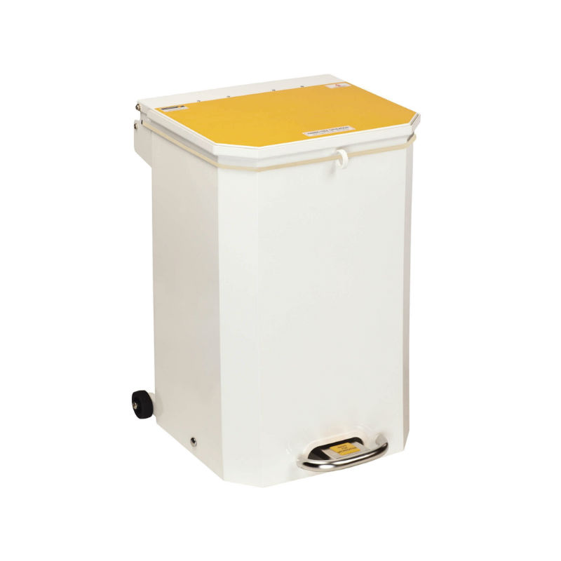
A24-095
Thiopentone/Suxamethonium Prefilled Syringes in Maternity.
Jack Houghton / ACCS CT3, Madeline O’Hare / Senior Pharmacist Ranvir Cheema / ACCS CT4, Victoria Millington / ST7,
Meenu Netke / Anaesthetic Consultant
Abstract
Previously at the trust prefilled thiopentone and suxamethonium syringes for use in emergency general anaesthesia caesarian sections as standard. This ended due to supply issues.
This project looks to find if a new supplier is now available, if the prefilled syringes make economic or environmental savings and if available would current anaesthetists on the maternity use them and why.
Further info
We investigated if thiopentone and suxamethonium prefilled syringes were available and what their current monetary and environmental costs were.
We collected data on thiopentone and suxamethonium wastage from maternity on call anaesthetists.
We are surveying obstetric anaesthetists on their opinion of use of prefilled thiopentone and suxamethonium in emergency general anaesthetia caesarian section.
Obstetric Anaesthesia
Should reintroduce prefilled thiopentone and suxamethonium into obstetric emergency general anesthetic practice?

