Slide 1
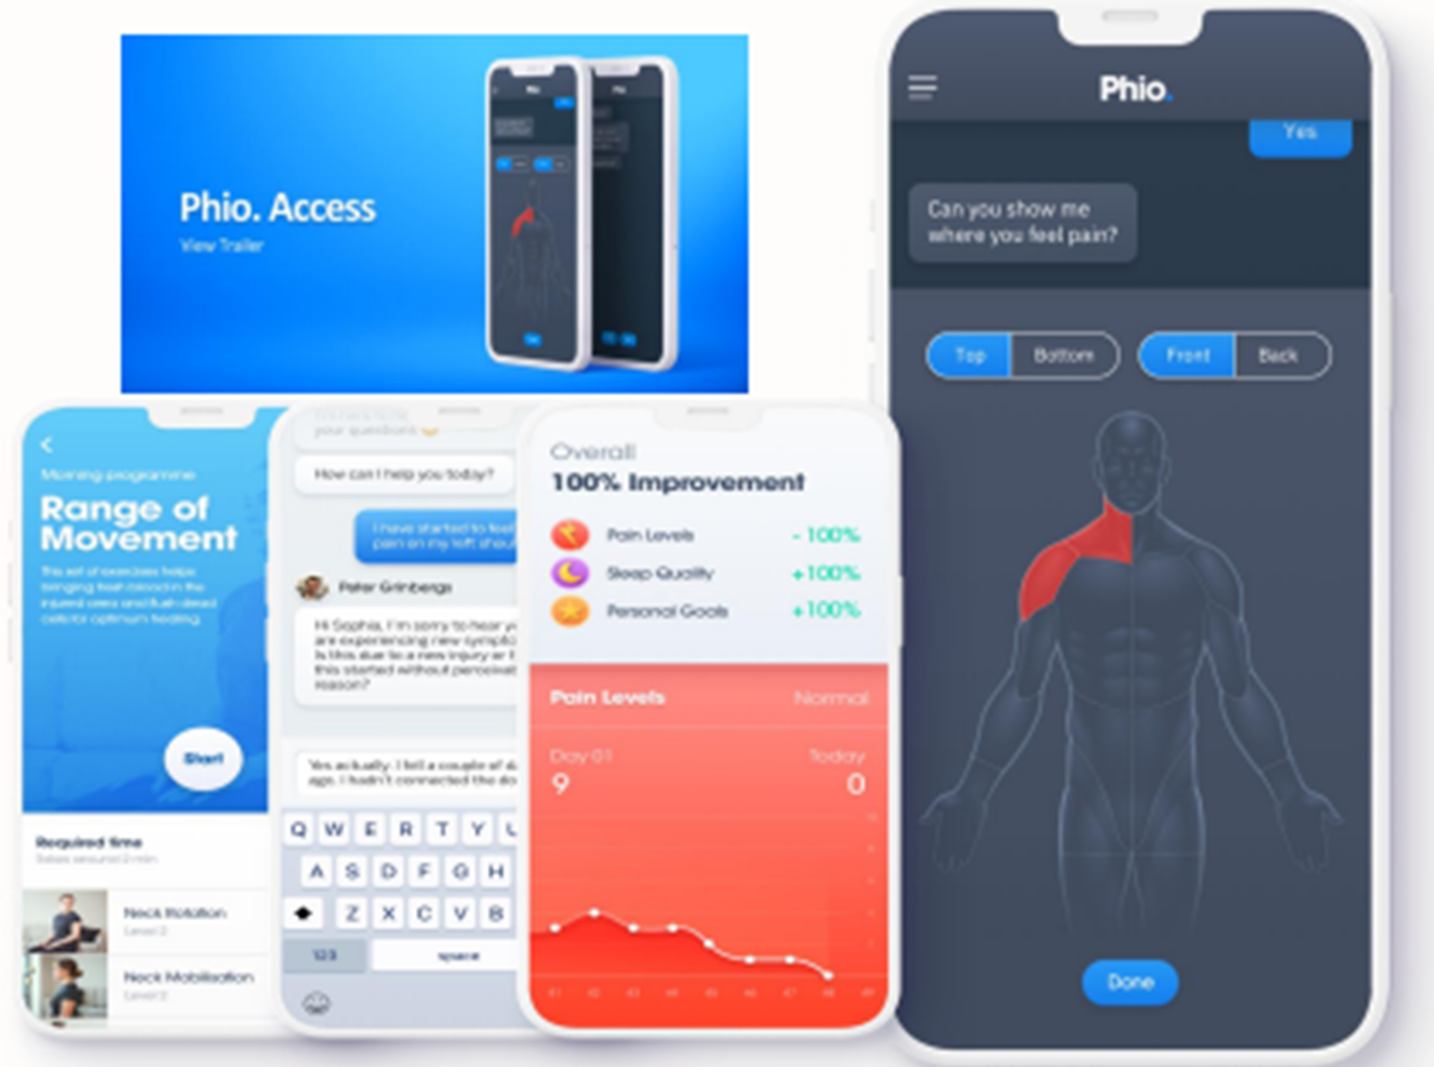
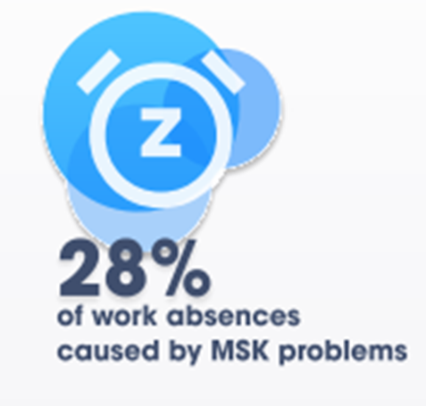
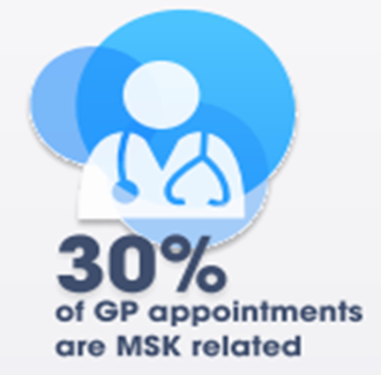
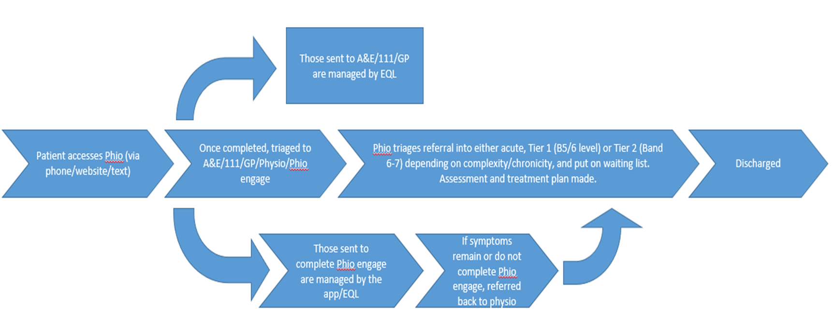
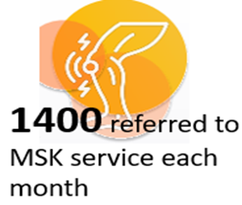
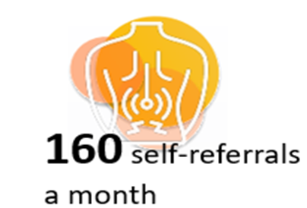
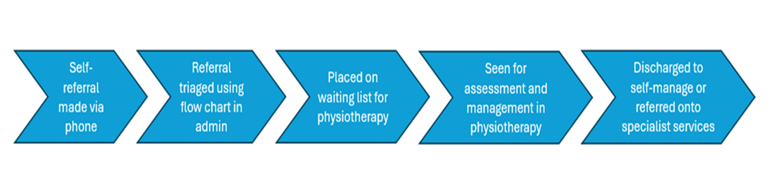
A24–094
Optimising patient flow through digital triage and self-management in a Musculoskeletal Service
Background
SWB Musculoskeletal (MSK) Service in partnership with BC ICB gained innovation funding in 2021 to implement a digital triage and self-management solution within their MSK service. Due to the success of this initiative, WHT’s MSK service are now ready to launch this service to improve the current pathway.
Problem
  Demand for MSK care was outstripping capacity post pandemic causing waiting times to increase.
  Clinical risk associated with patients waiting for treatment without thorough medical screen
  Inefficient pathway with Advanced Physiotherapy Practitioners (APPs) spending increasing hours triaging referrals rather than delivering face to face care.
  Limited workforce with APP level skills
Aims
To optimise the MSK patient pathway from first contact through to specialist care (GIRFT) using a digitised triage process. We specifically aimed to:
Increase safety through providing 24/7 access to rapid MSK triage (including self-referral)
Improve standardisation of triage decision making (equity)
Release APP staff back to face-to-face care therefore increasing clinical capacity
Manage referrals rapidly allowing for better oversight and patient safety
Offer digitally supported self-management as a triage outcome for appropriate non-complex patients, providing improved patient choice and additionally allowing faster access to face-to-face care for those with greater need
Digital Solution
Commercial Partner – EQL providing:
  Phio-Access: a chatbot providing an agile and remote triage tool for all MSK conditions using clinically developed, sophisticated algorithms with the intelligence to adapt to 3000+ scenarios.
  Phio-Engage: remote rehabilitation for appropriate patients who choose it as a replacement or adjunct to traditional face-to-face care. Personalised, self-paced MSK self-management accessed via a patient’s smartphone/PC/ handheld device.
New Pathway
Initial results from SWB
  80% of those who registered to access MSK through Phio Access completed the digital triage.
  37 hours of clinical time released each month, increasing capacity in the service.
  12% of those who completed digital triage were managed digitally, saving time & travel costs for the service user and an additional 76 clinical hours a month.
  Waiting times reduced meaning all patients are now seen within 12 weeks, meeting the national target.
Initial results from WHT
  A soft launch was done from mid-March 2024 without much advertisement, with 123 patients registered in first 4 weeks alone.
  75% of those who registered to access MSK through Phio Access completed the digital triage.
  12.2% who completed digital triage were managed by Phio engage, saving clinicians an extra 21 hours per month.
Cost and Sustainability
  NHS spends £1.5 billion annually on physiotherapy for 10 million people which is equivalent to an average of £15 per person.
  EQL suggests unlimited access to both Phio Access & Phio Engage, would cost £0.20 per person annually.
  Shifting just 10% of typical cases into Phio Engage's supported self-management, delivers an immediate fivefold return on investment based solely on in-person physiotherapy expenses.
  Introduction of Phio Access in primary care could decrease demand for GP appointments by up to 20%, bringing potential cost savings and capacity release in primary care for the future.
  Carbon footprint is reduced, and access increased for those who otherwise lose income to attend appointments.
Current Pathway
Quality Improvement Team
Jonathan Morris, John O’Regan, Rebecca O’Sullivan, EQL

