Slide 1
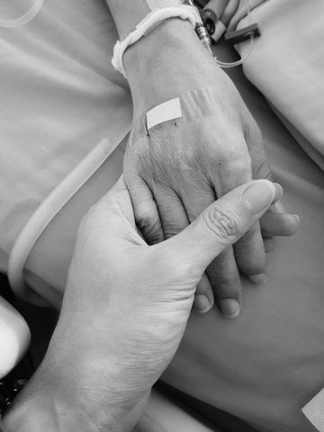
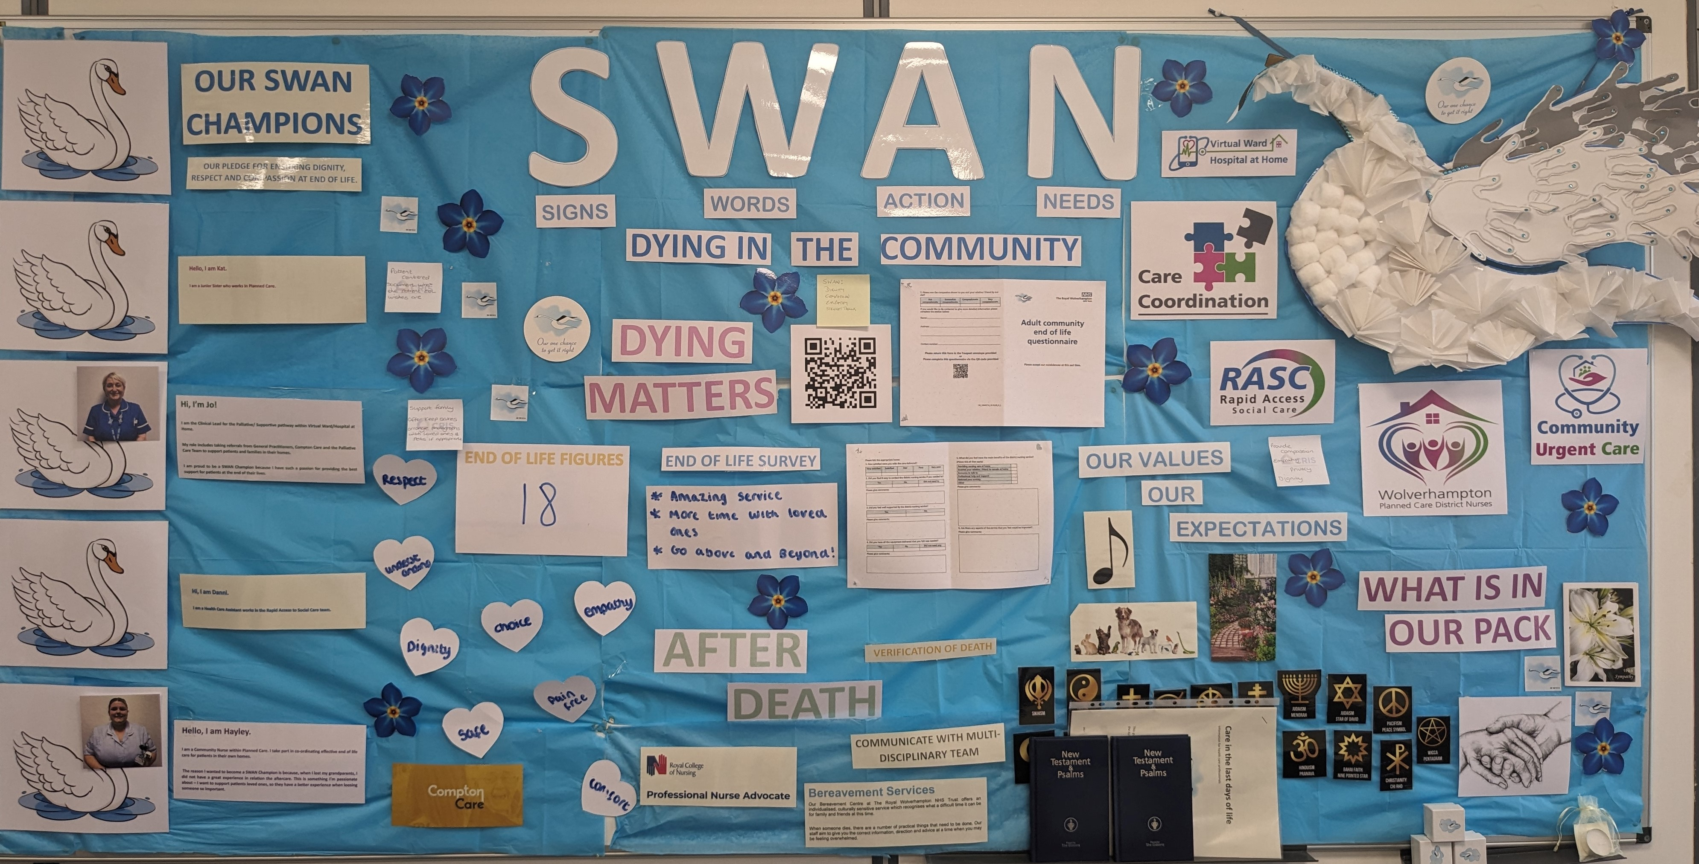

A24-093
District Nurses - End of Life Care
Hayley Langford - Matron
Alexandra Devers - Service Delivery Manager
As part of our drive to improve care for our end-of-life patients, we implemented taking SWAN images in patients own homes, residential homes and nursing homes.
We recognised that this is a key factor and keepsake in the acute setting and wanted to be able to provide this service within the community and patients preferred place of care and death.
The images are available for any family who wish to have the keepsake and is recommended that the images are of the hands, keepsakes/memorable items and pets.
Created a SWAN board which is displayed at our community base. This includes all SWAN champions, their name and why they are a SWAN champion.
Implemented individual SWAN packs for each community staff member to have within their community equipment in their vehicles. This includes memorable keepsakes, handprints, and relevant information.
All community services who are involved in providing end of life care in the home are displayed on the board. We include our up-to-date active end of life figures, and feedback from our end-of-life survey that is sent out to relatives. This can be completed by freepost or QR code. We have also included our values, expectations and religious beliefs.
Patient Feedback
“beyond excellent”
“a wonderful group of caring nurses”
“we received amazing service”
“compassionate, caring and professional”
Adult Community Service – Planned Care
Summary Summary Summary Summary Summary Summary Summary Summary Summary Summary

