Slide 1
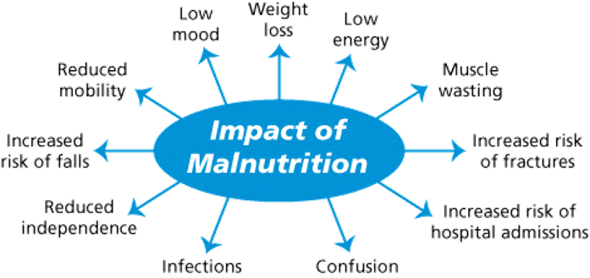
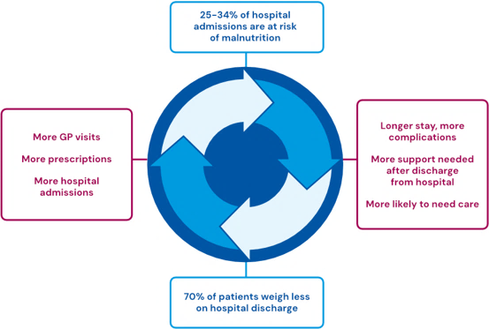

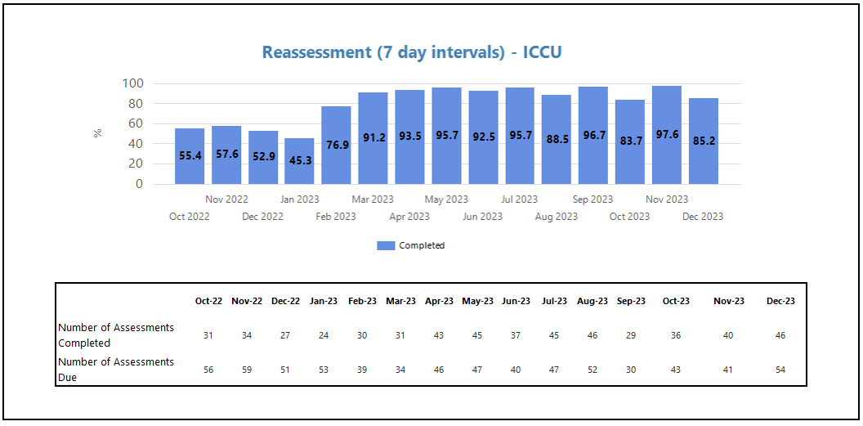
A24-092
MUST on Vitals Dashboard
Jaci Chapman / Deputy HOD for Nutrition & Dietetics, Katrina Creedon / Nursing Quality HoN,
Jasbir Singh Khun-Khun / Senior Information Specialist, Ruth Stokes / Senior Sister, Nursing Quality Team
Dr Yat Wah Li / Clinical Lead Digital Innovation
A MUST on Vitals task and finish group was set up with Jaci Chapman (Deputy HOD for Nutrition & Dietetics); Katrina Creedon (Quality Matron), Jasbir Singh Khun-Khun (Senior Information Specialist), Ruth Stokes (Senior Sister, Quality Team) and Dr Yat Wah Li (Clinical Lead Digital Innovation) to work on a collaborative workstream between clinical staff and analysts to build a MUST on Vitals reporting system.
In June 2021 Ruth & Jaci provided Jasbir with a good understanding of the MUST tool, MUST on Vitals, Trust compliance requirements & the barriers to compliance.
Using a testing environment, Jasbir provided the clinicians (Ruth & Jaci) with an understanding of what reports could be created from the data obtained from Vitals, what data could be displayed, how readily the data could be made accessible & how the reports could be adapted to the needs of the organisation.
Jasbir created an initial ‘live’ compliance report showing each ward’s compliance. Ruth and Jaci validated the reports with the MUST on Vitals input data, testing the accuracy of the results within the dashboard, tweaking the terminology & aligning the reporting to Trust policy.
After more discussions, further fine-tuning was done by Jasbir to drill down to pull reports to patient level. For every metric that was published, patient level details needed to be available to further investigate as needed.
The dashboard was then piloted using selected wards with the aim of getting clinical feedback which resulted in slight adjustments to the reports and the generating of daily summary reports for a more ‘live’ version of compliance which is a more proactive rather than reactive response.
MUST on Vitals reporting was launched June 2023
On going Monitoring
What is Malnutrition?
- Malnutrition is a state of nutrition in which a deficiency or excess (or imbalance) of energy, protein and other nutrients causes measurable adverse effects on tissue / body form (body shape, size and composition), function and clinical outcome. (Elia 2003)
The British Association of Parenteral and Enteral Nutrition’s (BAPEN) Malnutrition and Nutritional Care Survey in Adults 2022 revealed that nearly half (45%) of all adults screened across health and care settings in the UK were found to be at risk of disease-related malnutrition.
-If left unidentified and untreated, malnutrition can result in serious consequences for both
patients . Identifying the presence or risk of malnutrition is the first step in breaking the cycle of malnutrition.
What is the MUST?
-The ‘Malnutrition Universal Screening Tool’ (MUST) is a validated screening tool used to identify patients who are malnourished or at risk of malnutrition. It categorises patients according to their risk of malnutrition and is based on an assessment of a patient’s Body Mass Index (BMI); unintentional weight loss in the preceding 3-6 months; and the presence of acute illness/disease resulting in poor dietary intake for 5 days or more.
-With permission from BAPEN the MUST at RWT has been adapted for local use and is completed electronically via the MUST module on Vitals.
-With no prior MUST reporting mechanism in place at RWT, it has been impossible to know the full extent of compliance with malnutrition screening or where the barriers or challenges exist which prevent excellent compliance and high-quality assessments..
Measuring compliance with malnutrition screening
MUST on Vitals reporting was developed as a way of capturing Trust compliance with malnutrition screening. As per Trust policy CP17 Identification and Management of Patients at Risk of Under Nutrition, MUST screening should be done on all adult patients within 24 hours of admission to hospital and every 7 days thereafter.
Snapshot of The MUST Dashboard
Summary
New reporting approach proving beneficial to clinical staff, Senior Leaders & the Nursing Quality team for Quality overview.
The MUST Dashboard can now be accessed by all Ward Managers, Practice Education Facilitators & Matrons.
Wards now able to manage their MUST compliance by viewing their data & monitoring monthly, with support available from the Nursing Quality & Dietetics Teams.
Reports & the Dashboard are under ongoing development, with additional metrics added, where needed.
The dashboard is based on individual assessments undertaken on Vitalpac, ensuring data visibility and helping to drive improvements at ward level.
Information / Nutrition & Dietetics / Nursing Quality Team
Please visit the Information Portal for more information
FUTURE PLANS Include:
Ward Manager engagement to further develop data.
Daily MUST ward report developed – piloted & near roll-out.
Scope to develop/improve metrics & data.

