Slide 1
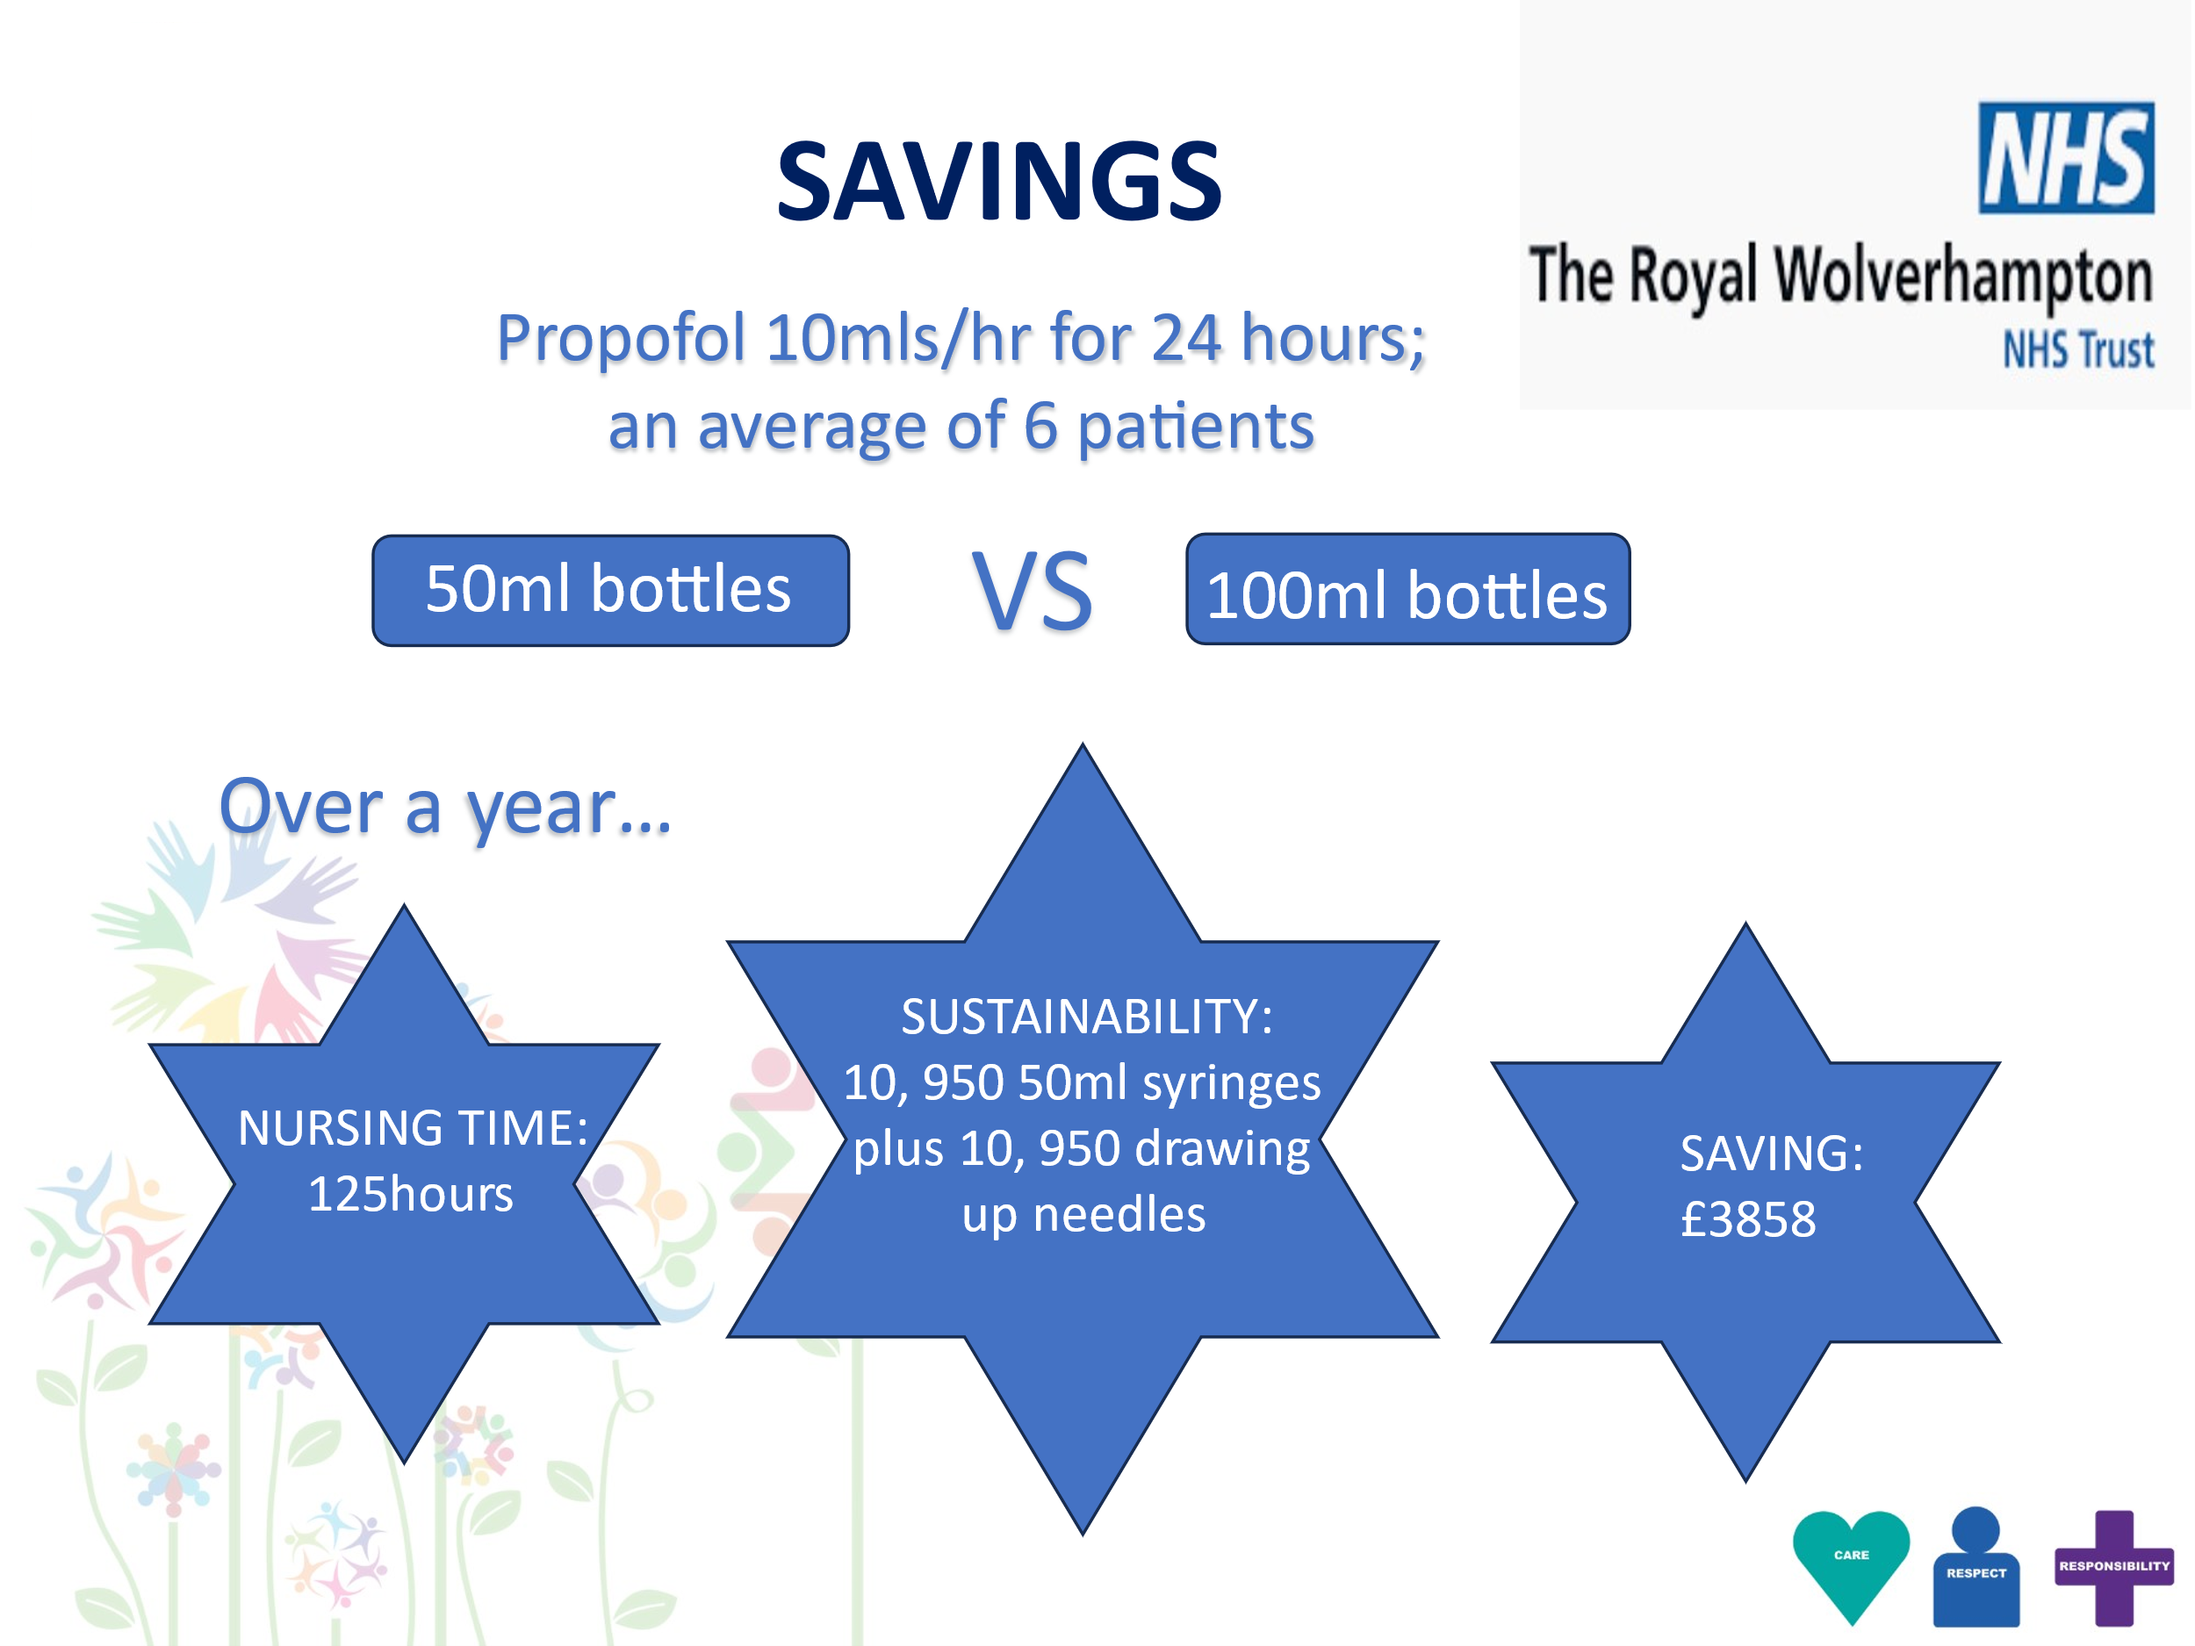
A24-090
Optimising Propofol Usage: Transition from 50 ml to 100 ml Bottles
Shaveta Devesar/ tACCP
Background:
Propofol, a commonly used anaesthetic, typically involves using 50 ml bottles. This project explores the benefits of switching to 100 ml bottles to enhance operational efficiency and environmental sustainability in our healthcare setting.
Objectives:
To evaluate the time saved by nursing staff when using 100 ml bottles of propofol.
To quantify the reduction in resource usage, including syringes, needles, labels, infusion lines.
To assess the decrease in the carbon footprint associated with using fewer bottles.
To improve nursing workflow and overall efficiency in medication administration.
Methods:
A pre-audit will be conducted to establish baseline data on the time nurses take to draw propofol from 50 ml bottles into 50 ml syringes. Twenty nurses will be observed during this process. Additionally, data will be collected on the total volume of propofol infused in ICU general patients over 24 hours. This data collection will span two weeks to ensure comprehensive and reliable data. Following the transition to 100 ml bottles, a similar post-audit will be conducted to compare and analyze the results.
.
Results:
Preliminary findings indicate a significant reduction in the time spent on bottle changes, leading to enhanced nursing efficiency. Nursing feedback highlighted a positive impact on workflow, reducing interruptions and allowing more focus on patient care.
ICCU
The transition to 100 ml bottles of propofol presents a compelling case for operational improvements and sustainability in healthcare. This project underscores the potential for significant time and resource savings, alongside environmental benefits, thereby aligning with our broader QI objectives.

