Slide 1
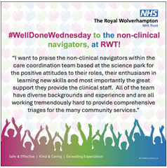
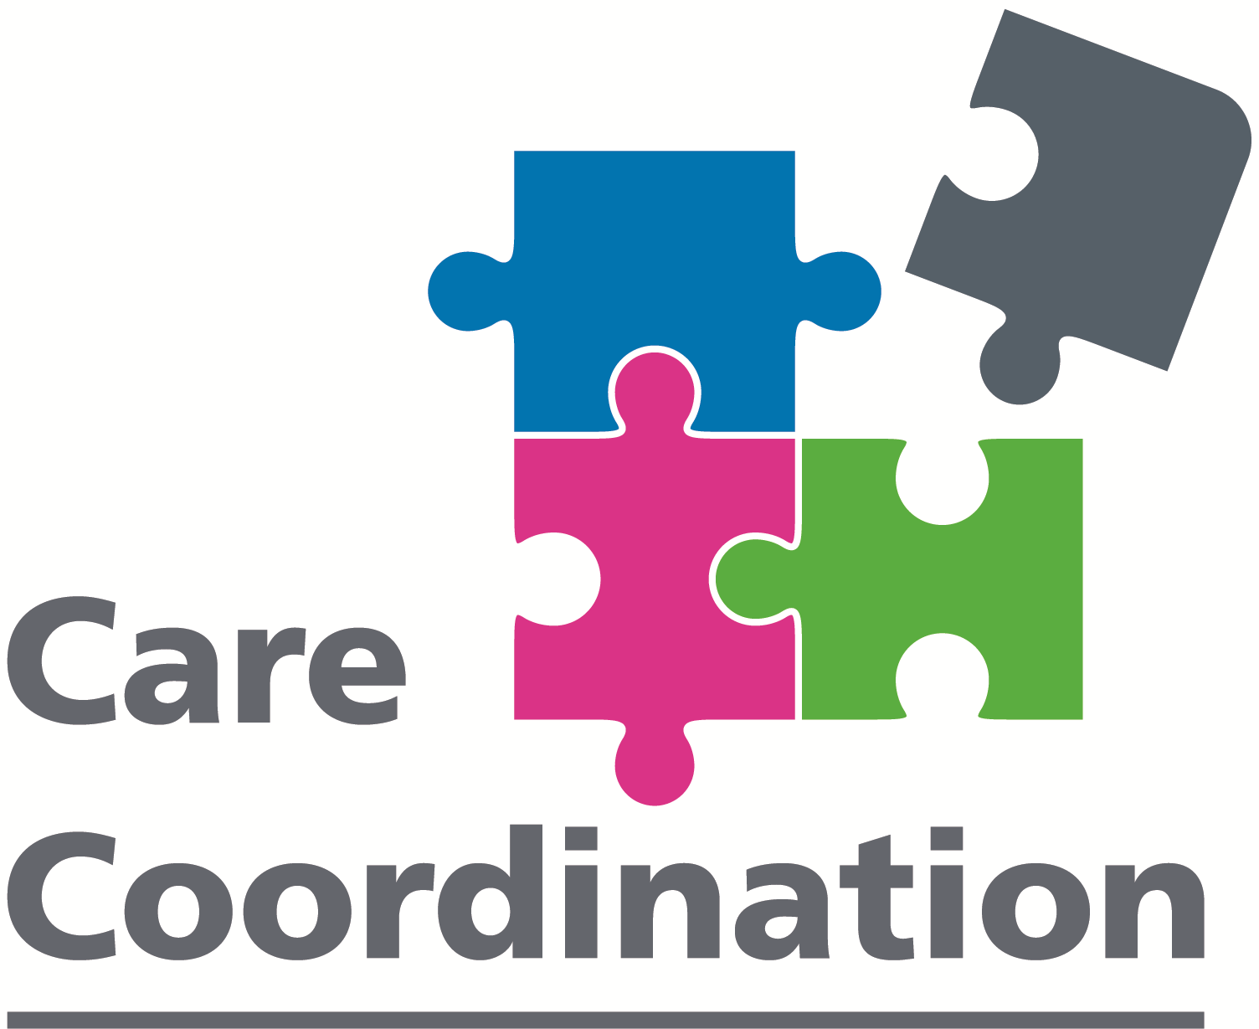
A24-089
Introduction of the Non-Clinical Care Navigators
Ami Whiston - Interim Senior Matron
Tyrese Salmon - Service Delivery Manager
Helen Esty - Community Practice Education Facilitator
Care Coordination Team - Clinicians and Non-Clinical Care Navigators
Background
Care Coordination is the Single Point of Access Hub for Adult Community Services, made up of clinical and non-clinical professionals who receive calls, triage, and process referrals from a wide range of individuals to an appropriate community service. With aim of relieving the pressure off the Acute Setting and the Emergency Services, as a result of the growing ageing population.
It was recognised that an additional role was required to support the clinical triage within Care Coordination, allowing more of our Registered Nurses to be available to triage more urgent referrals such as referrals to the Rapid Intervention Team (RIT), Same Day Emergency Care (SDEC) and the Urgent Treatment Centre (UTC) to avoid unnecessary ED Attendances and Hospital Admissions.
After much discussion and research, the concept of the Non-Clinical Care Navigator (NCN) role was developed following the Health Education England Care Navigation Competency Framework.
Community
(RIGHT PLACE)
FIRST
(RIGHT TIME)
THINK
(RIGHT CARE)
“The Non-Clinical Care Navigator triaging the referral reassured me that my mom was in good hands, and I had a clear idea of what would happen next.”
Feedback from a patient’s daughter – March 2024
What is a Non-Clinical Care Navigator?
Non-Clinical Care Navigators (NCNs) help to co-ordinate person-centred care, allowing patients to access care in the right help, at the right time, in the right place.
The NCNs in Care Coordination have been trained to “think community first”, utilising their knowledge of adult community nursing services, therapy services and the voluntary and social care sector the team are required to triage and signpost referrals to services who are be best placed to meet the needs of patients.
Aim
To support patient flow from the acute to community setting.
To support Care Coordination clinicians in the triage of routine referrals, allowing more clinicians to be available to support the triage of urgent referrals for patients requiring a 2-hour Urgent Community Response.
To reduce the strain on patients trying to navigate the complex health and social care systems
Method
Recruited 8 NCNs in November 2023, who were given a 4-week induction which included a competency specific bootcamp in the first week of the NCNs induction.
In January 2024, a bootcamp and triage crib sheets were devised specifically for the NCNs, with the support of a Community Practice Education Facilitator.
The first cohort of NCNs started on 29th January 2024 and the second cohort started on 11th March 2024
The NCNs were trained to triage referrals from registered healthcare professionals, particularly onward referrals to the District Nurses, including simple wound referrals, ABPI/doppler referrals, medication referrals, catheter referrals and Therapy referrals.
Results
NCNS have improved efficiency within Care Coordination, since the NCNS have been in post, triage delays have decreased allowing Adult Community Services to meet the 2-hour Urgent Community Response (UCR) KPI in April and May 2024.
NCNs have triaged over 1547 referrals since they started triaging and signposting at the start of February 2024
The NCNs have received outstanding feedback from patients, relatives and colleagues.
Care Coordination
Innovation is a part of the structure of Care Coordination and therefore, Care Coordination will continue to adapt to meet the needs of our patients.
In the near future, we hope to further expand the pathways triaged by our Non-Clinical Care Navigators, as they continue to help patients access the services they need to receive the right care, in the right place, at the right time!

