Slide 1
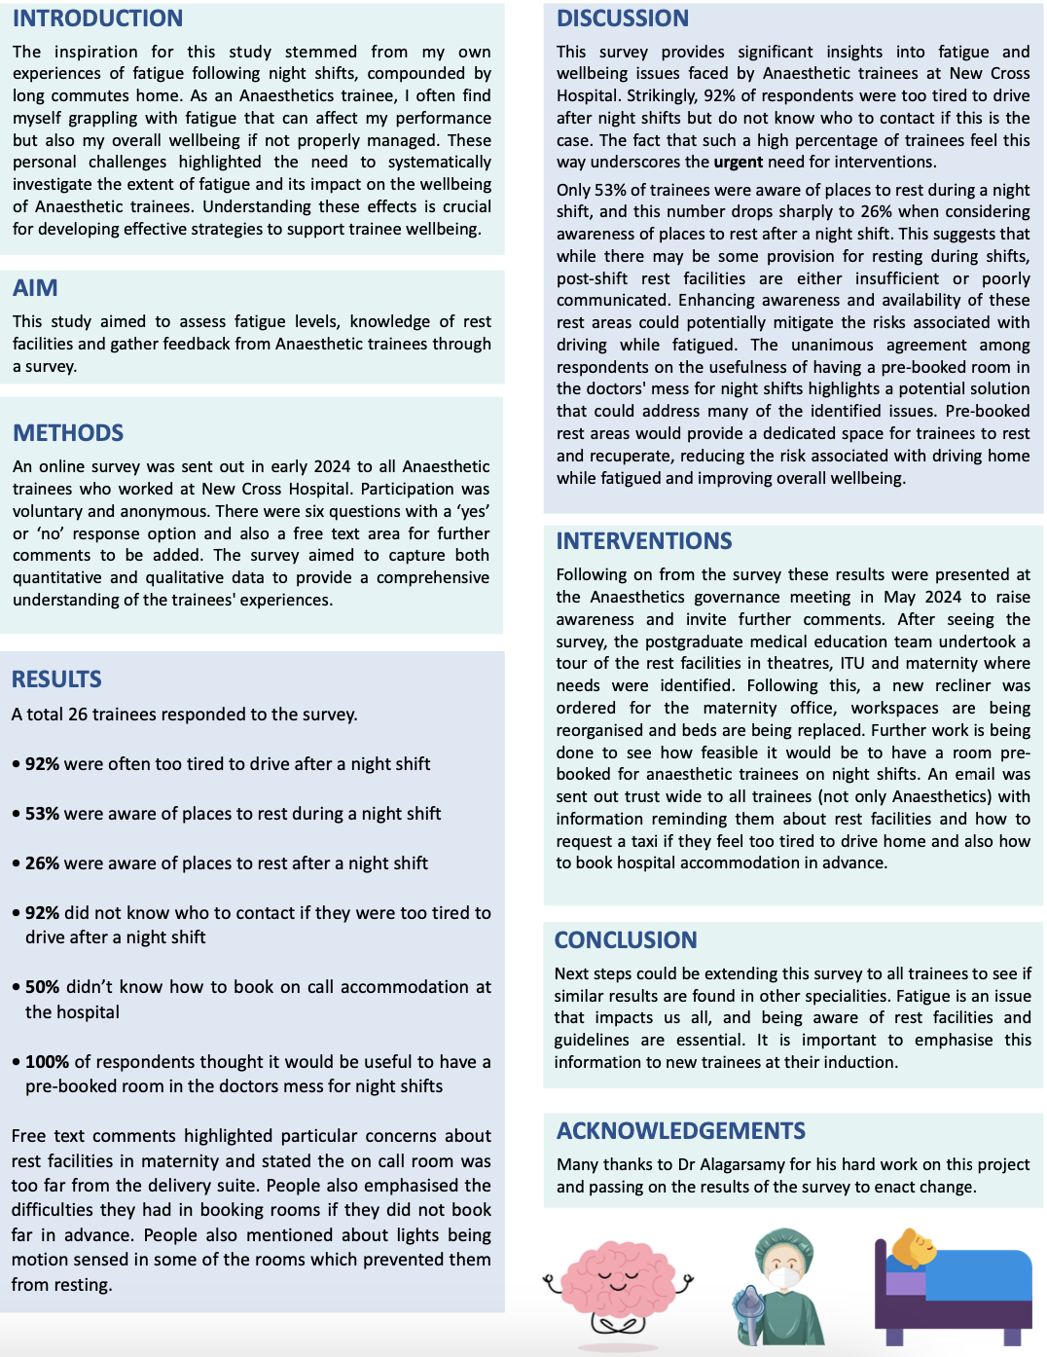
Assessing Fatigue and Rest Facilities Among
Anaesthetic Trainees: A Survey-Based Study
Dr Edward Cook / CT2 Anaesthetics,
Dr Shiva Alagarsamy / Consultant Anaesthetist
Department of Anaesthesia, New Cross Hospital

