Slide 1
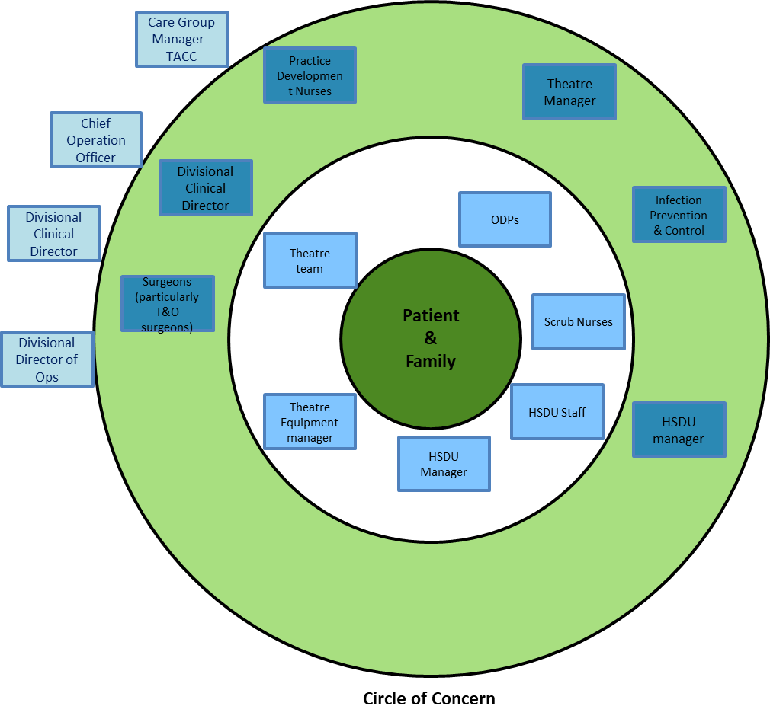
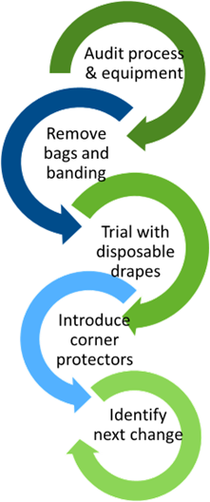
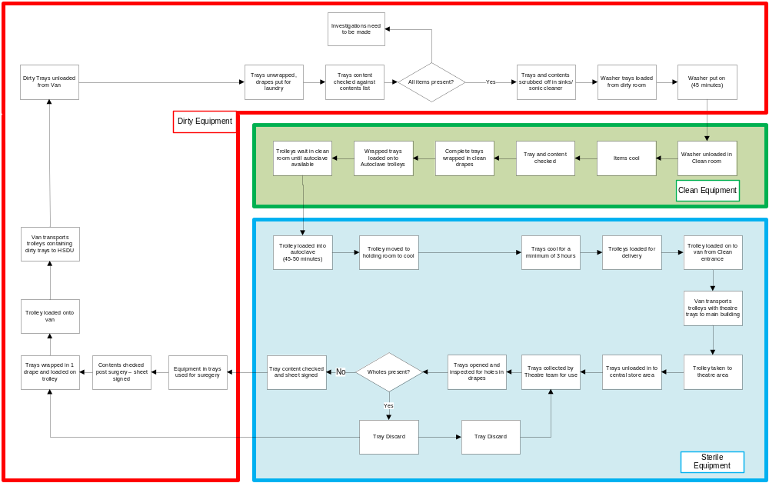
A24–086
Learning from Setbacks – Theatre Trays
Anna Holden – Theatre Sister,
Louisa Adams – Theatres Manager,
Tony Sullivan – Interim HSDU Manager,
Joyce Bradley – QI Team
Introduction
Surgery, by its nature and T&O surgery especially, requires the use of instruments and equipment which need to be sterile. This ensures that surgical site infections do not occur, and patients recover effectively from their surgery. T&O surgery because it is bone deep is especially and understandably, careful to ensure that all instruments, equipment and implants are sterile.
The surgical instruments at Walsall are processed through an onsite Hospital Sterilization and Decontamination Unit (HSDU). Recently there had been an increase in the number of theatre trays being returned to HSDU because the status of the kit (sterile or compromised) was unclear.
Background
Theatre trays were identified with holes in the drapes which they are wrapped in. This occurred over a number of days/weeks and in multiple theatre lists. The consequence of this is that multiple trays needed to be opened to find instruments where their sterility was not compromised. This caused delays to lists starting and increased on the day cancellations because surgery started late. A Stakeholder Map (Figure 1) was developed to identify who needed to be involved.
A high-level process map (Figure 2) was developed to identify the full process that theatre trays go through. There were three distinct stages for theatre trays:-
Dirty Equipment (Within the Red section)
Clean equipment (within the Green section)
Sterile Equipment (within the Blue section)
Issues (pink dots) were identified across the process. The Theatre Manager and an Interim HSDU Manager with extensive experience in the management of a HSDU, started to make changes – one at a time so that the impact of those changes could be seen and validated as a sequence of PDSA cycles.
Figure 1: Stakeholder Map
Tests of Change
There were 4 tests of change initially undertaken:-
All HSDU and equipment for storing or transporting Theatre trays were audited
Theater trays had plastic Banding to secure them and had started to be wrapped in a plastic bag – the bag
was believed to lead to
condensation causing wet trays,
the banding to be sharp and
cut the drapes.
These were removed
Disposable drapes were
trialed – this was to
overcome the holes in the
re-usable drapes, also to reduce possibility of condensation.
Cardboard corner protectors
were introduced to protect the
drapes from the trays sharp
corners and the shelving
Dirty Equipment
Clean Equipment
Progress to Date
Figure 3: PDSA cycles
The number of holes being identified in drapes for theatre trays has reduced, the volume of work (re-work) through HSDU has reduced and lists are not delayed due to theatre equipment.
Training and Development of the HSDU staff has continued.
Figure 2: High level Process Map for Theatre Trays
Sterile Equipment
Problem(s) identified
Theatre & HSDU Teams

