Slide 1
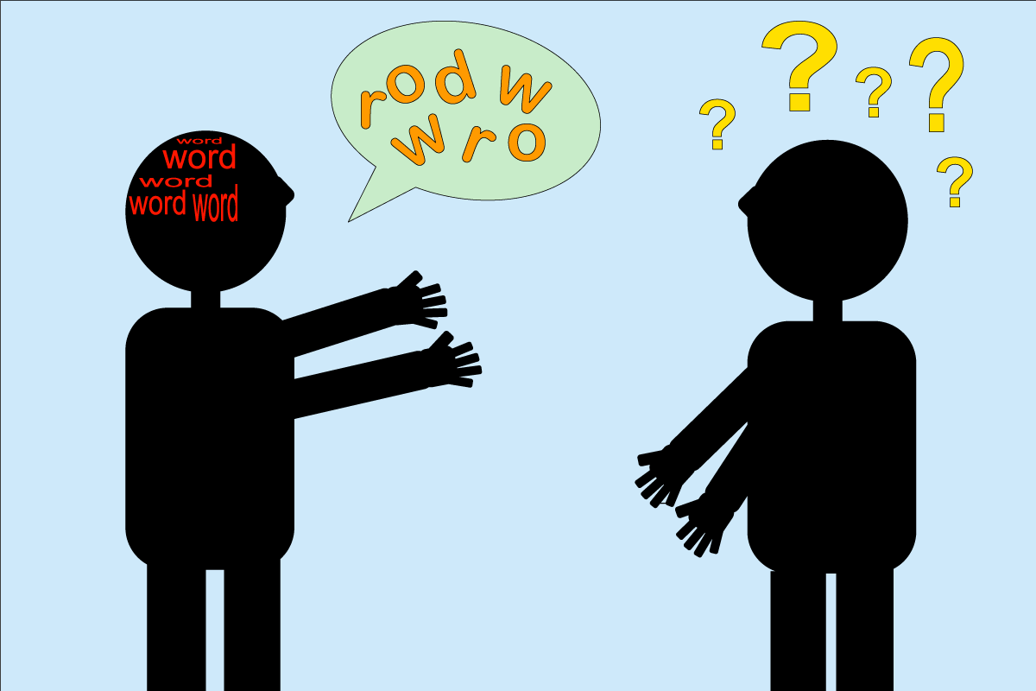
A24-085
Group Therapy and Support for Stroke Patients with Communication Difficulties
Mark Chalmers / Speech and Language Therapist (SLT), Laura Jones / Speech and Language Therapist (SLT).
The Background…
The Challenges…
Stroke patients under Stafford and Cannock ESD and Community Stroke Rehab Teams felt low in confidence with their communication abilities in social settings, leading to feelings of low mood and isolation.
All groups stopped during the pandemic.
Patients feeling low in mood and isolated.
Carers feeling a lack of support.
Difficulties progressing patients further in 1:1 sessions.
Stroke survivors experience elevated levels of loneliness (Byrne, et al., 2020).
Caregivers can feel overwhelmed, uncertain and even fearful (Stroke.org, 2023)
The Idea…
To re-establish regular social communication groups to help build patients’ confidence with communicating.
To manufacture support networks organically for patients and their carers.
To gain pre- and post-group therapy self ratings and feedback to measure positive change and impact on people’s lives.
To improve our service.
Participants in group therapy also showed an increased tendency to communicate for the purpose of social closeness (Fama, et al., 2016).
The Solution…
The Outcome…
Identify appropriate patients who can attend the clinic.
Restart weekly small group therapy sessions.
Collect pre-and post-therapy feedback and self ratings to measure impact and change.
Encourage ongoing contact between patients and their carers.
Our first communication group started in clinic and lasted 6 weeks. They will run on a 6-week rotation focused on social communication goals.
Carers are invited to wait together with tea/coffee and biscuits to establish support links.
Positive qualitative feedback received (written PALS booklet and FFT).
Patients and carers have continued contact post-discharge.
Adult Community / Stafford and Cannock ESD and Community Stroke Rehab Teams
Restarting social communication groups for patients who have communication difficulties post-stroke post-pandemic. Providing support to patients and carers.

