Slide 1

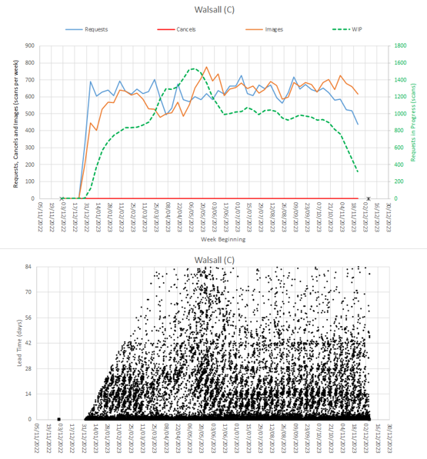
Seeing the voice of the CT system using Health Care Systems Engineering – Part 1
Tom Johnson Quality Improvement Programme Lead
Using a novel approach to data analysis to understand a systems performance
Background
Imaging departments are subject to increasing pressures to ensure they meet national NHS England targets, such as ensuring 100% of CT scans are reported within 28 days of procedure. The QI Team were approached with a request to support some local improvement work, focusing on CT scanning, and to help the team ensure that they were being as efficient and productive as possible.
Results
The above Vitals chart took 107,000 rows of data for all CT scans undertaken from 01/01/2021-20/04/2024. Some key identifying features identified by the chart include the run in/wash out effect of an invalid data query. This highlights missing data for interpretation. Demand has been rising over time, as is the national picture and the scanning team have been able to keep up activity to match this. There has not been a build up in the queue over this time period.
Aim:
To explore the CT scanning processes and its interactions with other areas and to identify any potential improvement ideas to make CT as efficient as possible.
A Level 1 Health Care Systems Engineer (HCSE) took on the role of improvement coach to support the local CT/Imaging team. A 6M design framework (SAASoft 2024) was utilised to begin to explore the system and start diagnosing potential causes of the current performance.
Methods:
The rigour to the 6M design begins with mapping the current state. This allows us to understand what is happening and who should be involved. The maps obtained included:
Stakeholder Map
4N Chart and Niggle-o-gram
System Flow Map
Multi Stream Map
Microstream Map (Below)
Having completed the initial mapping phase as required to this point, the next task was to obtain data from the radiology information system (CRIS). The data/measures help to give some objective evidence to subjective observations from the stakeholders. To allow visualisation of the context that the CT scanning team are working in, a Diagnostic Vitals Chart is required.
Retrieving the data set involved liaison with the imaging PACS team. The initial data extract, which accurately reflected the data query requested has been used to create the above diagnostic vitals chart.
Conclusion and next steps:
Using a HCSE approach to map the CT department and presenting the data using Vital Charts, we have been able to have a visual representation of potential booking policy constraints. This will be explored with the CT booking team to confirm and then work through possible solutions.
This project so far has demonstrated the need to obtain high quality data, in full. This learning will be caried into future projects using the same methodology that has been proven to be invaluable.
HCSE Case Study
Seeing the voice of the CT system Part 1
References
SAASoft (2024) https://www.saasoft.co.uk/index.php accessed 10/06/2024

