Slide 1
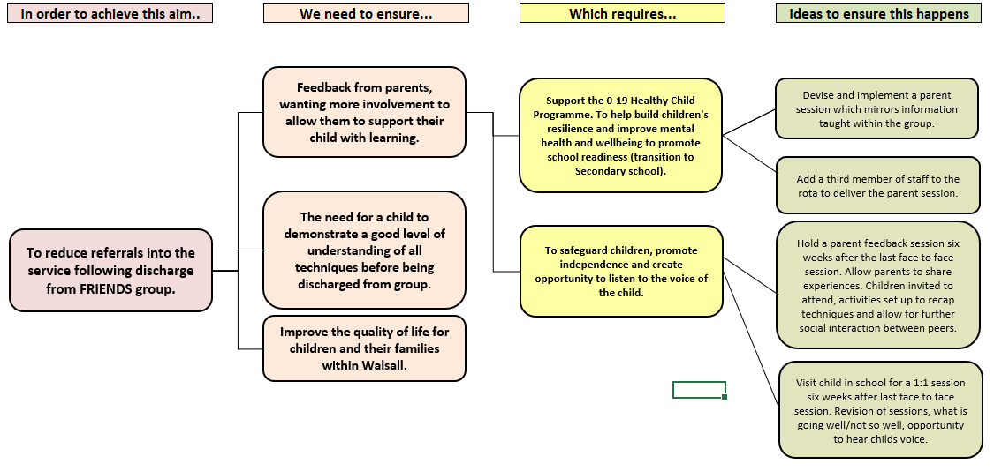
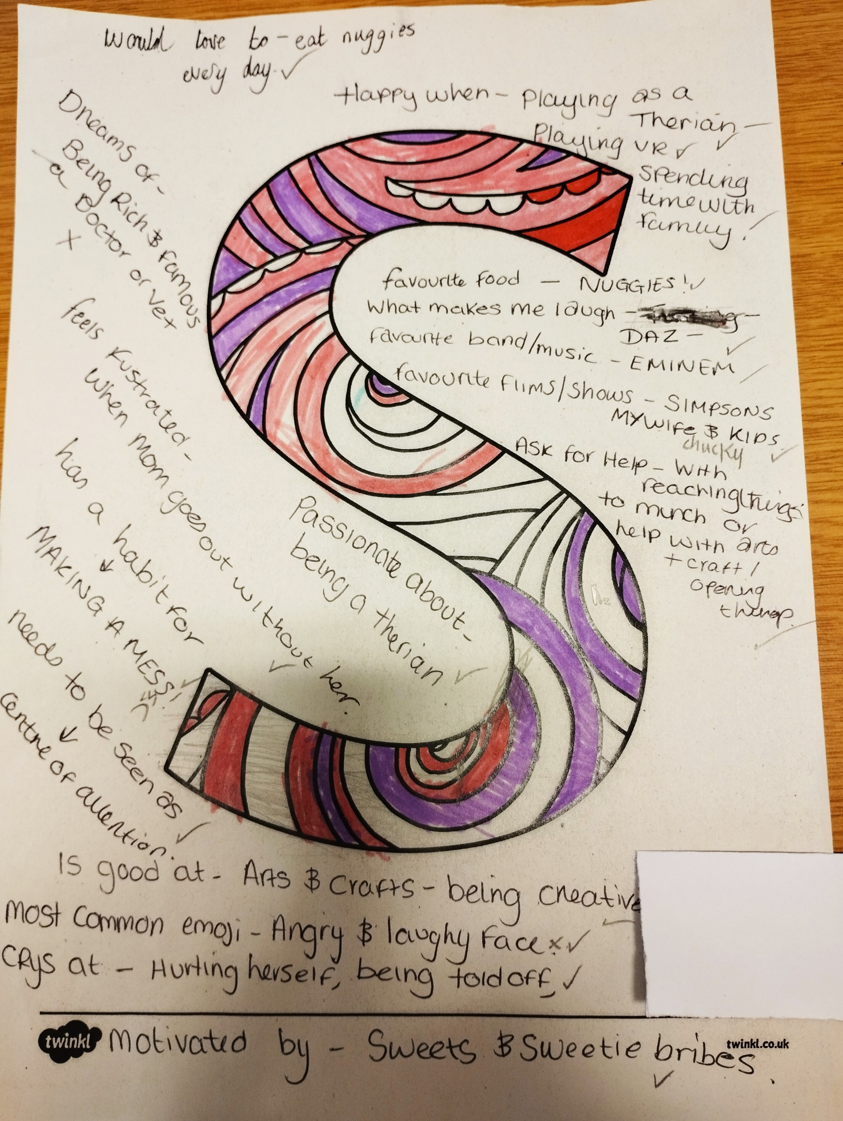
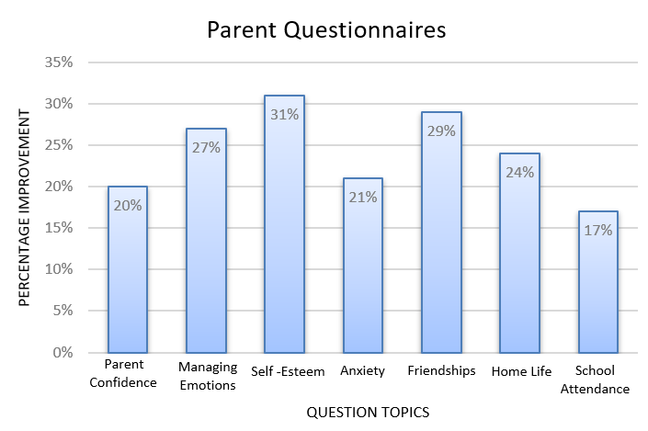
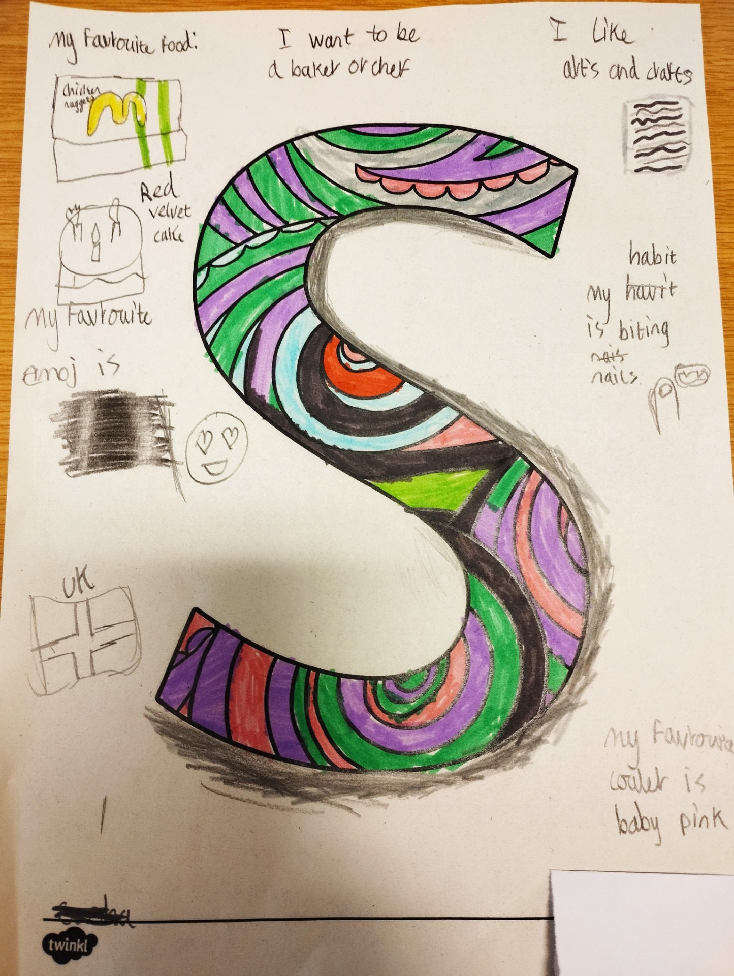
A24-083
Primary friends-Parent Engagement
Gemma Pheasant Senior Nursery Nurse, Jeanette Williamson Clinical Support Worker
Joanne Wiles NNEB Support Worker Trainer, Amanda Street Clinical Team leader
Sam Masood- NNEB/CSW Team leader, (Supported by Vicky Bailey- Quality Lead)
ABSTRACT
FRIENDS for LIFE parent session has been developed to run alongside the current FRIENDS groups for children aged 7-12yrs. This empowers parents to support their child with their emotional health and wellbeing. Parents are provided with adequate information to enable them to support their children's emotional resilience. Tools and techniques taught within the children’s sessions are also delivered to parents. ​
Further information​
The FRIENDS for Life is an evidence-based programme which aims to develop children's emotional resilience. It provides children and families with a tool kit of strategies to reduce stress, anxiety and depression. It became apparent that the effectiveness of the course is reliant on parents continuing the strategies with their child at home. We therefore piloted running a course with parents, delivered at the same time as the child's course. This ensured that, what the child learnt in the programme, continued to be put into practice and embedded at home, thus continuing to promote a child's resilience and self-esteem. This will have the potential of reducing future re-referrals for emotional wellbeing into the service. ​
As part of our PDSA cycles we trialed eight sessions where parents have had more involvement, but we were unable to fully meet expectations due to limitations of staffing capacity. These sessions received praise from parents, but the qualitative feedback found they wanted to be involved further in the group. We revisited the PDSA cycle and decided a third member of staff would enable us to provide in-depth sessions alongside the FRIENDS children's group. This was aimed solely towards parents, bringing parents together to allow them to share experiences and feel supported, not only by us, the School Nursing Service, but also each other.​
This term, we have had the addition of a third member of staff who will run the parent session alongside the children's session. Previously parents would sit and wait for their child in the waiting area, however parents are now engaged with the session, which makes it an enjoyable and informative experience for our parents. Since introducing the parent's sessions so far, we have piloted two parent sessions and have seen 23 parents. ​
Qualitative feedback demonstrates children have felt an increase in confidence and self-esteem when managing their emotions.
Parent feedback prior to course
Was lot of said about talking to kids, but what needs to be highlighted is kids not really listen, they watching. First step is to make example of parent as leader at the same time with talking with them
PDSA Cycle
Plan –To devise a way to provide parents with more information and a better understanding of how to support their child.
Do – To pilot a parent programme which runs alongside child's programme
Study- To collate qualitative and quantitative data over a period of 6 months to confirm effectiveness of group
Act- If successful, to pilot this alongside other groups. If not successful, review ways to share information with parents
Young person's feedback
Beginning- I felt upset a lot of the time. I found it hard to make friends. I only have one friend and came here because of those reasons but this group is helping as I meet new people and new strategies to calm me down.
Middle- Now I feel happier I find it easier to make new friends now and talk to people I have used some techniques and they have calmed me down. I feel more confident and better in myself. I used to feel depressed and sad sometimes but now I don’t anymore.
End- The breathing technique has helped because my heart races when I get worried, so it helps me to slow down my breathing and the group helped me because now I know how to calm down and If I am feeling down. I know how to cheer myself up using the techniques I have learnt.
"Very helpful, lots of interesting information to take back with on how my child's behavior work"
Parent feedback
post course
"The ladies were fantastic! The children were engaged and loved the practical activities they brought. Thank you very much for a lovely session, was so happy with the recommendations of Gemma I have a very picky eater and I didn’t know where to turn now"
As part of getting to know the children, they were each given the first initial of their name along with questions relating to "Who am I?" Their parents were also asked to complete the same activity about their child. Parents and children were brought back together at the end of the session to compare. There were lots of fantastic discussions within the room. Sometimes we can take for granted how well we know and understand our children, this was a mindful activity which helped to build communication skills and start a conversation along with building a connection between parent and child.
A lot of information was given which was helping for me as a parent to understand my child’s emotions.
Next Steps
To complete pilot parent sessions
Feedback to the team at FRIENDS evaluation session – what went well, what could be improved
This is in early stages. The strategies used in FRIENDS require long term practise, which can also be improved by the ongoing support of parents. The techniques taught within the sessions may not be utilised until a child or parent faces a situation that may cause them anxiety i.e., coping step plan.
Revisit children at 3 months, 6 months and 9 months to gain qualitative data.

