Slide 1
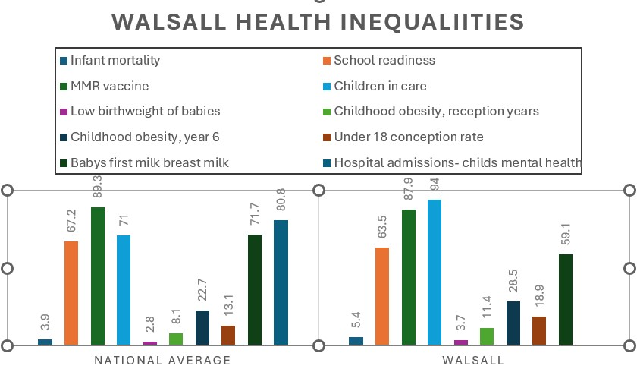
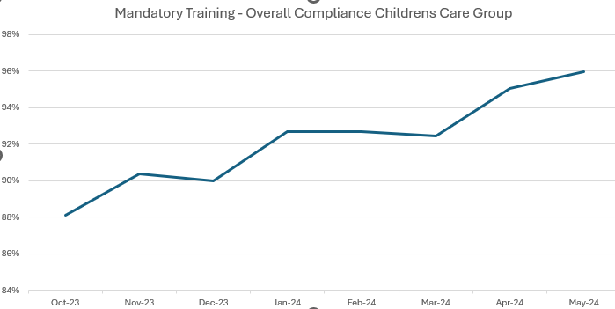
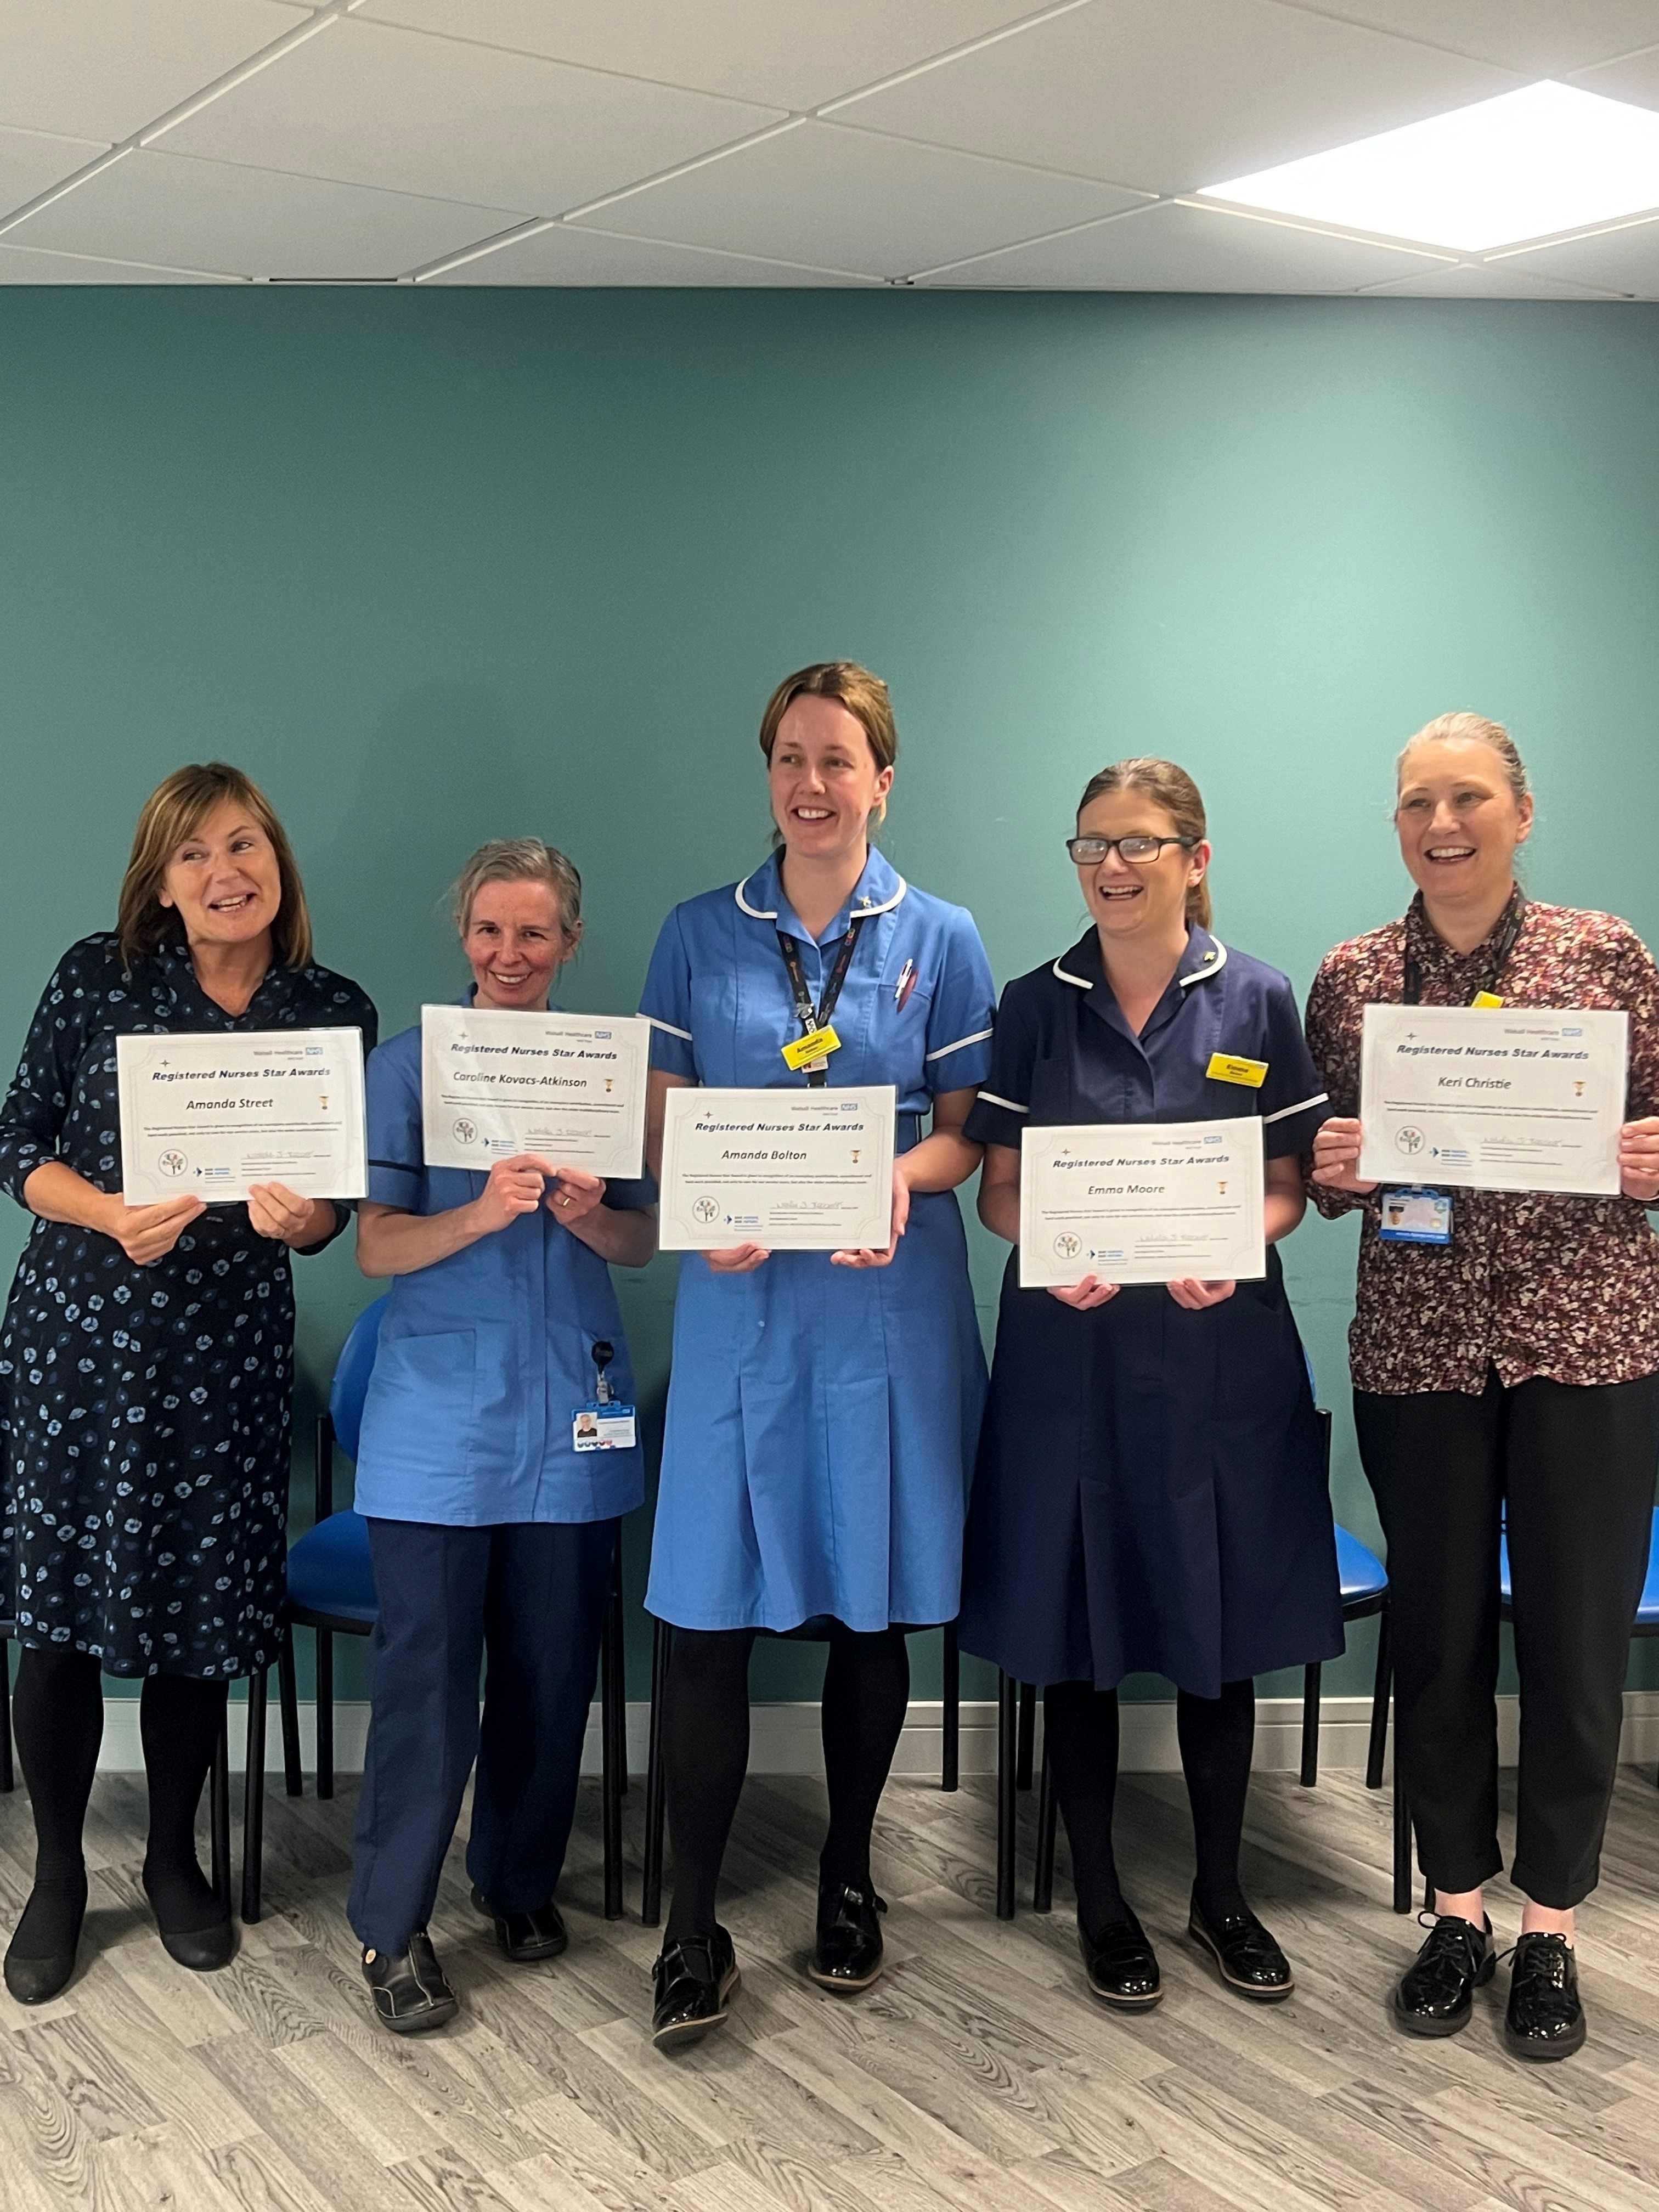
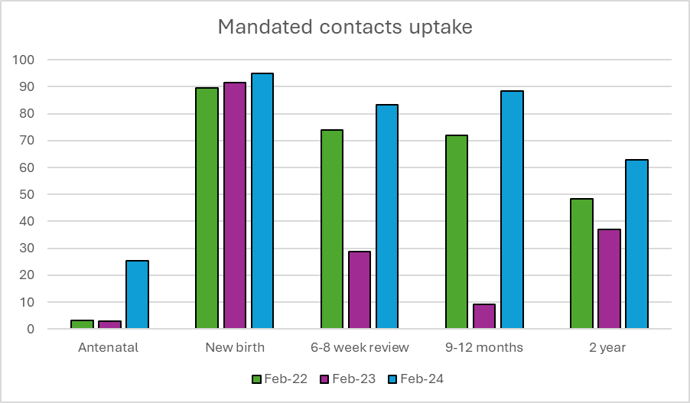
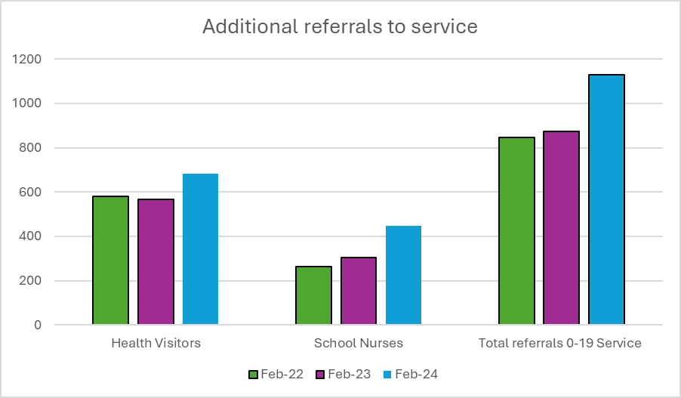
A24-082
The Redesign of the Healthy Child Programme 0-19 Service (Health Visiting, School Nursing and Teenage Pregnancy)
Keri Christie-Professional Lead, Tryphine Molineux -Deputy Professional Lead, Vicky Bailey- Quality Lead, Jolene Crosdale-Professional Development Lead, Greg Perry-Care group support officer, Sue Hems,-Digital lead, in collaboration with clinical team leads and senior specialist practitioners within the service
Abstract
The 0-19 HCP service supports children and families across Walsall by delivering the Healthy Child Programme (HCP) to 62,300 (+) children (Data to 16 years old, however service works with children up to 19 years old) (Walsall Council, 2024). The care delivered is led by Specialist Community Public Health Nurses (SCPHN) (School Nurses and Health Visitors) to children on a universal, targeted or specialist level and delivers a range of interventions to children and families, tailored to the level of care and support required. The HCP National delivery model (2021) demonstrates that all children receive a universal offer, however due to individual or family circumstances, some children require more specialist or targeted support.
Across England, 0-19 services are struggling due to a national shortage of health visitors, estimated to be a shortfall of 5000 (IHV, 2023). SCPHN practitioners are seeing an increase in poverty, development delay, perinatal mental health problems, domestic abuse and child safeguarding concerns (IHV, 2023).
In 2019, Walsall ranked in the top 10% areas of deprivation nationally with 30% of children live in low-income families (Walsall Council, 2019). This has worsened since the pandemic (PHE Fingertips, 2024, ONS, 2024)). There is a clear correlation between poverty and inequalities (See chart opposite).
SCPHN practitioners nationally were feeling burnt out, feeling they could not do enough for the children and families in their care (IHV, 2023), due to increasing public health concerns and decreasing specialist practitioners nationally. It was therefore important that the 0-19 service were innovative and looked at how we delivered safe high-quality care, to children and families in Walsall, whilst supporting the health and wellbeing of practitioners in the service.
What did we do?
Introduced 0-19 teams, including Special Educational Needs Team, Strengthening Families Team, Family Hubs
Introduced Targeted team for children with medical needs
Introduced skill mix into teams
Devised an induction programme and a rolling programme of training to upskill staff
Advocated for restorative supervision from 0-19 Professional nurse advocate
Collaborative leadership development of pathways and processes, utilising evidence based best practice guidance, ensuring that children receive the right help at the right time, by the right practitioner.
Listened to and engaged staff with changes through working groups, including digital, record keeping and flexible working groups.
Introduced a staff committee, ensuring staff have a voice in service developments.
Introduced monthly service meetings so all staff are engaged with processes.
Introduced focus groups with parents and are planning focus groups with children, to ensure their voice is heard with service improvements.
Introduced celebrations into service for high quality care
What have we achieved ?
100%compliance with appraisals
96% compliance mandatory training
Reintroducing all universal mandated contacts as per healthy child programme, significant increase in uptake
34% increase in new referrals for targeted or specialist support
Stabilising in recruitment and retention
Six International Nurses Day Star Awards
Three Cavell awards
One Trust Unsung Hero Award
Multiple Quality Stars
A very positive Healthwatch Report for our teenage pregnancy team- feedback opposite
An increase in service user feedback by 84% with 100% positive feedback
Staff engagement with quality improvement processes has increased
The introduction of a baby bank for vulnerable families
16 new SOPS implemented
Presentation to trust board about our service development and improvements
Presentation to NHS England and Institute of Health Visiting (IHV) about restorative supervision within service
Healthwatch feedback
The participants said the courses provided a ‘calming atmosphere’ which enhanced concentration, performance and attitude, together with reduced anxiety and anger. The atmosphere was said to strengthen friendships and increase confidence. The course participants had a more direct approach to learning and aspirations.
Challenges
Increased referrals, rise in child protection concerns and increased inequalities in family health with Walsall
National shortage in Specialist Community Public Health Nurses
Next Steps
Review team capacity to manage workload
Continue to engage with IHV, SAPHNA and NHS England to learn from others about new pathways
Roll out staff development programme
Recruit student Specialist Community Public Health Nurses
NB: Dip in figures in 23 were as a result of a service prioritisation plan, however these charts demonstrates that over the 3 years, the service is now achieving more since before prioritisation plan in addition to a 34% increase in Specialist or Targeted contacts

