Slide 1
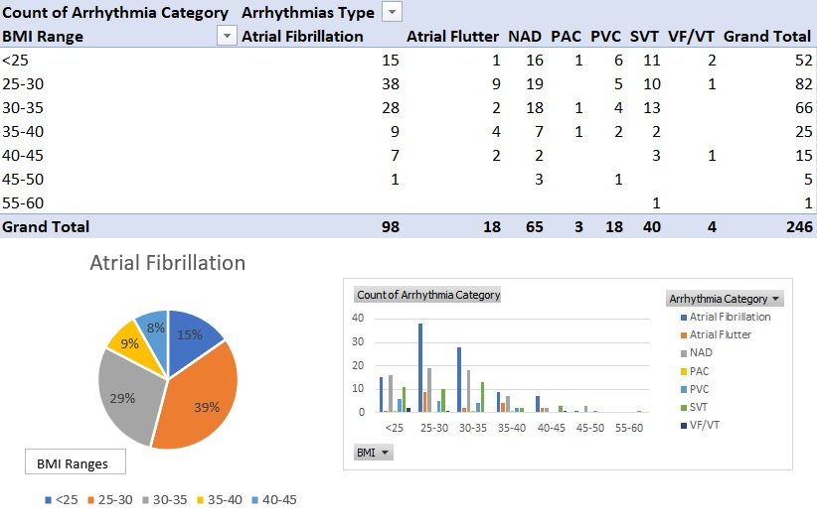
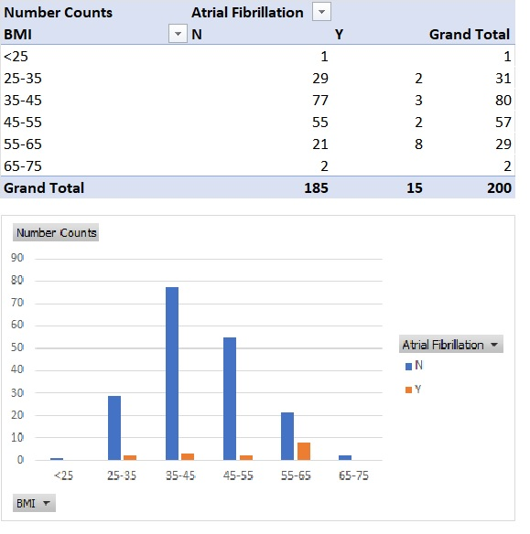
A24-080
The prevalence of combined Atrial Fibrillation and Obesity in Both Arrhythmias and Bariatric Outpatient Clinics; The Need For Early Implementation of a Weight Loss Management Program
Abstract
Atrial fibrillation (AF) is associated with increased mortality and morbidity. It is the most common arrhythmia encountered in the adult population and obesity increases its incidence.
Studies have shown that exercise and weight management programs reduce AF burden, improve symptoms and enhance quality of life.
Objective and Methodology
We aim to identify the combined prevalence of obesity and atrial fibrillation in our local outpatient
population attending two different clinics, arrhythmia and bariatric.
Retrospective data were collected from electronic case note reviews from all patients attending single
provider arrhythmia and bariatric clinic during the year from January 2022 to January 2023. A total of 246patients were identified from the arrhythmia clinic and 200 patients from the bariatric clinic.
Figure 1: Data from the arrhythmia Clinic – Types of arrhythmias and its correlation with BMI
Results
A total of 98 out of 246 patients (40%) from the arrhythmia clinic had a diagnosis of AF. AF was the most common arrhythmia seen in the arrhythmia clinic followed by supraventricular tachycardias (SVT) (16.2%) and atrial flutter (7.3%).
Of the 98 patients with AF, 38 patients (38.8%) had a BMI between 25-30, 28 patients (28.6%) had a BMI between 30-35, 9 patients (9.2%) had a BMI between 35-40, 8 patients (8.2%) had a BMI between 40-45 and the remaining 15 patients (15.3%) had a BMI of less than 25.
The prevalence of AF in obese patients (BMI>30 Kg/m2) attending the arrhythmia clinic was 45.9% while 38.8% of patients were overweight. (BMI>25 kg/m2 but < 30 Kg/m2). This showed that 84.7% of our patient population with AF had BMIs > 25 Kg/m2 with the majority in the obese category.
However, from the bariatric clinic attenders, the prevalence of AF was 7.5% (15/200 patients). Of these, eight had a BMI between 55-65 Kg/m2 and the remaining seven had a BMI between 25-55 Kg/m2
Figure 2: Data from the bariatric Clinic – Atrial Fibrillation and BMI
Conclusion
High BMIs, specifically clinical obesity, have been shown to increase the risk of developing AF. The prevalence of excess weight and obesity in patients with AF attending our arrhythmia clinic was nearly 85%. Despite the marked difference of BMIs between the two cohorts, AF prevalence was only 7.5% in the patients attending the bariatric clinic. This could be an underestimate, as clinical data including routine electrocardiograms and arrhythmia screening were not available. The high prevalence of obesity among AF patients highlights the urgent need for intervention such as diet and exercise in a structured weight management program
Department of Cardiology
Yi Lung Gan (Cardiology Trainee),
Sondos Eladawi (Internal Medicine Trainee), Dr Nadia Sunni (Consultant Cardiologist)

