Slide 1
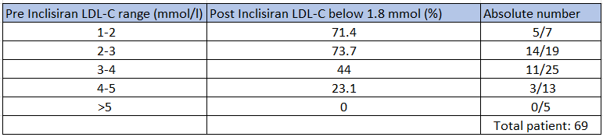
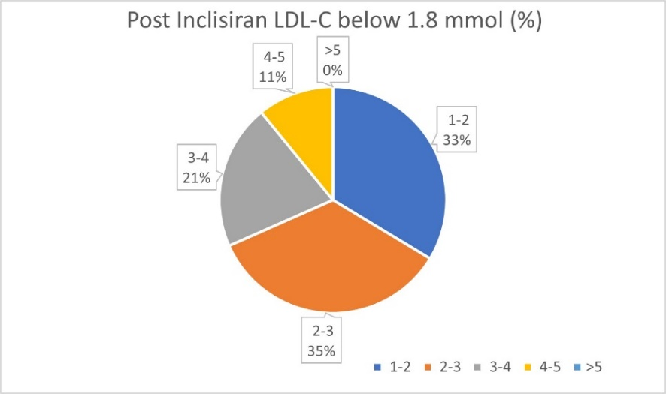
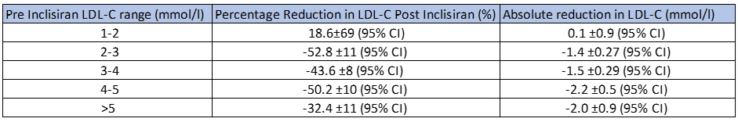
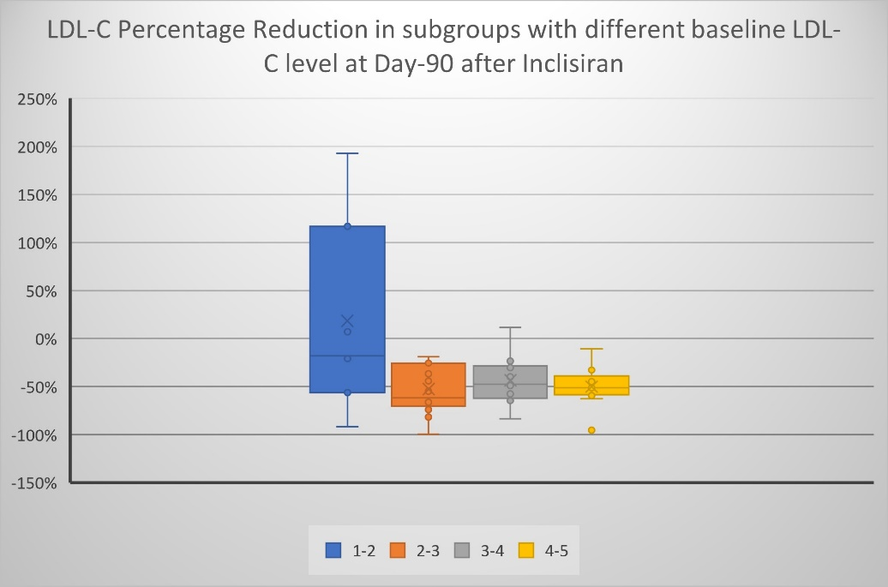
A24-079
Analysis of the baseline LDL-cholesterol level as a predictor in achieving target level of less than 1.8 mmol/l at 90 days after initiation of Inclisiran
Abstract
Inclisiran provides an alternative for patients on maximal dose of statins or intolerant to statins and not achieving their target LDL-C level.
Inclisiran binds to the mRNA of the precursor for proprotein convertase subtilisin-kexin type 9 (PCSK9). The reduction of PCSK9 concentration in turns increases the LDL receptors leading to lower LDL-cholesterol (LDL-C) level.
Aim and Method
This study aims to determine the baseline LDL-C level as a predictor in determining the percentage of patients achieving LDL-C level less than 1.8 mmol/l at day 90 after the first dose of Inclisiran with or without statins
This is a retrospective observational study which we collected the data electronically by looking at patients who received Inclisiran as an addon to their usual lipid lowering therapy.
Results
A total of 69 patients were included in the study. The greatest percentage achieving the target were those with a baseline between 2-3 mmol/l, which was 74%.
Of those between 3-4 mmol/l, the percentage reduction was 44%, with 4-5 mmol/l 23% and with 1-2 mmol/l 71%. None of those above 5 mmol/l achieve the target.
In addition, the percentage reduction in LDL-C in these subgroups were also determined. Those with a baseline between 2-3 mmol/l have the highest percentage reduction of 53% ±11 (95% CI), followed by those between 4-5 mmol/l with 50% ±10 (95% CI), between 3-4 mmol/l 44% ±8 (95% CI).
In those with level above 5 mmol/l, they had a reduction of 32% ±11 (95% CI). Surprisingly in those with levels between 1-2mmol/l, 3 patients had an increase in LDL-C level of 7%, 117% and 197%
Conclusion
Baseline LDL-C level can potentially be used as a predictor to determine if patients may achieve the target of below 1.8 mmol/l following the first dose of Inclisiran at day 90, with the best baseline level being 2-3mmol/l.
Our study showed that adding Inclisiran in patients with baseline levels of more than 5 mmol/l did not reach target and the effect can be mitigated in those with low level of 1-2mmol/l, both of which will need further exploration.
1: Department Of Cardiology / 2: Department of Pathology / 3: Medical School of King’s, Guy’s and St Thomas
Yi Lung Gan¹, Anura Kalansooriya², Hannah Tranter¹, Hana Jaumdally³, Andrew Hartland², Rumi Jaumdally¹

