Slide 1
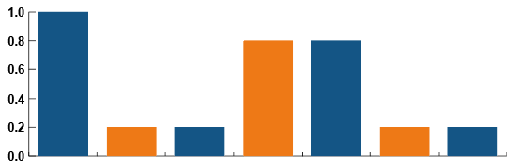
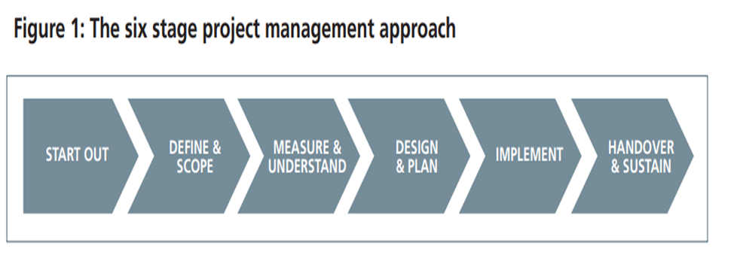

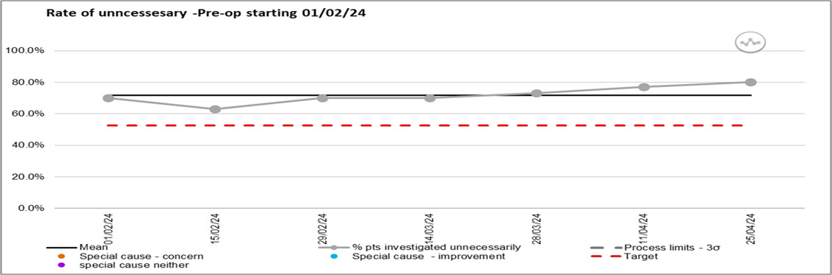

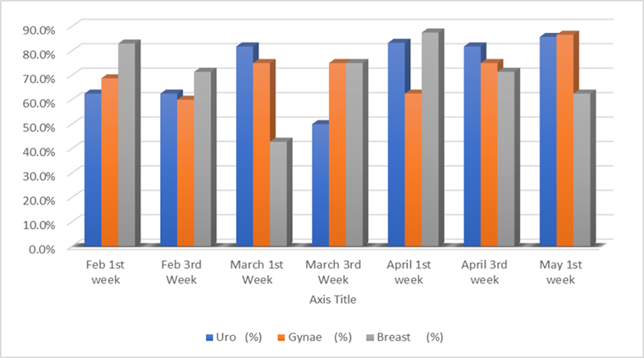
A24-078
Reducing unnecessary preoperative blood investigations: Model for Improvement
Dr. M. Gudipati, Dr. J. Johnson, Sr. N. Bateman,
Dr. M. Singh, Dr. R. Morse
Chart to go here
BACKGROUND
NICE guidelines exist for Preoperative investigations for elective surgeries
Audit in our department: nearly 70% of preoperative blood tests were UNNECESSARY
Urological, Gynaecological and Breast specialities were considered
QI approach to solve the issue: Audit as the diagnostic tool, QI as the treatment
AIM
Reducing the amount of UNNECESSARY blood investigations in ASA 1 & 2 patients undergoing the above elective surgical procedures by 25% (around 52.5%: 25% red of 70%) over a period of 12 months
Chart to go here
METHODS
Portal system database
Statistical analysis/ SPC charts
Data collection: 1st and 3rd week of every month, starting Feb 2024
30 patients included in each set
Liasing with Stakeholders
CURRENT RESULTS
Average % of unnecessary inv being 71.85%
CRP, Iron studies, LFT, Calcium, bone profile: common unnecessary investigations
30% necessary investigations being done
Photo to go here
Department of Anaesthesia
SUMMARY
INTERVENTIONS: Education of pre-op nurses, Posters, Inter- departmental meetings
MASSIVE financial savings to the department
Decreased environmental warming

