Slide 1
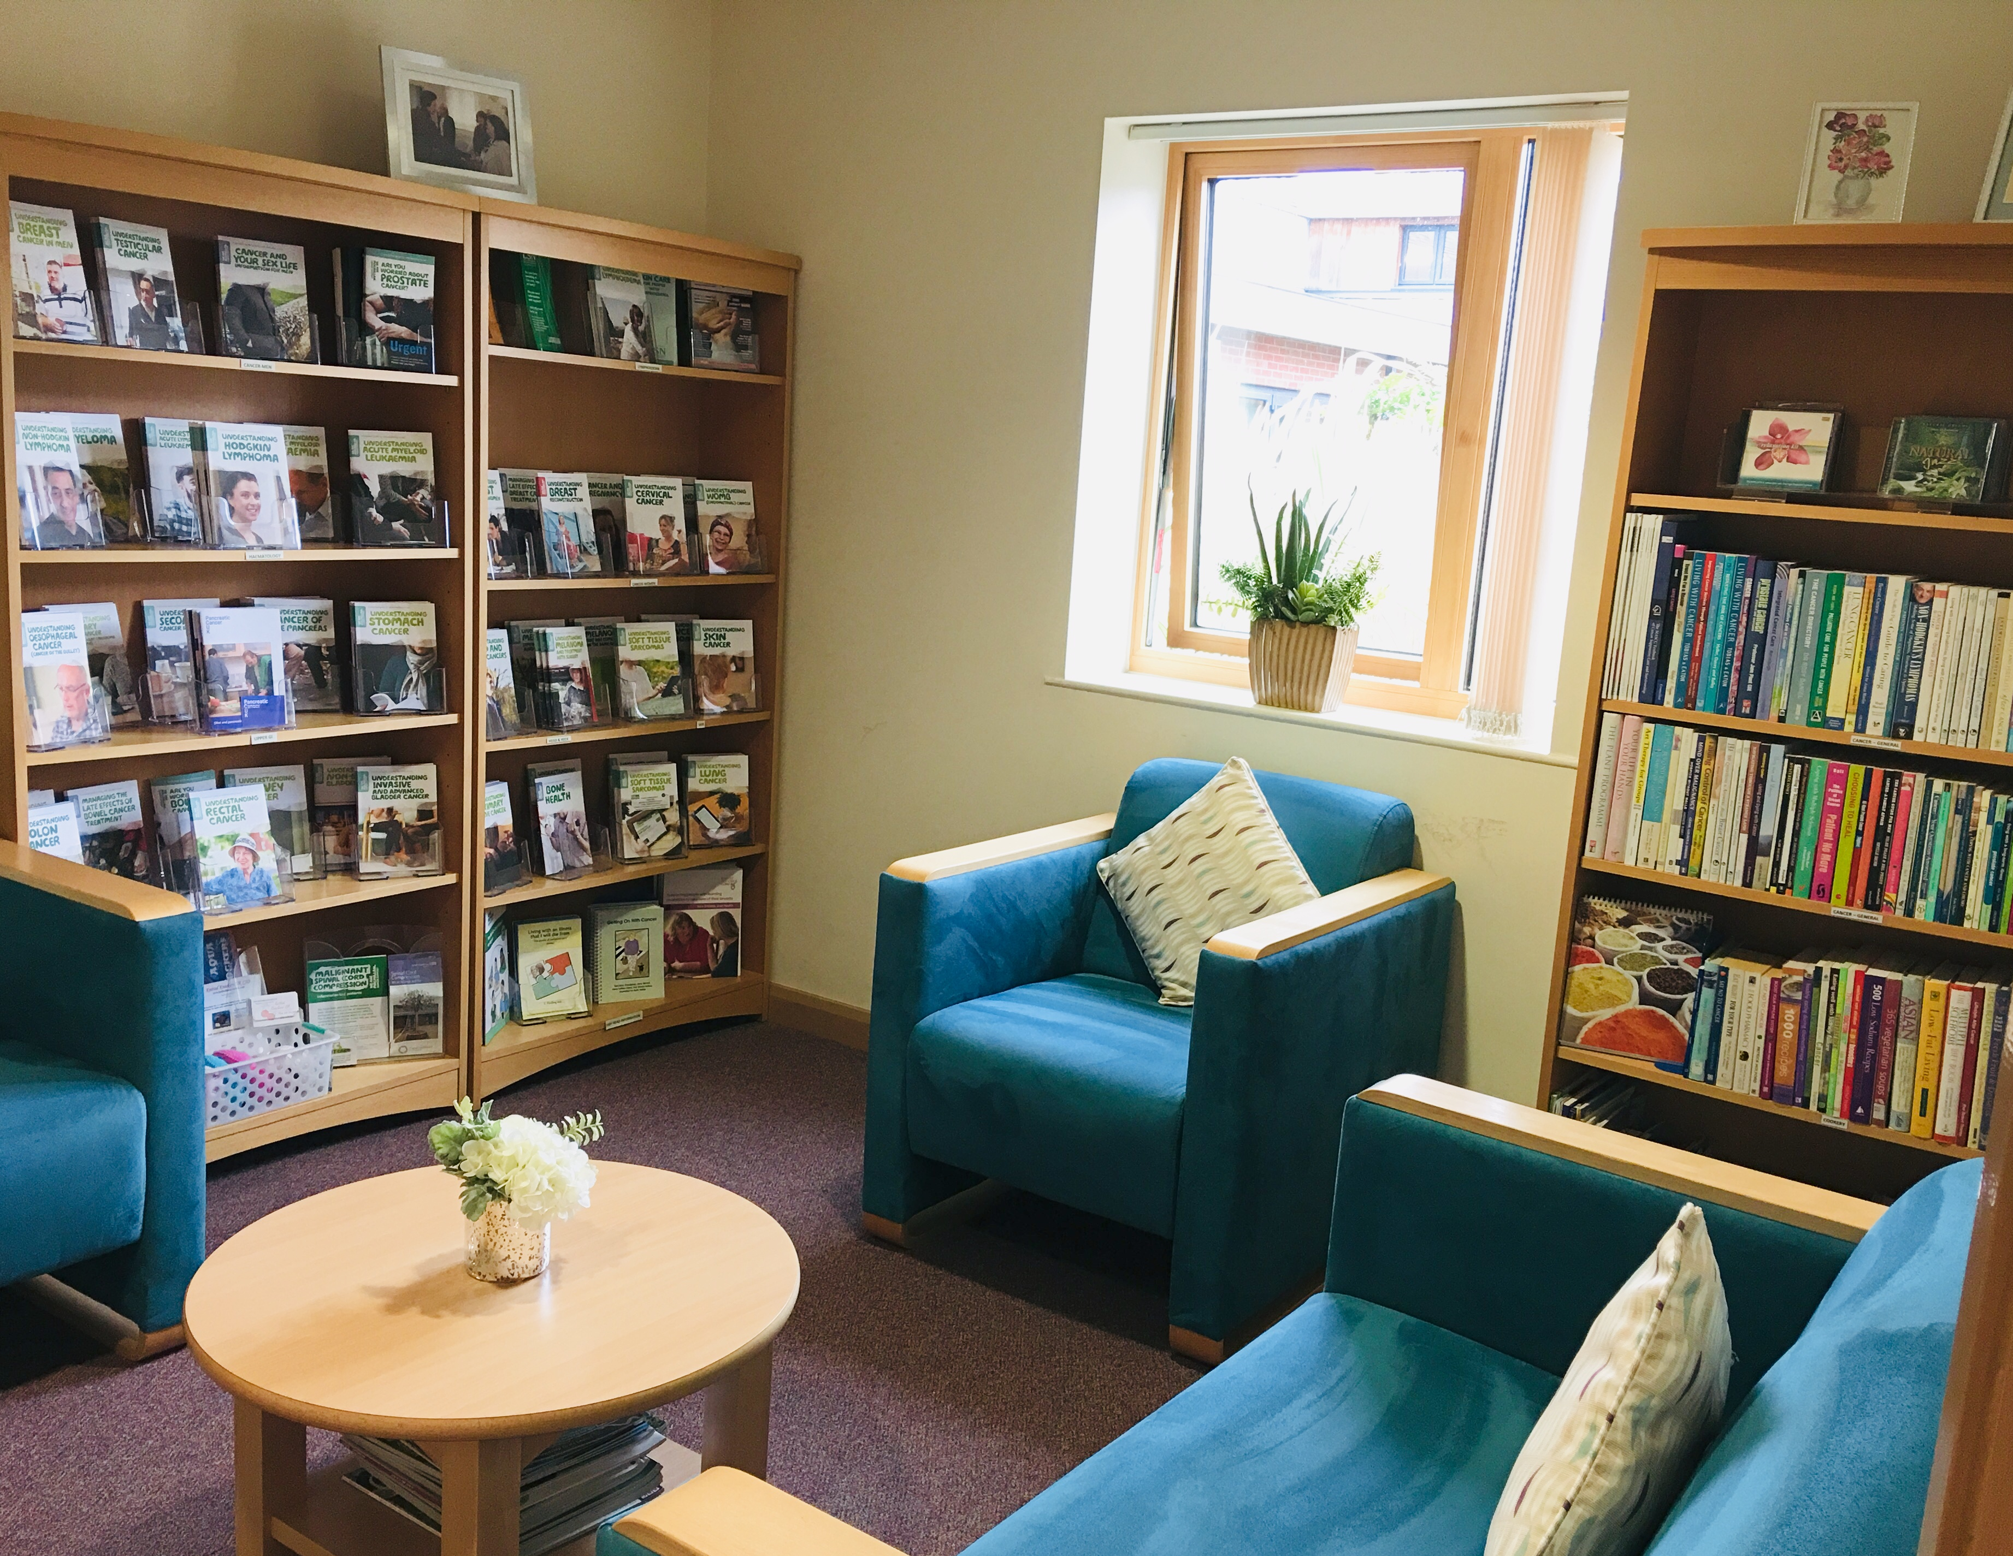
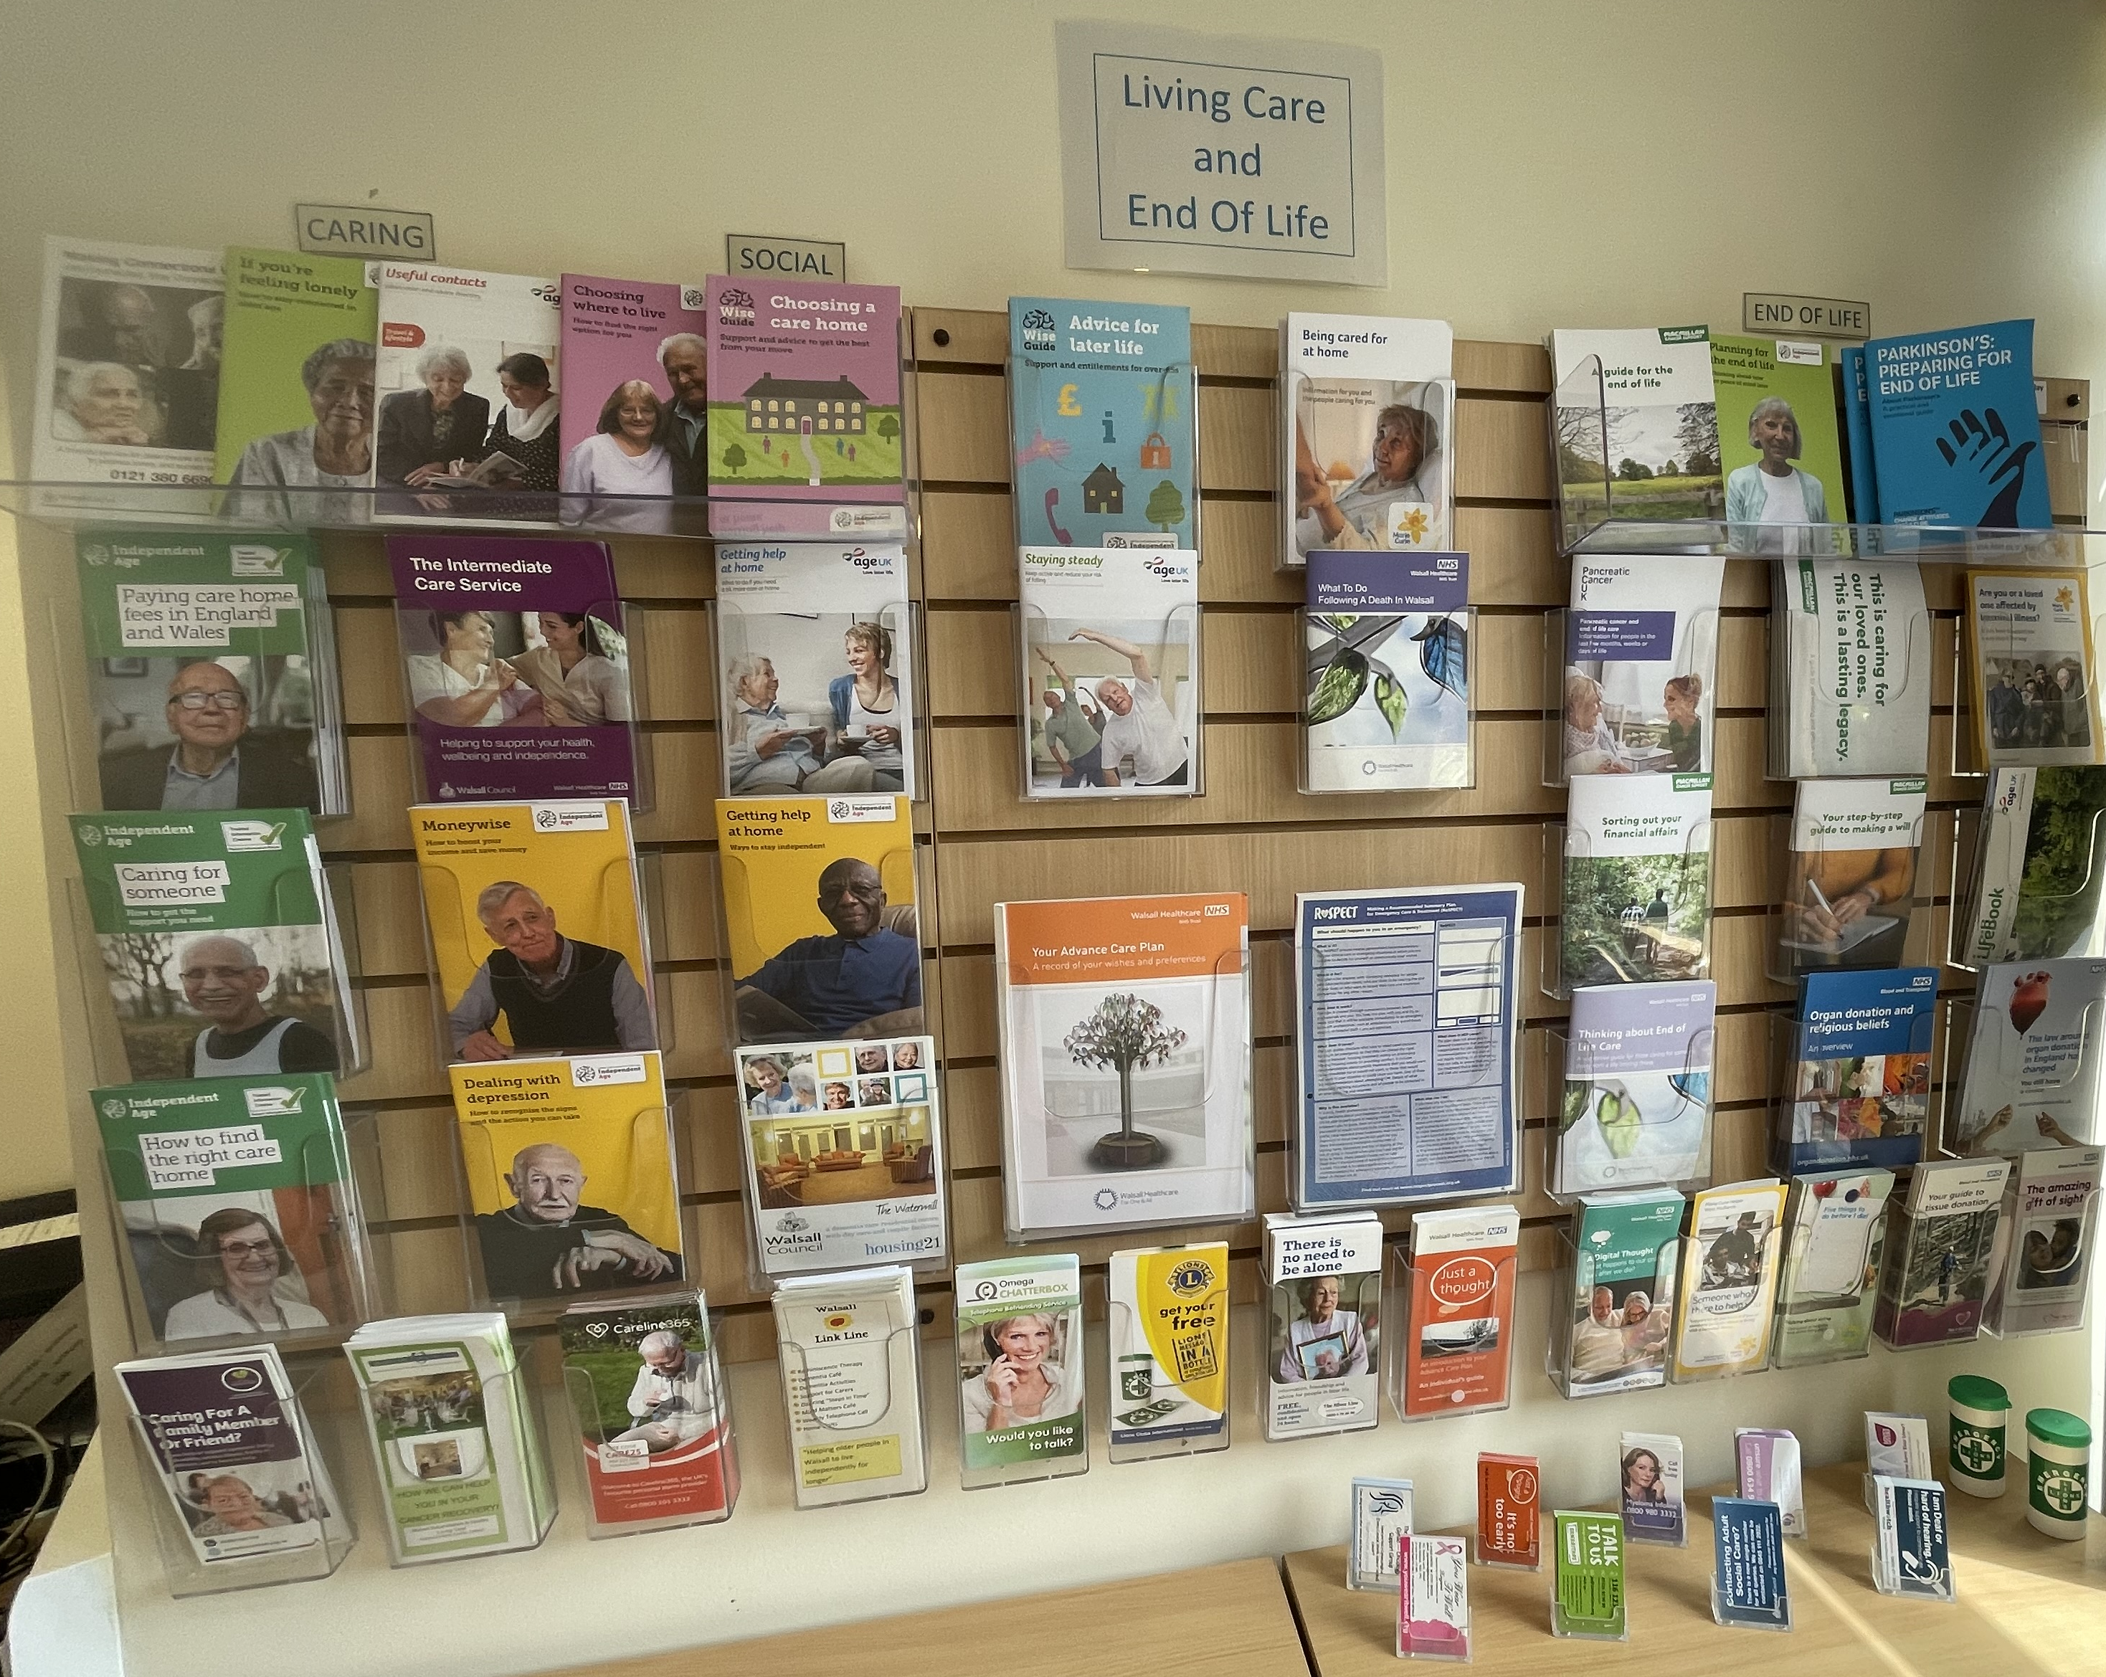
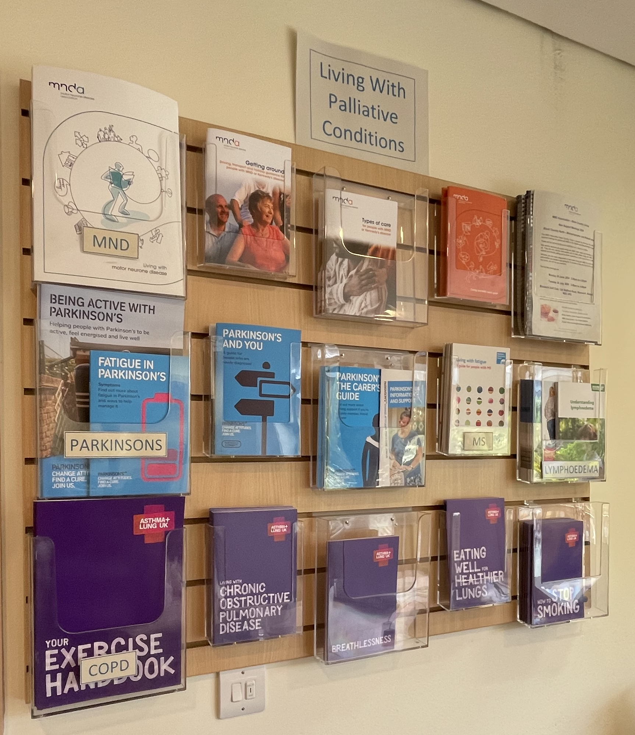
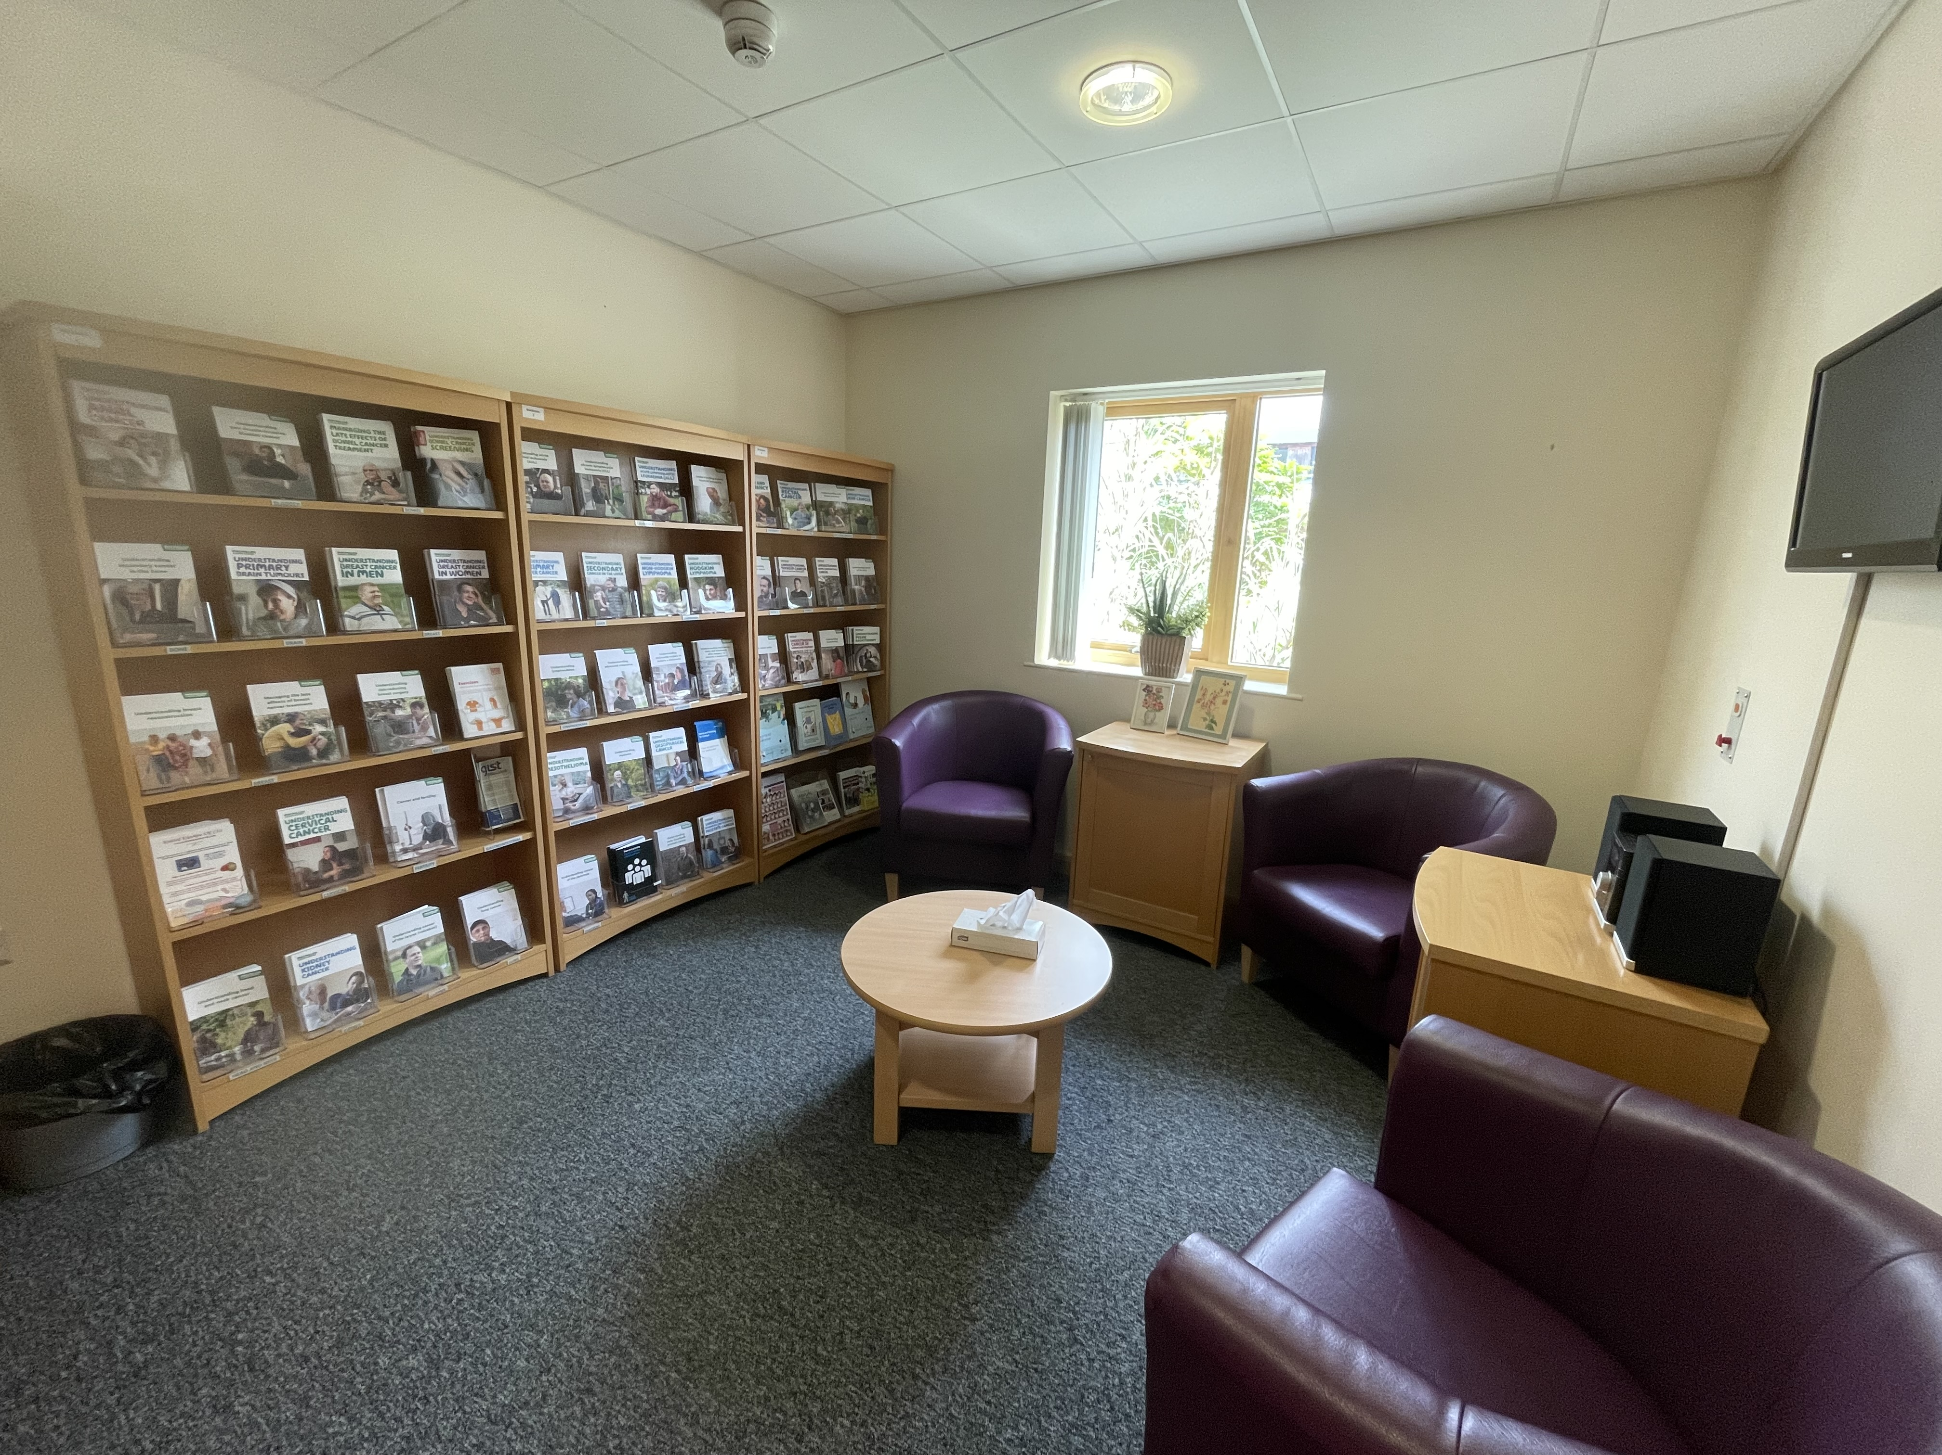
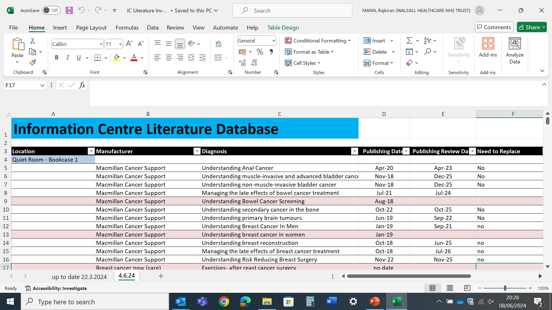
A24-077
Information Centre, Walsall Palliative Care Centre.
Service Improvement and Redesign.
Raj Mann – Information Centre & Outreach Support Manager.
Before in 2018
Present in 2024
Information Centre
Information Centre
Quiet Room
Background
The NHS Information Centre, based at the Walsall Palliative Care Centre, is a dynamic department which offers information and support to people living with, at risk of, and affected by a Cancer or a Palliative condition.
We supply a comprehensive range of leaflets, booklets and various sources that can be provided in alternative languages and different formats such as Easy Read, BSL and Audio.
Method
We believe trustworthy up to date information is essential in helping make better decisions on health and wellbeing.
Whether you're a member of the general public, a patient, carer for a relative or a healthcare professional. A personally tailored information pack can be produced, taking into account social, spiritual, cultural and ethnic needs.
Aim
Conclusion
The new database offers ease of access to key information/literature when responding to an enquiry.
Staff no longer to need to conduct a physical check of literature when answering a telephone enquiry.
Able to monitor popular themes of literature requested.
Able to highlight gaps on certain literature.
Staff can remove outdated literature in a timely manner.
Re-check all the literature across Outpatient Waiting Area, Information Centre and Patient Quiet Room.
Review all publication dates.
Remove all ‘out of date’ literature.
Reorganise literature displays into Healthcare, Social Care and Community Information related areas.
Redesign the Patient Quiet Room layout to maximise a cohesive space and display more literature.
Create an electronic inventory style literature database.
Create a database that provides a prompt and effective search and find response to immediate requests.
Environmental Sustainability
With the new literature database, a first of its kind in the Information Centre. We can now effectively monitor and manage all literature across the Outpatient Waiting Area, Information Centre and Patient Quiet Room.
This has significantly helped with the reduction of excess stock, over ordering, wastage with expiry dates, storage space and notably reducing the print and postage costs for charities who supply the literature for free.
Comprehensive Electronic Literature Database
Acknowledgements
Elizabeth Clark, Keith Duckett, Penny Elwell, Caron Gobsill, Linda Hayes, Naheed Razzaq & Sylvia Ryder
Community Palliative & End of Life Care
Information Centre & Outreach Support Team
Linda Hayes – Cervical Cancer Outreach Nurse Specialist
Penny Elwell – Outreach Support Officer
Naheed Razzaq – Outreach Support Officer
Donna Sharpe - Administration Officer
Caron Gobsill – Administration Officer

