Slide 1
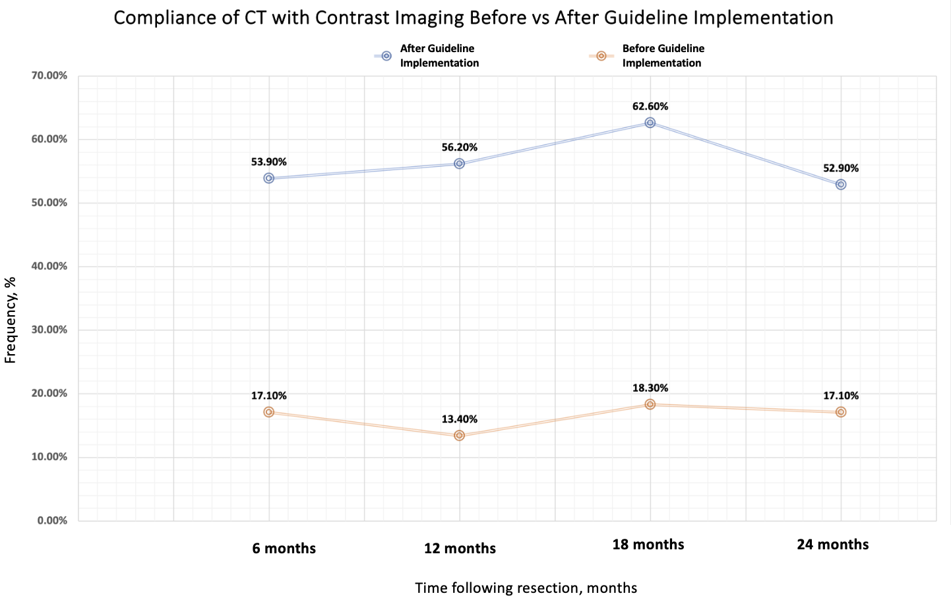

A24-076
Optimizing Post-Lung Cancer Resection Surveillance Imaging - ASCO Guidelines in Action
Aishah Z Mughal, Ahmed El-Zeki, Ahmed Habib, Ahmed Oliemy
Thoracic Surgery Department, The Royal Wolverhampton NHS Trust
Background
ASCO Clinical Guidelines 2020
Surgical resection with curative intent is offered to patients with localised lung cancer.
Post-operative surveillance imaging is essential to detect cancer recurrence.
Clinical guidelines by the American Society of Clinical Oncologists (ASCO) recommend all patients with curatively treated lung cancer should undergo surveillance imaging every 6 months for 2 years, mainly using CT imaging with contrast.
We aim to present a QIP to show the impact of implementing ASCO guidelines on surveillance imaging post lung cancer resection.
Adequacy of Surveillance Imaging Following Lung Cancer Surgery – How Can We Optimise Follow Up Care?
Methods
A QIP was performed on all patients undergoing curative lung resection surgery between 22/01/2021 to 30/03/2022.
Data was collected from electronic health records on presence of surveillance imaging at 6-, 12-, 18-, and 24-months following resection.
Data analysis was performed in respect to patient survival at each of these time points. Analysis was performed using SPSS V.29.
Results
110 patients undergoing lung cancer resection were included in analysis.
Median age of patients at operation was 72 years (IQR 64-77). Most patients had pre-operative tumour staging of T1 (57.3%), N0 (72.7%), M0 (94.5%).
The most encountered post-operative histological diagnosis was adenocarcinoma (54.5%) followed by squamous cell carcinoma (26.4%) and small cell lung cancer (1.8%).
Surveillance imaging was performed in 78.4%, 72,9%, 71.4% and 63% of patients at 6, 12, 18 and 24 months, respectively.
Primary lung cancer recurrence was most frequently detected at 18-months post-resection (8.8%).
Primary Lung Recurrence Detection Rate
Lung cancer recurrence detected | Number (%) of patients
6 months | 6 (5.9%)
12 months | 4 (4.2%)
18 months | 8 (8.8%)
24 months | 1 (1.1%)
Primary Lung Recurrence – Detection of primary lung recurrence following implementation of ASCO Guidelines
Compliance of CT with Contrast Imaging Before vs After Guideline Implementation
Implementation in Practice - Conclusion:
Implementation of ASCO guidelines has resulted in higher compliance of surveillance imaging following resection.
This has enabled a greater proportion of lung cancer recurrence detection, offering the patients curative treatment at earlier stage of lung cancer.
References

