Slide 1
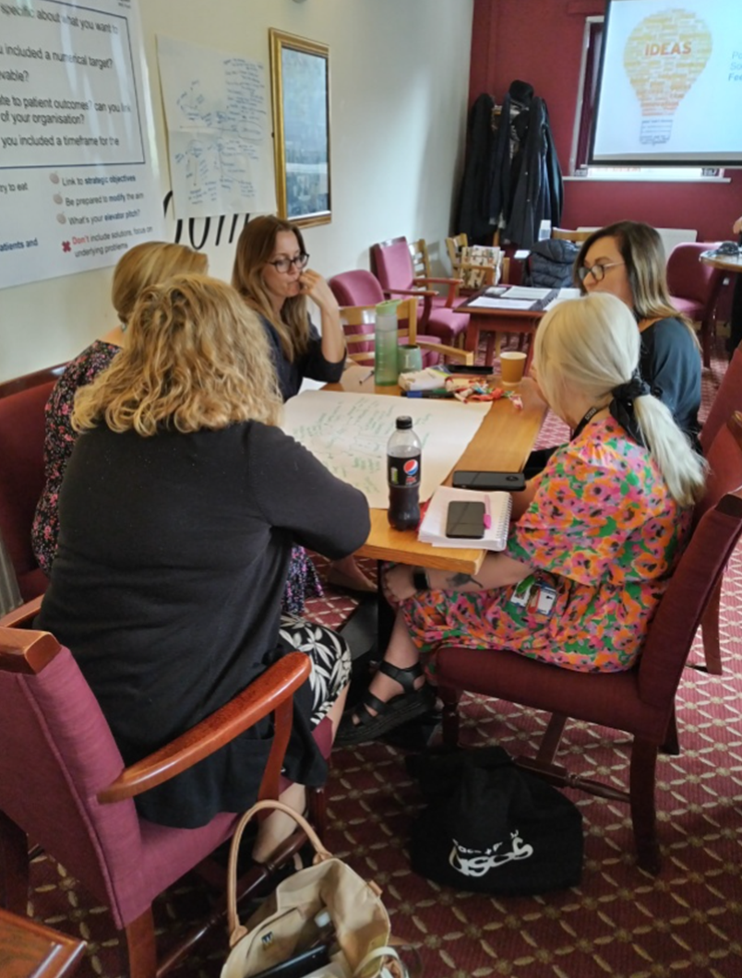
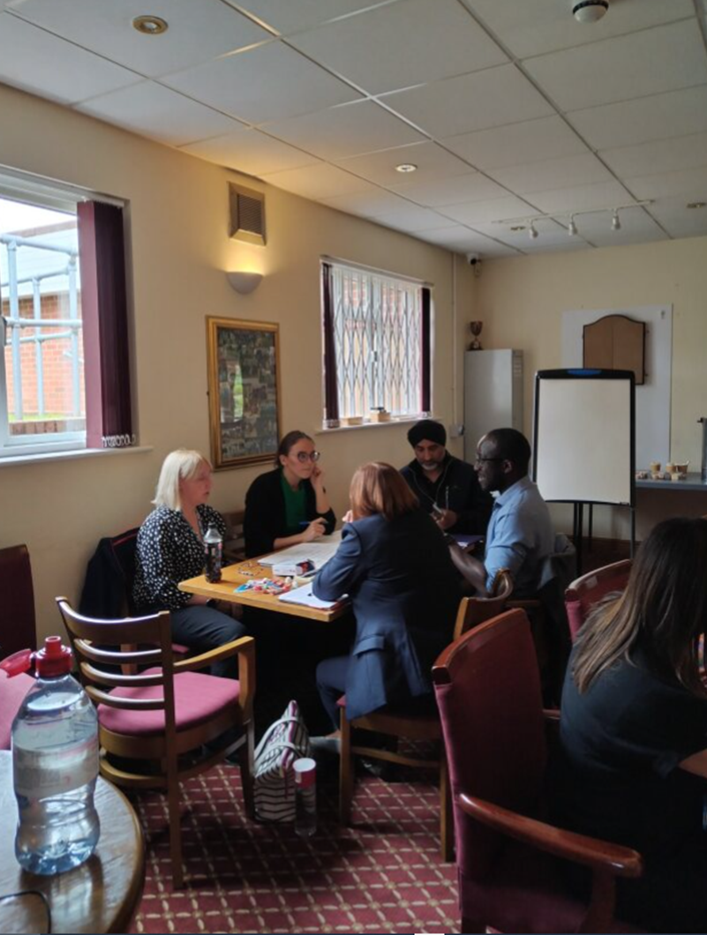
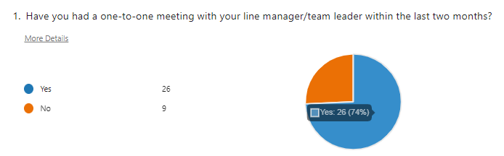
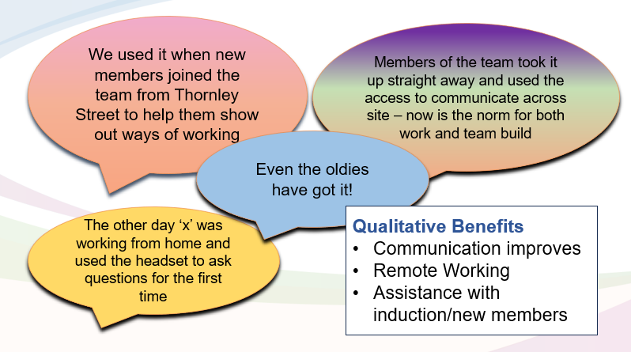
A24-075
Staff wellbeing in primary care
Chace Smith – Communications and Engagement Lead
Sarita Jones – Interim Directorate Manager
Dr Olomolaiye – GP and Deputy Clinical Director
Baljit Juss – Digital Implementation Lead
Background
The Quality and Outcomes Framework guidance released in March 2023 introduced a new quality improvement (QI) module, which focused on workforce and wellbeing in 2023/24 which formed part of the QOF activity from April.
In primary care, we decided to utilise this opportunity to collaborate with the QI team to make a difference. We chose our administrative staff as our target audience as we knew that our administrative staff were often the first point of contact for staff and patients, and we understood the pressures and stresses that can often come as part of their role.
Objectives and measures
Upon surveying our administrative staff we were able to identify the area they felt they required the most support with (in terms of staff wellbeing). Communication came out on top which is why we focussed on two separate projects relating to communication.
The objectives of our staff wellbeing project was:
Project 1: To at least double the uptake of one-to-ones for administrative staff within the PCN (from 23% uptake to at least 46% uptake) by end of November 2023.
Project 2: To ensure 100% of permanent staff have access to headsets and 80% of permanent staff have access to a video camera (which can also be used by bank staff) to attend virtual meetings when required by February 2024 leading to increased inclusion and staff wellbeing.
Activities
Project 1: Multiple surveys with administrative staff to understand and identify the area they felt they would benefit most from improving. We then developed a bespoke one-to-one meeting template cascaded to all line managers/team leaders and asked them to speak to their staff members and ensure monthly meetings were in the diary.
Project 2: Initial audit of existing equipment staff administrative staff have access to across the PCN. Once data was collected, the project team distributed the relevant equipment to the staff who needed it – bearing in mind any specific accessibility requirements.
Outcomes
Project 1: Increased administrative staff having one-to-one meetings with their line manager/team leader from 23% to 74%.
Project 2: Led to a qualitative improvement in staff wellbeing and 41 members of staff who did not have a camera and/or headset were provided with one – also better
for the environment with less staff travelling to face-to-face meetings.
Increased from 23% of admin staff having one-to-one meetings to 74%.
Outcome
The future state and sustainability
Project details and successes were shared with the PCN Board who agreed we should aim to roll this staff wellbeing initiative across the whole of the PCN.

