Slide 1
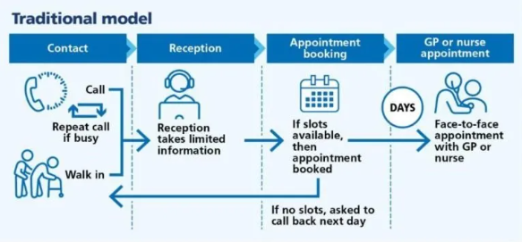
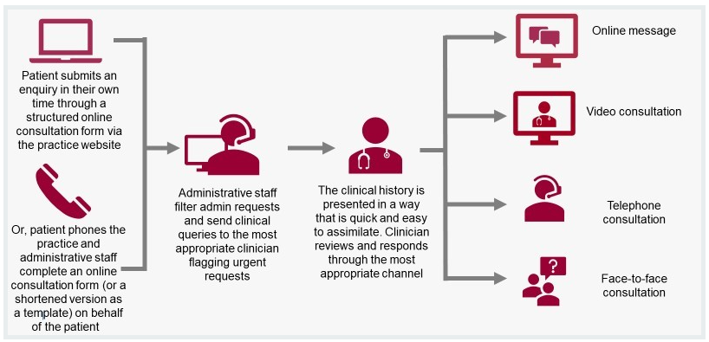
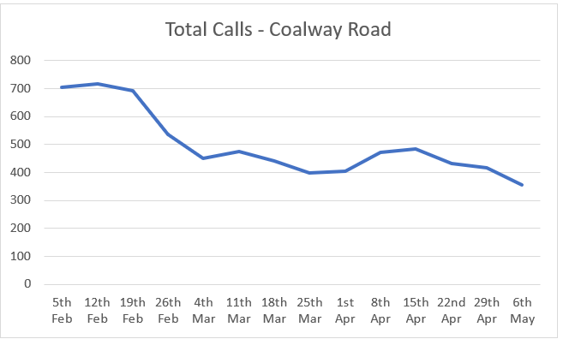
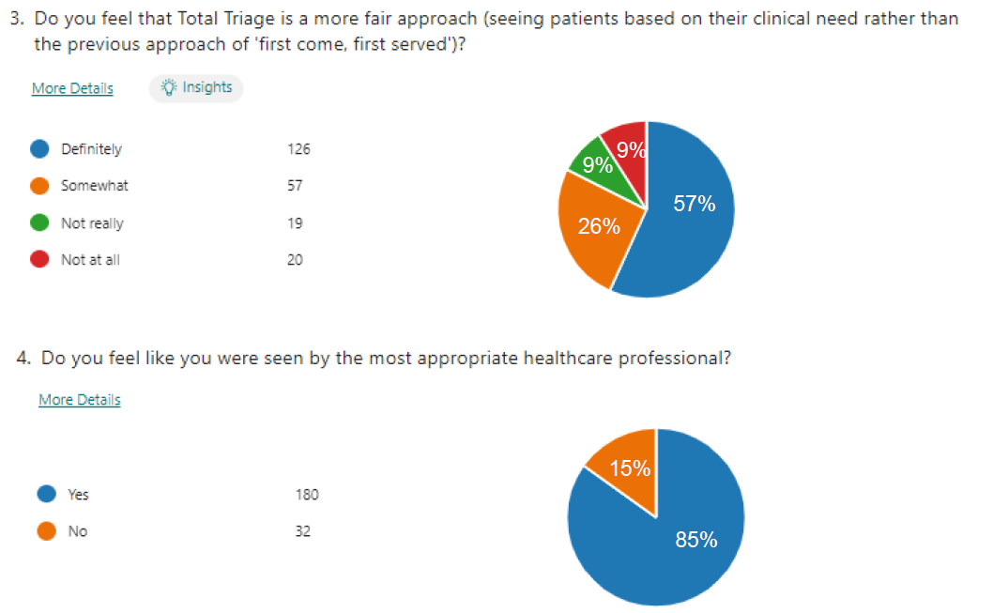
A24-074
Total Triage: a new patient appointment system
Dr Olomolaiye – GP and Deputy Clinical Director
Baljit Juss – Digital Implementation Lead
Chace Smith – Communications and Engagement Lead
Louise Landucci – Transformation Programme Manager – Primary Care
Total Triage Model
Background
The demand for appointments has increased significantly in recent years, and General Practice must address the issues of capacity and demand to maintain patient safety and satisfaction.
Traditionally, patients would book appointments to visit the practice in person or by telephone. By introducing Total Triage the practice will be able to help prioritise patients who need our help most urgently.
Objectives and measures
Outcomes so far;
Circa 75% of requests received are clinically triaged
60% of requests result in same day appointments
Around 90% utilisation of GP appointments available
Reductions in DNA rates for GP appointments – currently around 3% compared to average pre Total Triage of 5%
No patients waiting at the practice in the morning to book an appointment
Reduction in calls to practice as people utilise online form
The objectives of Total Triage are:-
To ensure patients are given the most appropriate appointment or advice to meet their needs
Patients know on the day how their request will be handled
Appointments will be based on clinical need
Align practice capacity with patient need
The benefits we are realising as part of this pilot are;
Patients being seen by the right person, at the right time, in the right place navigating to other providers – Pharmacy First/Pharmacists, Nurses/ANPs and First Contact Physiotherapists (FCPs), Mental Health Practitioners
Improved access to care - freeing up face-to-face appointments for those patients that need them the most.
Convenience: Using digital communication, patients engage with the practice at a time convenient for them. No more having to travel to the practice, waiting for enquiries or repeat prescriptions.
Enhanced patient experience - patients are navigated to the best service to help them in a timely way.
Embracing innovation - adapting to the needs of our PCN.
Happy practice staff - reduced turnover with consistent teams and ways of working to support our patients.
Current picture
Chart 1 – Demonstrating the impact on call volumes
Patient engagement in progress at PPG groups
Staff and patient feedback under review
Operational at two GP practices;
Coalway Road – 4,772 patients
Warstones Surgery - 3,916 patients
Penn Manor Medical Practice – 9,339 patients –
Go-Live 19.06.24
The future state and sustainability
Chart 2 – An example of patient feedback at Coalway Raod
Total Triage will be live across the PCN by the end of October 2024. The sustainability of this model is paramount to ensure that we continue to deliver the needs of our patients. Close engagement with our stakeholders to monitor and respond to fluctuations in capacity and clinical need is essential to support the wider roll-out of Total Triage and to ensure collaborative working to deliver a PCN approach to appointment management in the future.

