Slide 1
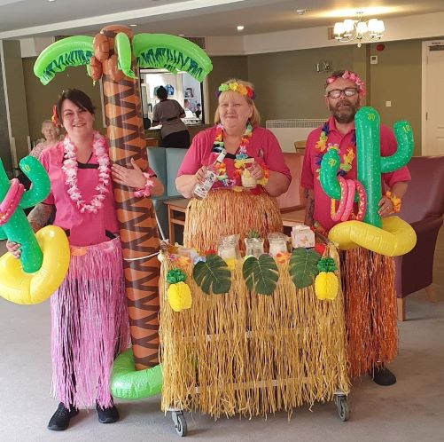
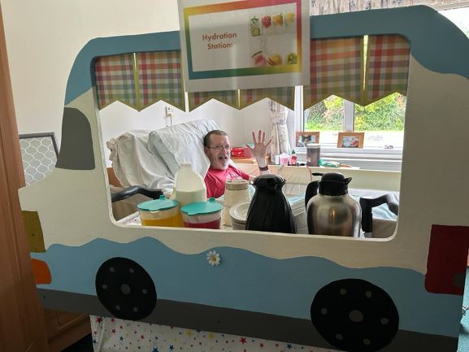
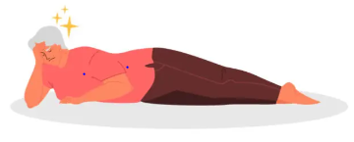


A24-073
Dietitian Support for Falls Prevention
(Falls Prevention Hydration Project)
Tahira Mirza / Project Lead Dietitian
Rebekah Maxwell / Apprentice Dietitian
Abstract
“drinking behaviours was new to me, never thought of it before”
This project was funded by One Wolverhampton for
the period April 2023 to March 2024 (12 months). A Senior
Dietitian from RWT with the assistance of an Apprentice Dietitian delivered hydration training sessions to care home staff over a 9-month intervention period between June 2023 to February 2024. The aim of the project was to help care home staff optimise their resident’s hydration status by improving knowledge regarding best hydration practices, therefore preventing issues related to dehydration. The primary outcomes for the project were,
Reduction in falls in care homes (CHs) by 5%
Reduction in urinary tract infections (UTIs) requiring antibiotics in CHs by 5%
Reduction in GP and/or ambulance attendance within CHs
Aswell as attending hydration training sessions, the intervention included care homes implementing seven structured drinks rounds throughout each 24-hour period, decorating drinks trollies to stimulate resident engagement and appropriate use of drinking aids. The secondary outcomes were,
Improve staff knowledge on the importance of good hydration for older adults
Improvement in numbers of residents meeting their fluid targets
Improved quality of life for CHs residents
Increase variety of drinks offered
Further info
Hydration training was delivered to care homes from June 2023 to February 2024 (9 months)
19 CHs received falls prevention hydration training
Covering 27.5% of care homes in the Wolverhampton area (19 out of 69)
42 hydration training sessions delivered
291 individuals received hydration training
‘Hydration Champion’ resource packs and hydration posters were provided to each CH to improve sustainability of the intervention
Metrics collected every month over 9 months
Pre-intervention period was over 2 months and post intervention period was 3 months
18 CHs, divided into 4 cohorts included in post-intervention analysis
11 CHs used to analyse long term impact of intervention over 9-month period
Project had a 5.6% attrition rate
“You connected the dots!”
Post-Intervention across all care homes there was a 29.7% decrease in falls managed in the care home…
… and a 38.8% decrease in falls requiring an ambulance with no hospital admission.
The data shows that overall, there was 50% decrease in falls in care homes requiring hospital admission.
Post-Intervention across all homes there was 23.5% decrease of UTIs requiring antibiotics…
… and an 88% decrease in UTIs requiring hospital admission.
Overall, the data shows this intervention had a positive impact on reducing falls, their severity, reducing UTIs and subsequent use of antibiotics.
“training was pitched at the right level for everyone to understand, thank you!”
RWT Nutrition & Dietetics with support from ICB – FREED Team
This project intervention has produced positive results for both the primary and secondary outcomes. The outstanding 50 CHs in Wolverhampton would benefit from receiving this intervention and the project scope extended to include the wider Black Country boroughs – Walsall, Dudley and Sandwell.

