Slide 1
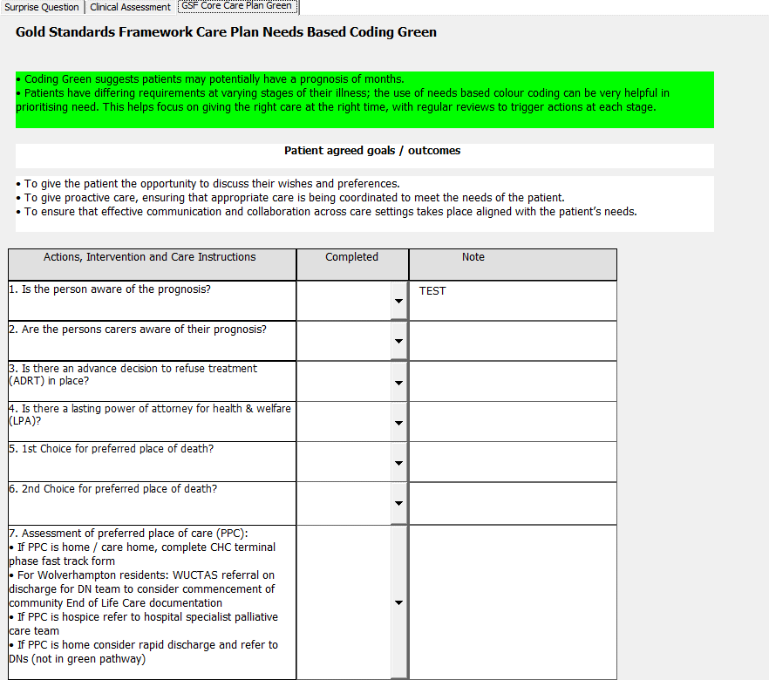















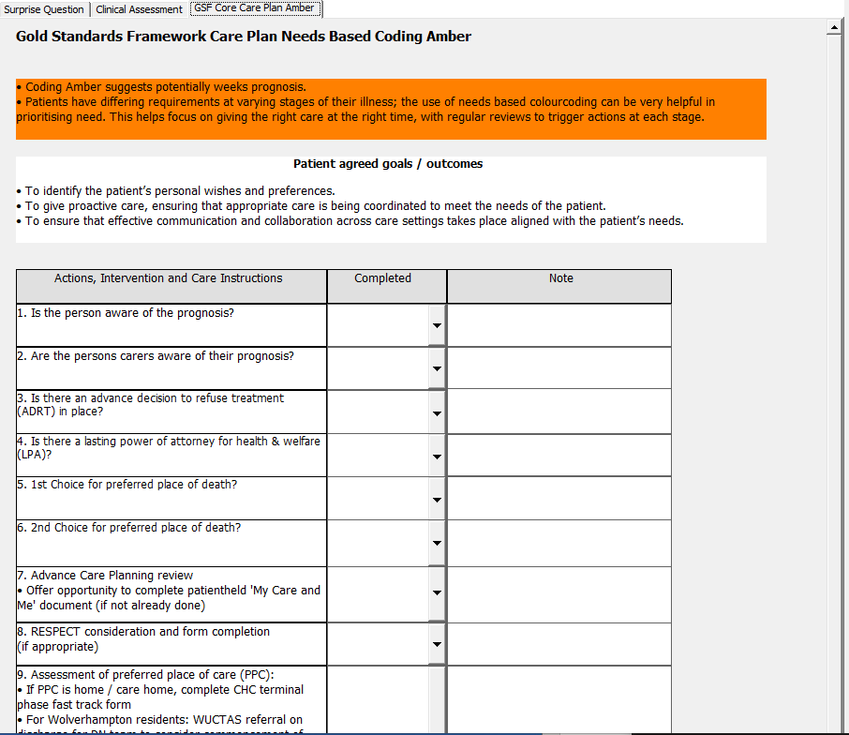














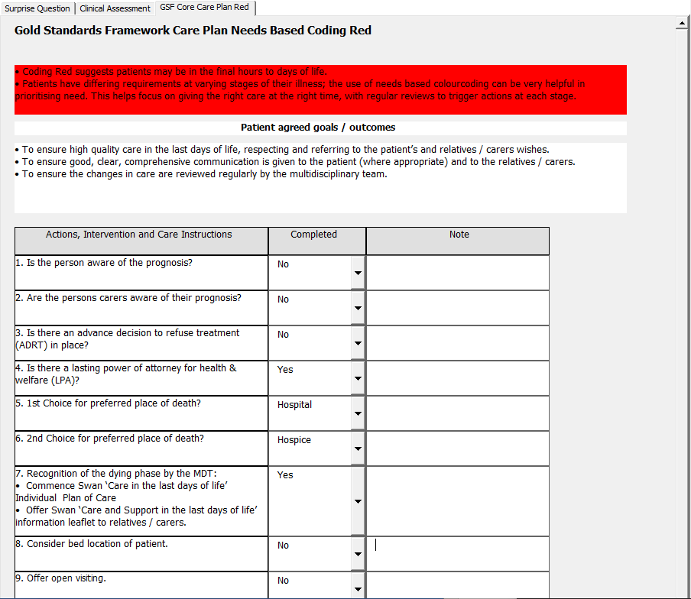












A24-072
Proactive Risk-based Data-Driven Assessment of Patients at EOL
Nisha Kumari-Dewat - Clinical Digital Healthcare Nurse
Background & Aims
PDSA | Plan | Do | Study | Act
Cycle 1 | Pilot practices to engage with system (RWT PCN) | Pilot practices utilised system | Feedback from practices was analysed | System user interface improved for more effective use
Cycle 2 | Engage pilot practices in new and improved interface | Pilot practices utilised system | Feedback from practices was analysed | Analysis showed preparation for wider rollout out could be pursued
Cycle 3 | Engage wider group of practices within RWT PCN | New practices engaged in system, maintaining engagement with original pilot practices | Feedback from practices was analysed | System data feed was interrupted due to outside controls. Accuracy of data was compromised. Resolve data feed an establish stable feed
Cycle 4 (Current) | Engage with practices outside of RWT PCN | Engage practices outside of RWT PCN in system and ensure they can use the system as RWT PCN practice can | Feedback from practices to be analysed and review of risk factors and EOL bot | TBC
Results
Background:
As outlined for better EOL care in the UK by NICE a national deficit with patients who have been correctly identified as EOL and those who have been registered on GSF and recognition that GSF registration directly impacts patients care during their last 12months. The earlier the registration the better the care.
SMART Goal:
Increase number of patients registered on GSF in 12-month period by utilising a digital health care system which supports clinicians to identify the cohort of complex care patients who may require end of life support. This will be achievable by 80% of RWT PCN practices being registered to system and in turn increasing the number of surprise questions asked and the of PRADA care plans completed.
 | Sep-23 | Dec-23 | Mar-24 | Jun-24
% EOL Register | 0.42% | 0.43% | 0.43% | 0.45%
% Respect Document | 0.52% | 0.54% | 0.54% | 0.57%
% EPPACS /Advanced Care Plan | 0.50% | 0.53% | 0.53% | 0.58%
Total GP W-ton Population | 305657 | 308013 | 308013 | 309043
Methods
By using modern day digital system which highlights risk factors linked to complex care we have been able to assist our clinicians in Primary Care by identifying those at risk and prompting GSF registration.
Pre-PRADA
Post-PRADA
EOL
EOL
Patient reaches EOL and requires specialised care
Healthcare professional touch point e.g., ED attend, GP review by community service or other service they are known to
GP
PRADA
NEA
Patient is recorded on EOL register by GP
PRADA care plan initiated by SPCT/Adult Community Services
A patient experiences a Non-Elective Admission (NEA)
ReSPECT & ACP
Patient is reviewed by GP
ReSPECT & ACP
GP
Inpatient
ReSPECT documents and Advanced Care Planning are completed by GP
Therapeutic Services
ReSPECT documents and Advanced Care Planning are completed by GP
Information is recorded during inpatient stay in relation EOL Care
Introductions to therapeutic services
Virtual Ward/ Community
Discharge
Community
Before or upon discharge documents are sent to GP
GP
Minimal interventions through virtual wards and ACSG
Patient is referred to Community Services for EOL Care needs
Follow-up review by GP and further care planning
NEA
PPPC
GP/EOL Register
A patient experiences a Non-Elective Admission (NEA)
Full interaction from services
Patients are in preferred place of care
Patient is discharged back to GP for EOL Care and is registered on GSF
Preferred Place of Death
Patient is discharged back to GP for EOL Care
Preferred place of death
Preferred place of death is often an unmet need
Post-PRADA EOL Care
Patient is referred to Community Services for EOL Care needs and bereavement services are sourced
Digital and data driven reviews of patients
Population Health
Patients receiving care in preferred places of care
Enabling preferred places of death
Registering patients on the GSF in a timely manner
Team: Digital Innovation Unit
Summary:
In hospital, community and primary care settings, digital risk escalators are applied to stratify the population, then clinical stratification is by the GSF surprise question (SQ). The system ascertains key end-of-life processes (Electronic Palliative Care Co-ordination Systems (EPaCCS), Recommended Summary Plan for Emergency Care and Treatment (ReSPECT), end-of-life care plans, end-of-Life registration) and key activity (death, place of death, non-elective urgent care). It incorporates clinical governance functions and digital algorithms for decision support. It deploys the information live into direct care displaying patient lists for end-of-life assessment, promoting proactive care, capturing live clinician data and creating an EPaCC and end-of-life care plans, which are automatically distributed into hospital and General Practice (GP) patient records.

