Slide 1
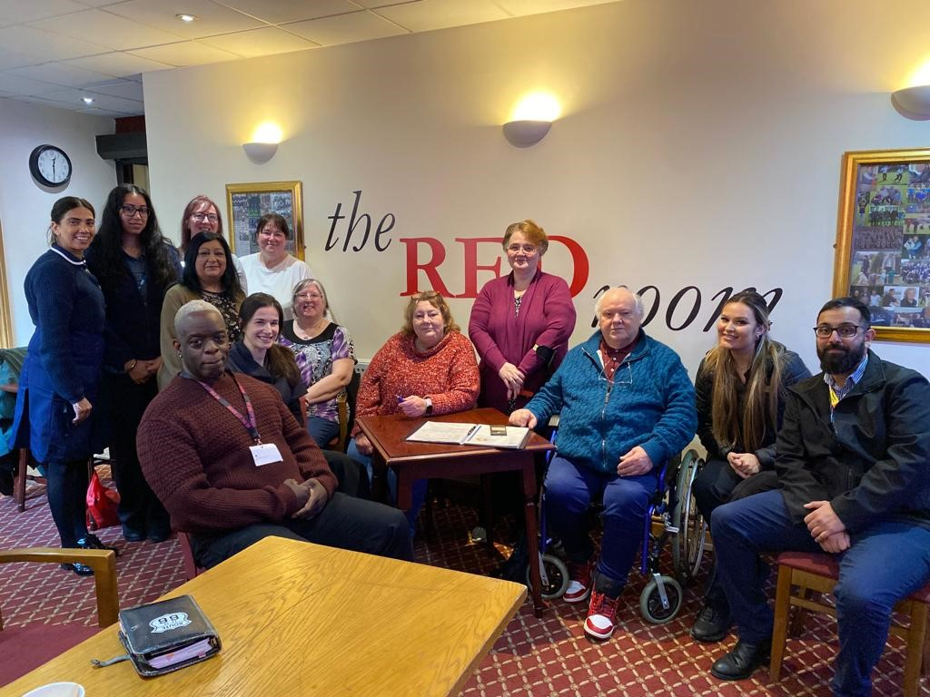
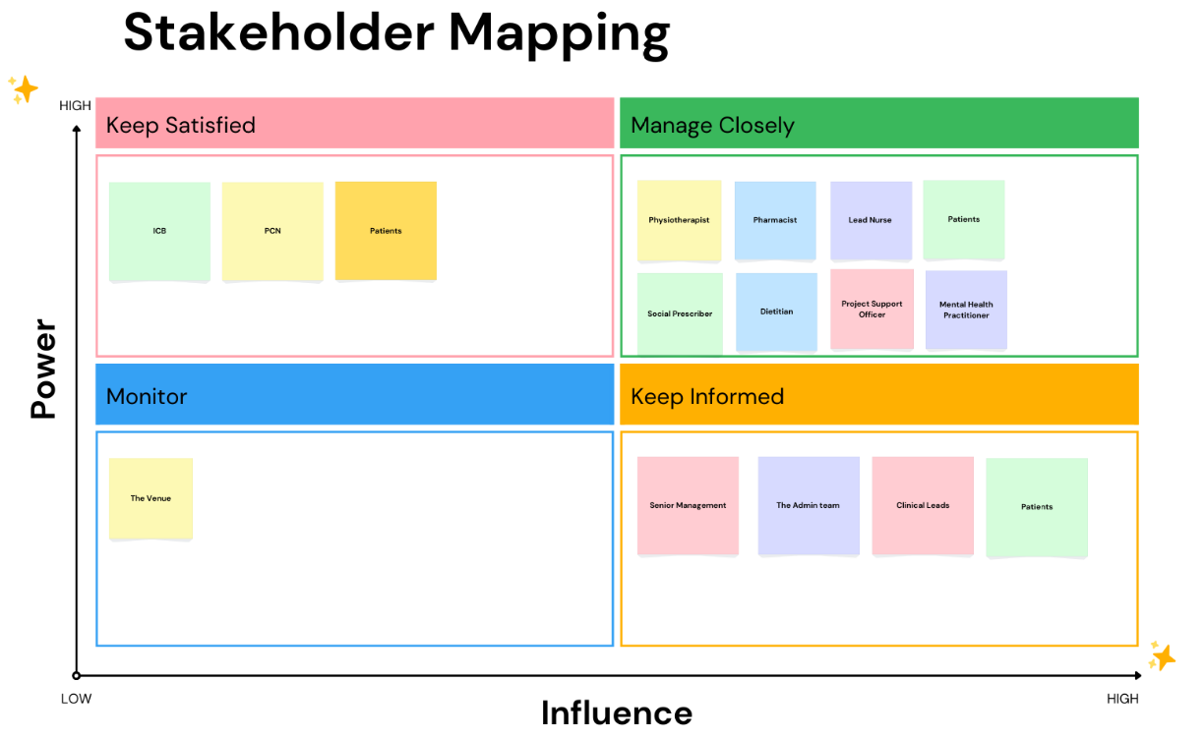
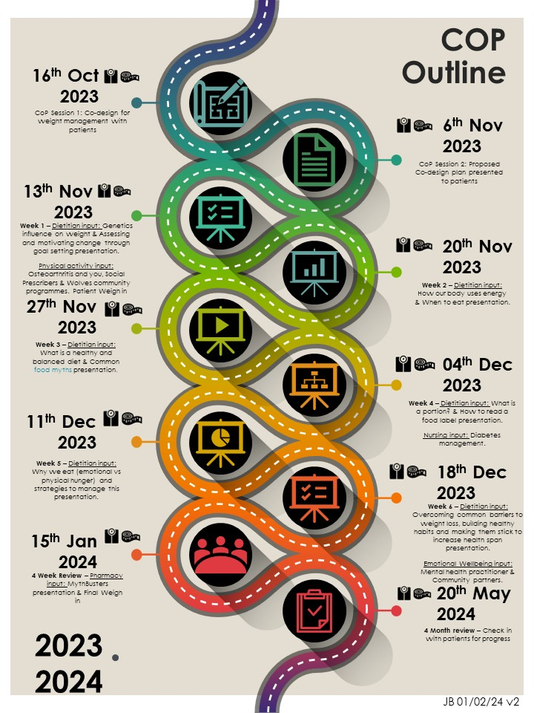
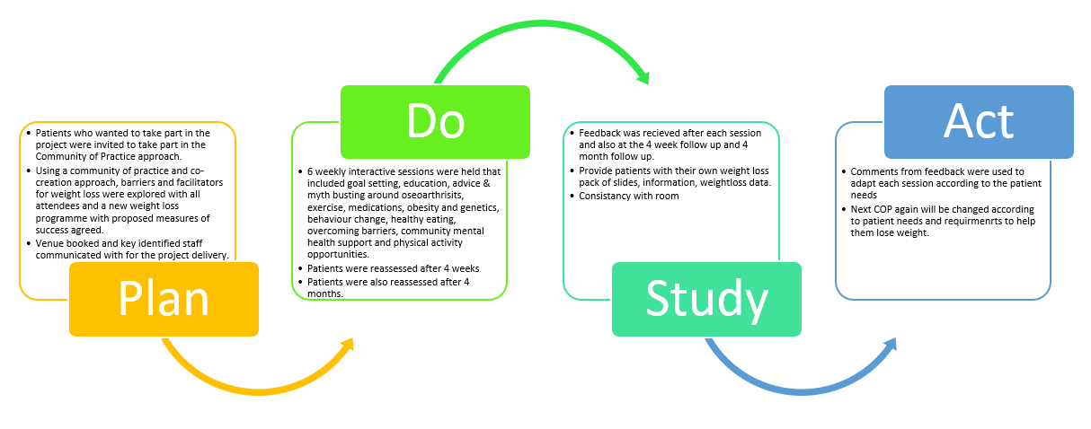




A24-071
Community of Practice – Weight Loss
Tina Hadley-Barrows – Consultant physiotherapist, Jogindro Jassal – Clinical Support Nurse Lead, Alice Johnson – Dietitian, Renford Lee – Social Prescriber, Navdeep Chugger – Clinical Pharmacist, Chase Smith – Communication & Engagement lead, Jo Moore – Operations Manager, Lisa Parker – Interim Directorate Support Manager, Bukola Olomolaiye – Deputy Clinical Director & GP, Jaspal Bassi - Project Support Officer
Project Overview
Results
A Community of Practice and co-creation approach formed a weight management programme which delivered 6 weeks of 2-hour education sessions, to empower a small cohort of patients to lose weight. It was decided to measure the patients progress by monitoring weight (kg), Waist measurement (cm) every week and Mental health improvements via PHQ-9 questionnaire and physical activity via a sit to stand assessments at the start and follow up sessions. Mini PDSA cycles were conducted after each session using feedback from patients to improve the quality of future sessions.
3.54%
0.44%
2.67%
4.40%
2.79%
7.60%
4.15%
0%
Group lost: 30.1kg
Project Background
Following an ICB call for novel ideas to address the ever-growing prevalence and burden of excess body weight; local practitioners decided to use a Community of Practice approach, to explore patient and practitioner perceived barriers and enablers to effective weight management and work together to co-create, pilot and evaluate a new approach to support weight management.
Stakeholder Mapping
Group lost: 66.5cm
Method
Groups PHQ-9 scores reduced
Sit to stand (Physical Activity) : from initial contact all patients increased their physical activity score and felt less exertion when exercising.
Successes:
Onward referrals:
One patient reduced their HbA1c from 54mmol to 49mmol by eating healthier and exercising during the programme and is motivated to continue to reduce it further.
3 patients went on to refer into the Social Prescribing Team
PDSA Cycle
Patient Feedback
I need to understand food is not my enemy
Having information about dieting to hand is useful. All staff and other people attending were very good.
Access to information regarding medication was excellent, opened pathways for further education for individual needs
Education is key! I have learnt so much thanks to Tina, Jogi, Renford, Jazz, Nav and having Alice weekly has been honestly life changing!!
Next Steps
The project results have been submitted to the ICB to request further funding to run future Community of Practices and cocreated interventions
Findings will be presented in June 24 to RWT PCN Practice Directors

