Slide 1

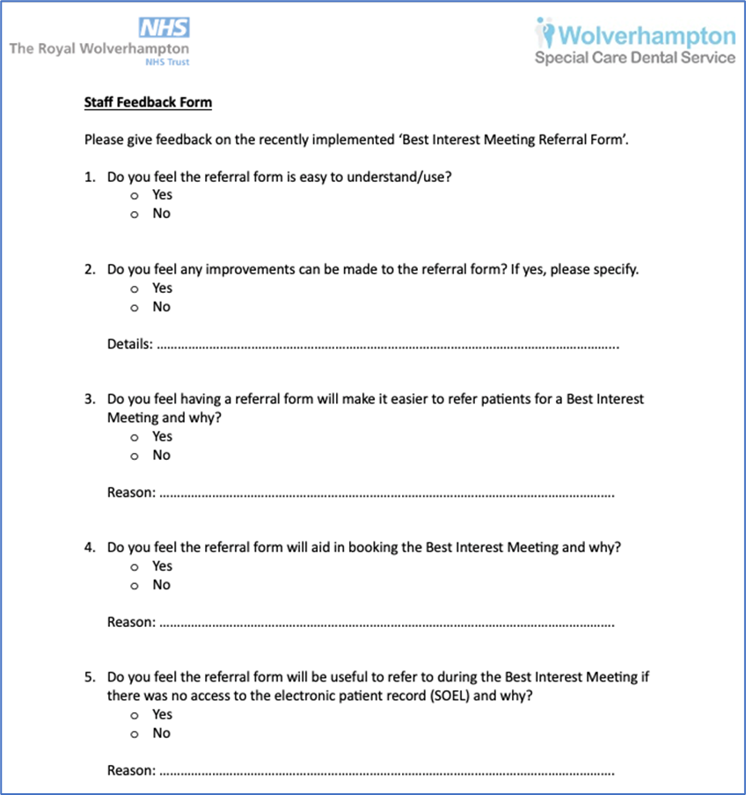


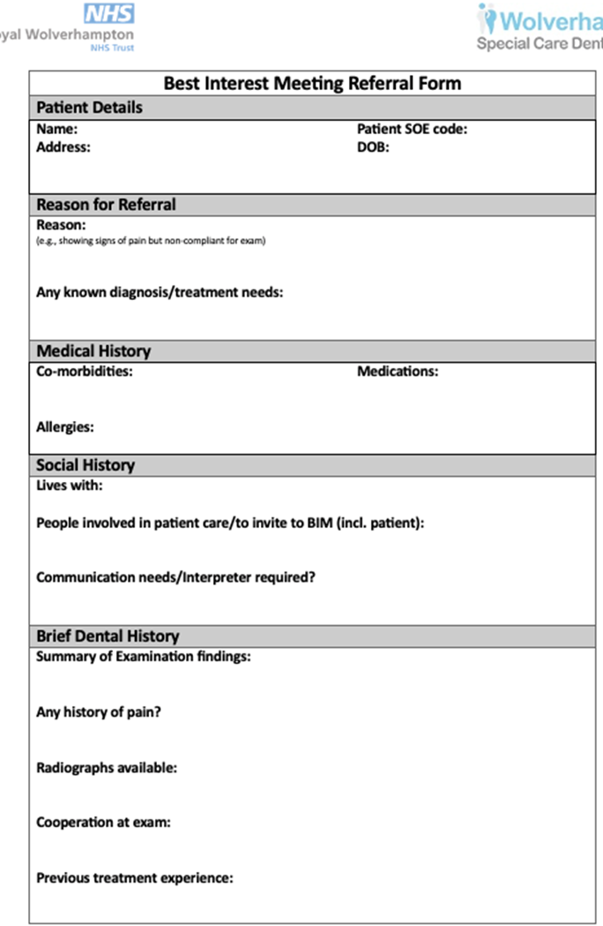
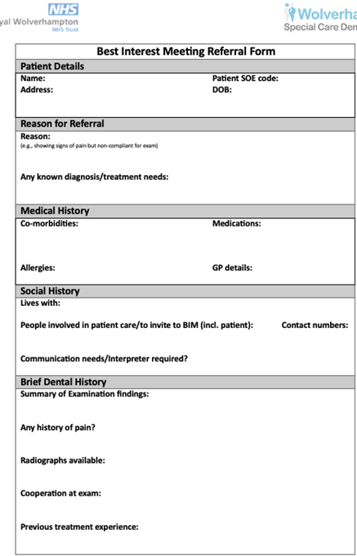



A24-070
Improving Treatment Referral Pathways for Patients who Lack Capacity
N. Murray (Dental Officer) , N. Ridha (Dental Core Trainee)
Wolverhampton Special Care Dental Service
When an adult is deemed to lack capacity under the Mental Capacity Act,
a decision about their dental treatment must be
made in the patients’ best interests.
The patient is referred in-house via email to the
Clinical Lead for a Best Interest Meeting (BIM).
Problems have been identified with this process,
causing the department to late cancel BIMs, leading
to wasted clinical time and delaying patient care.
All clinicians involved in referring patients and/or carrying our Best Interest Meetings were invited to complete a feedback questionnaire (Fig. 2).
Background
“Meeting runs more smoothly”
“Clear and concise”
“Makes the process more streamlined”
“Brilliant idea to aid communication”
To reduce the cancellation rate of the Best Interest Meeting appointments from 16% to 8% by November 2024.
To reduce wasted clinical time for patients who lack capacity and require Best Interest decision.
Aims
“All relevant info visible”
“Patients booked in terms of clinical need”
Figure 2. Staff Feedback Form
Methodology
Root cause analysis
BIM requiring late cancellation due to lack of information about the patient’s social history and therefore the appropriate people not being invited to the meeting.
No access to the electronic patient record during the meeting, therefore the reason for referral and clinical history was not to hand during the meeting.
Lack of standardisation of information provided in the referral.
Potential for poor quality referrals.
Baseline measurements
Retrospective analysis of clinic diaries over the 12-month period (Oct 22/23).
84% appointments were attended.
16% required late cancellation due to the following reasons:
  Patient required a domiciliary visit instead
  Patients family/support workers not made aware of the meeting
This equated to 5 hours of wasted clinical time
Figure 1. Best Interest Meeting Referral Form
Figure 3. Amended Referral Form following Staff Feedback
The Clinical Lead agreed the referral form will replace the current system.
Since November 2023 the department did not need to cancel any BIMs
– 100% appointments were attended, and no clinical time was wasted.
The referral form has proved to be user friendly, therefore we are confident the intervention will be sustained.
This has led to an improvement in patient care, better utilisation of clinical time and therefore the process is more cost effective.
Conclusion – Handover & Sustainability
Proposed intervention
A referral form was created to replace the current referral process (Fig. 1).
Pilot and Implementation
This was trialled on Best Interest Meetings carried out in October 2023.
The referral form received extremely positive feedback from the clinicians using it to refer patients, and the team involved in receiving the referrals.
References
General Dental Council (n.d.). Special Care Dentistry. [online] General Dental Council.
Department for Constitutional Affairs (2007). Code of Practice Mental Capacity Act 2005.
3. British Medical Association (2019). Best Interests decision- Making for Adults Who Lack Capacity a Toolkit for Doctors Working in England and Wales British Medical Association Best Interests decision-making for Adults Who Lack Capacity a Toolkit for Doctors Working in England and Wales Acknowledgements.
Mental capacity, digital image, accessed 5 June 2024, <https://mental-capacity.co.uk/capacity-and-consent/>.

