Slide 1
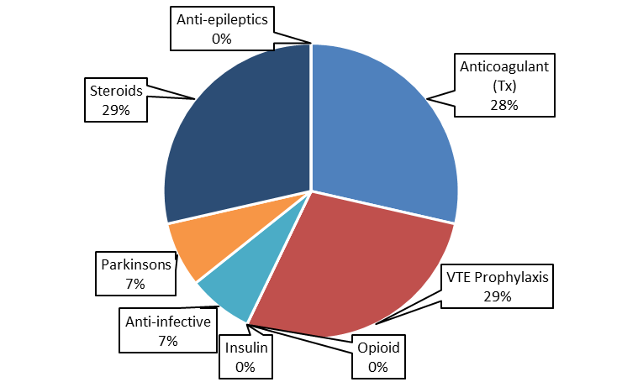
A24-066
Omitted Doses Audit 2024 - Elderly Care
Sweta Bhimani / Clinical Pharmacist
Jasmine Kandola / Lead Pharmacist - Education & Training
Background
Omitted or delayed doses have the potential to cause harm to patients and are considered to be medication errors¹ and may contribute to increased morbidity and length of hospital stay. The Walsall Manor Hospital (WMH) incident reporting system, SafeGuard, revealed that medication errors accounted for 12.0% of all incidents reported in 2023.² Of the 12.0% medication-related incidents at WMH, 26.7% were attributed to dose omissions or delays.²
Method
The audit was conducted on the Elderly Care wards (Wards 1-4) at WMH, in January 2024. Only medications that were prescribed regularly were reviewed. The data collected included information regarding any medication dose omissions that occurred in the preceding 7 days. This included the name of the critical/non-critical medication that was omitted, reason for omission, as well as number of doses omitted. For the purpose of this audit, we defined an omitted dose as failure to administer a dose of medication before the next dose is due.³
Audit Criteria and Standards
100% of patients did not experience a critical medication dose omission
100% of all medication dose omissions were due to a valid reason i.e., a clinical reason or patient refusal
100% of omitted doses were coded on the drug chart with regards to reason for omission
Results and Discussion
Interventions following 2023 audit
33 drug charts were reviewed. 91% (30/33) of the patients had an omitted dose in the preceding 7 days, with a total 230 doses omitted. Critical medications were omitted for 11 (37%) of the patients that had a dose omission and constituted 8% (18/230) of all omitted doses, which represents a 71% compliance to Standard 1. Medications for VTE prophylaxis, anticoagulants and steroids were the most commonly omitted critical medications. 40% (91/230) and 18% (41/230) of omissions were due to a valid clinical reason and patient refusal, respectively, likely due to the nature of the elderly population, especially with patients being on numerous medications. This represents an overall compliance of 69% to Standard 2.
Only 1 (0%) omitted dose did not have a code indicated on the drug chart with regards to reason for omission, representing 100% compliance to Standard 3.
1. Audit feedback was provided to the respective ward teams in real time so that any ongoing issues that could have led to dose omissions were addressed in a timely manner.
2. Educated nursing staff to administer delayed doses, where appropriate, instead of omitting doses entirely, and to ensure documentation of the reasons for non-administration.
3. Ward stock lists periodically reviewed by the ward pharmacist to mitigate omitted doses due to lack of medication availability.
4. Encouraged communication within the multidisciplinary team to ensure newly prescribed medications are ordered and administered in a timely manner.
5. Medications frequently refused by patients are reviewed to encourage compliance or deprescribed if not required.
Table 1: Comparison of compliance to set standards between 2023 and 2024
 | 2023 | 2024
Standard 1 | 57% | 71%
Standard 2 | 41% | 69%
Standard 3 | 81% | 100%
Conclusion
The results of this audit revealed that standard 3 was achieved. While the set standards 1 and 2 have not been met, there has certainly been a significant improvement since the last audit in 2023. However, further interventions are required in order to further improve future outcomes.
Figure 1: Omitted doses by critical drug class in the elderly wards.
Pharmacy Department
1.Coleman JJ, Hodson J, Brooks HL, Rosser D. Missed medication doses in hospitalised patients: a descriptive account of quality improvement measures and time series analysis. Int J Qual Health Care [Internet]. 2013;25(5):564–72. Available from: http://dx.doi.org/10.1093/intqhc/mzt044
2. Walsall Manor Hospital, SafeGuard Incident and Risk Management System.
3. Keers RN, Hann M, Alshehri GH, Bennett K, Miller J, Prescott L, et al. Prevalence, nature and predictors of omitted medication doses in mental health hospitals: A multi-centre study. PLoS One [Internet]. 2020;15(2):e0228868. Available from: http://dx.doi.org/10.1371/journal.pone.0228868

