Slide 1
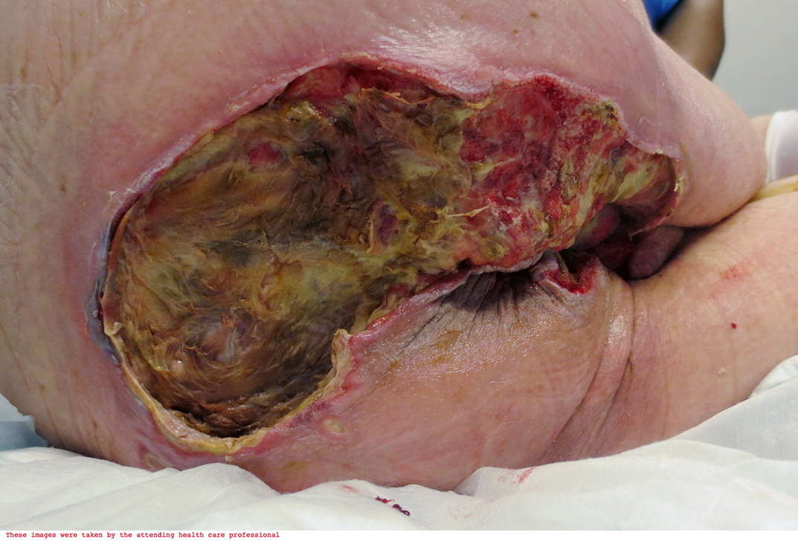
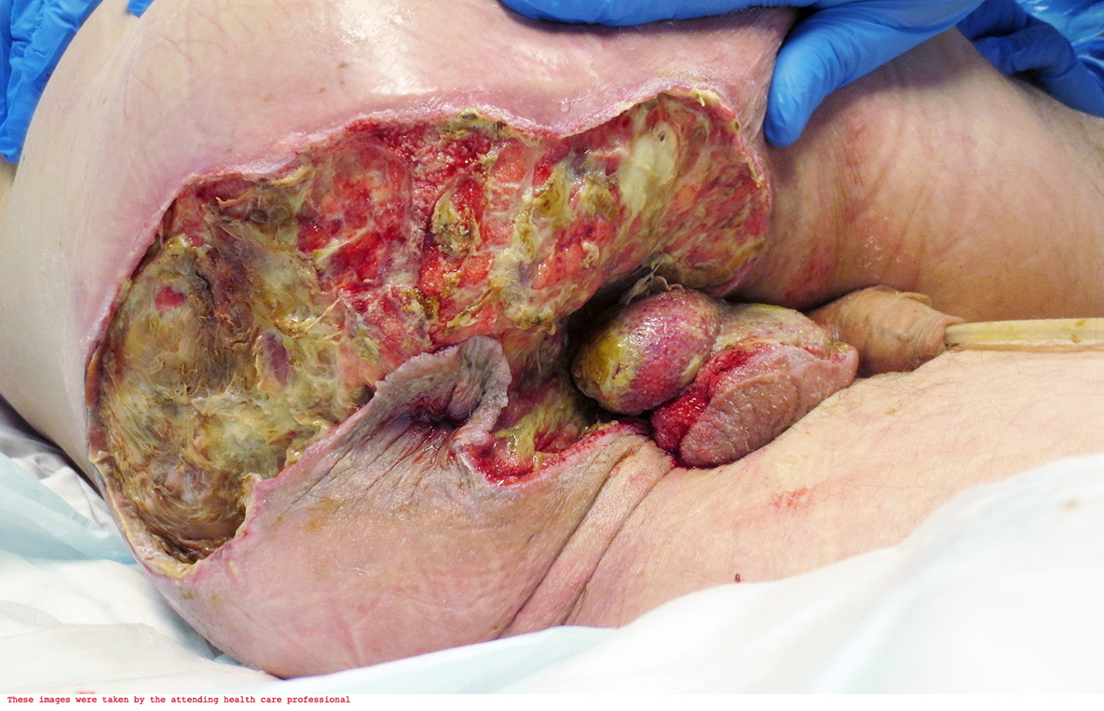
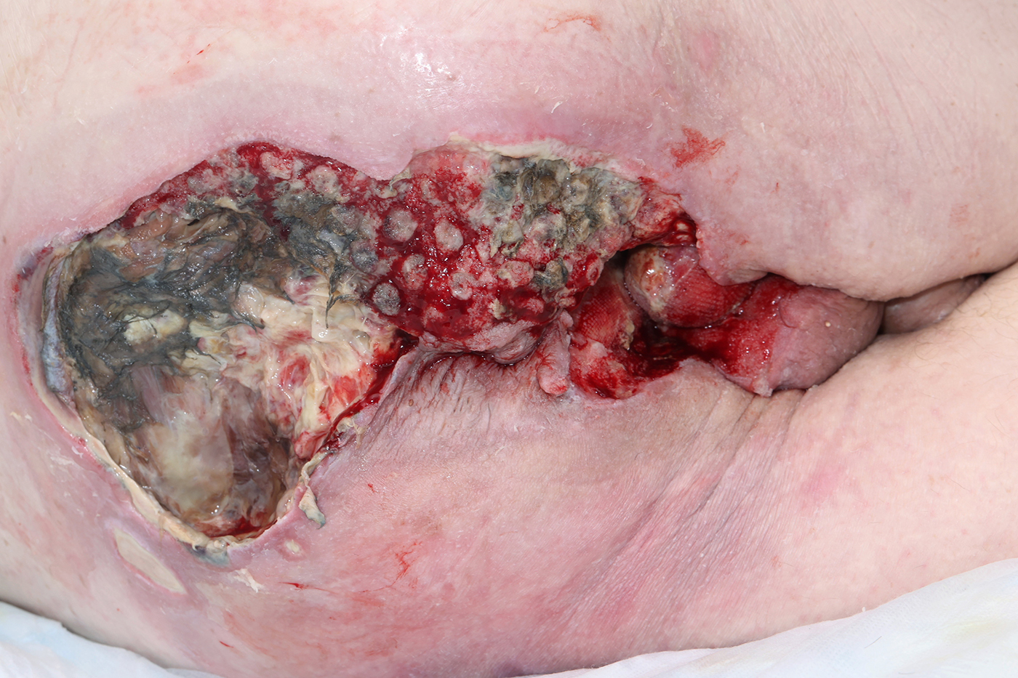
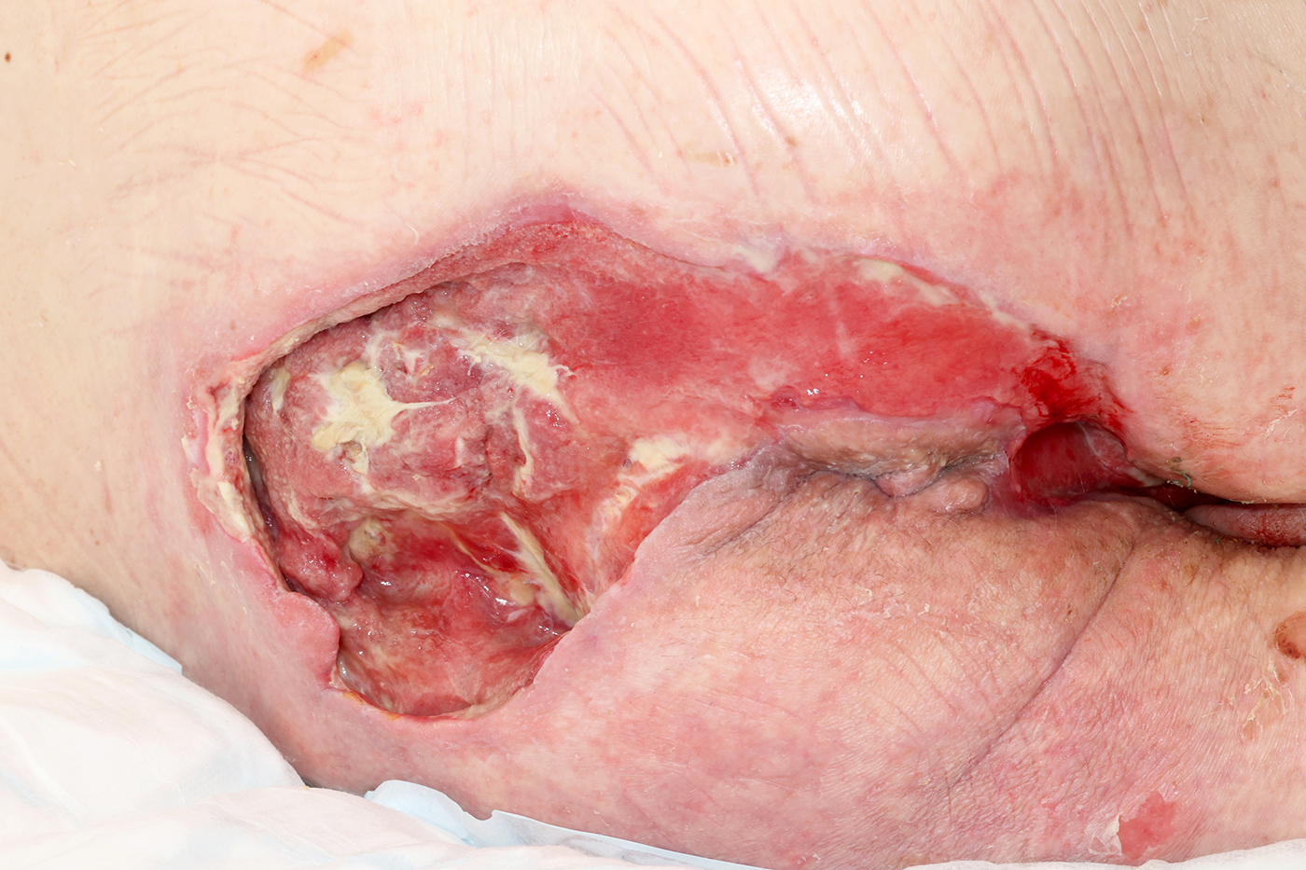
A24-065
Advanced Wound Care for a Patient With Fournier's Gangrene.
Clare Baker – Tissue Viability Nurse
Fournier gangrene is a type of necrotizing fasciitis or gangrene affecting the external genitalia or perineum. It commonly occurs in older men, but it can also occur both in women and children and in people with diabetes or alcoholism or those who are immunocompromised. FG is a rare but rapidly progressive disease with a high mortality rate. It is a surgical emergency which requires early recognition and management.
Background:
56 year old man, T2DM (poorly controlled) Patient admitted to hospital following investigation for perianal abscess, test results showed Fournier’s Gangrene to entire sacrum, perineum, right and left groins and both testicles. The patient underwent numerous surgical debridement procedure to remove infected tissue, resulting in full debridement to bone and underlying structures.
There has been an increase in the number of cases – Despite advanced management, mortality is still high and average 20-30%
Management and Outcomes:
Due to complexity of the wound and the patients medical conditions fluctuating due to the infections within the wound bed and the poor prognosis following the long admission time, The TVN team attended theatre during the debridement process to commence and teach the staff the application process of NPWT dressings. The TVN team also attended the wards thereafter to continue with this wound care.
Throughout the care the TVN recognised the importance of a holistic approach to wound care and to supporting any challenges that arose during the ongoing wound healing process. A collaborative approach with the multidisciplinary team, including the surgical consultant, ward staff, plastic team and physio team enabled optimum patient comfort and experience during his admission.
Patient Feedback: ‘Grateful for the repour built between me and the Tissue viability nurses, and for the wound care to enable me to go home and continue with a normal life’. I can now walk again which I never thought was possible, And I can now walk my daughter in law down the isle for er wedding as promised.
Figure 1 Figure 2: Figure 3 Figure 4
Department:
Tissue Viability Team

