Slide 1
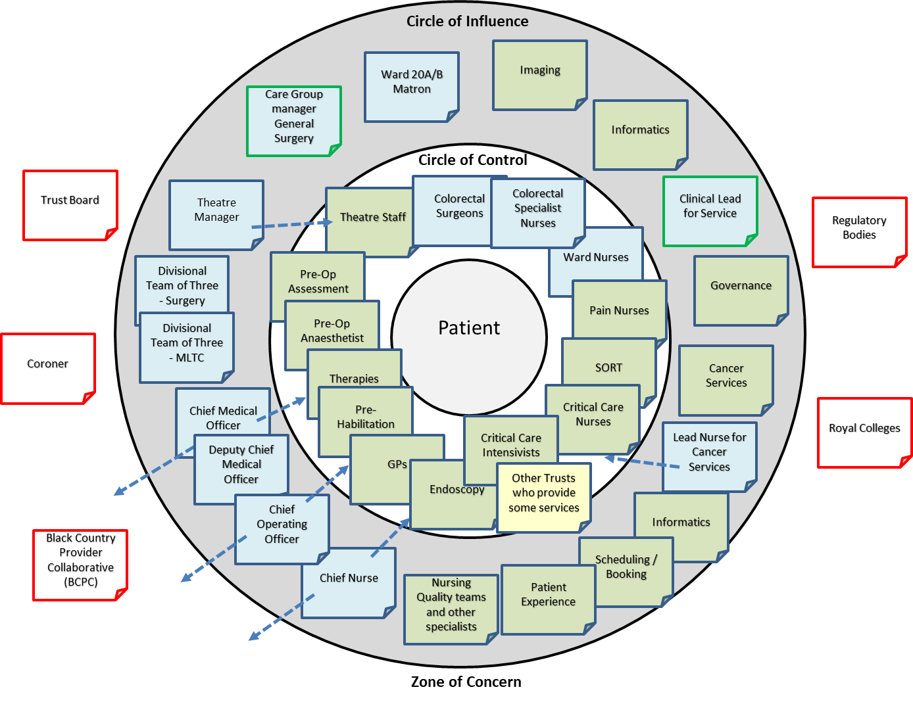
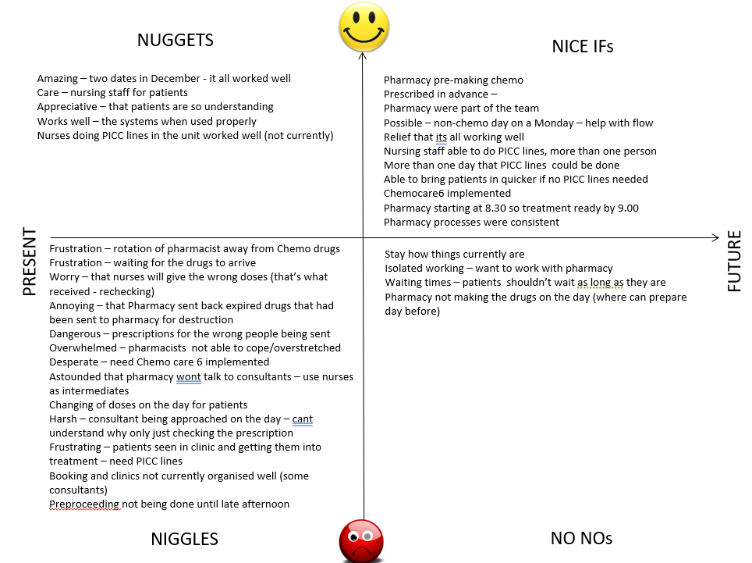
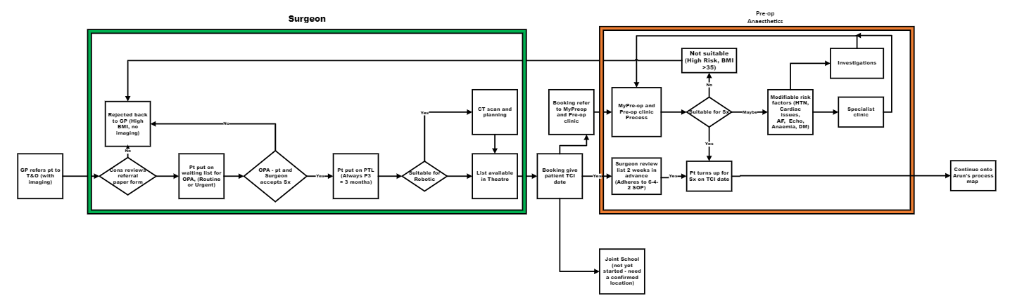
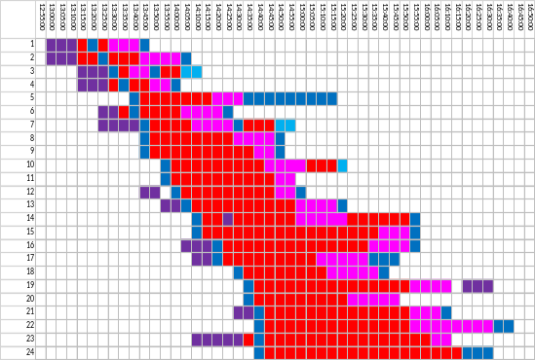
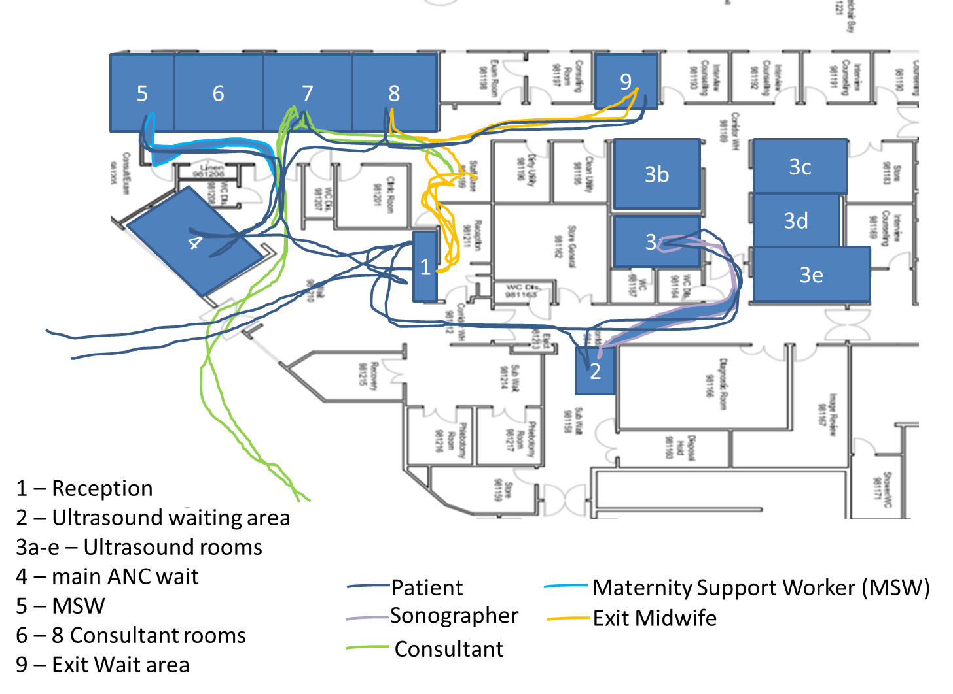
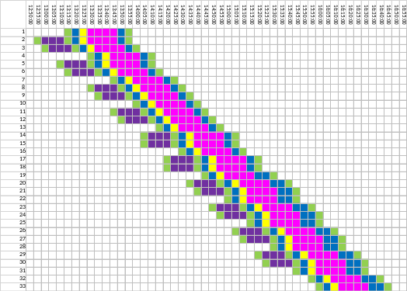
A24–064
Making Invisible Activity Visible - Mapping
Joyce Bradley,
Head of Quality Improvement
Background: Across all services in the NHS there are activities which take place that are not captured by metrics or reported on. To make improvement in any service you need to understand the current condition and what is actually happening, what is in place that enables the service as it is to deliver the results that it does.
This poster aims to show the benefit of using QI methodology to make those steps or movements through a service visible. Once the steps are visible then any duplicate, unnecessary, obsolete or outdated steps can be removed.
Mapping: There are a number of different types of
mapping which can be used to identify areas for
improvement:-
1. Stakeholder Maps – who to get involved
2. 4N Chart – maps the problems in an area
3. Process Maps – the steps that take place
4. Spaghetti Maps – the flow of work in an area
5. Process Templates – that align the steps over time
Figure 1
Stakeholder Map (Figure 1):
Identifying who needs to be involved in any changes that are planned. This type shows the circles of Control, Influence and the Zone of Concern for Colorectal cancer.
4N Chart (Figure 2): a mechanism for gathering what currently isn’t working well (Niggles), what is currently working well and you want to keep (Nuggets), what you do not want to have in the future (NoNos) and what you would like to have moving forwards (Nice Ifs). This makes visible the challenges which are being experienced and the aims for an area. The example given is from the Chemotherapy unit.
Figure 2
Process Map (Figure 3): Processes in healthcare are generally invisible except to the patients and people working within them. Some steps become so automatically that colleagues when asked what they do, they don’t mention them. Figure 3 is a high-level process map of the elective joint replacement from referral by GP to Pre-op assessment.
Spaghetti Diagram (Figure 5): Spaghetti Diagrams show the movement of people or equipment around a department. This helps to see the footfall through an area and whether the layout enables a smooth flow or hinders the work that is being undertaken in that area.
Figure 3
Figure 5a
Process Templates (Figure 5a and 5b): Process templates map out what is actually happening the sequence and the time each step takes. Figure 5a show actual patient journey through an Antenatal Clinic (red is waiting) and Figure 5b the model for scheduling patients. The top one has 24 patients, and the bottom one potentially has 33 or breaks could be scheduled for the medics in the clinic for discussion on patients or well being break.
Figure 5 is a Spaghetti
Diagrams for an antenatal clinic
showing the route of the
Consultant, the sonographer
the maternity support worker
and Exit midwife and a single
Patient (blue line).
The clinic had 24 patients
being seen by 3 consultants,
3 midwives and 3 Maternity
Support workers and
4 sonographers - to show all journeys for all patients and staff in the unit wouldn’t have been possible.
Figure 5b
Figure 4
Quality Improvement Team
To make invisible activity visible there are a number of different QI tools which can be used – there are more than are showed here so if you want to show the hidden work and your not sure where to start – contact the QI Team
wht.qiteam@nhs.net

