Slide 1
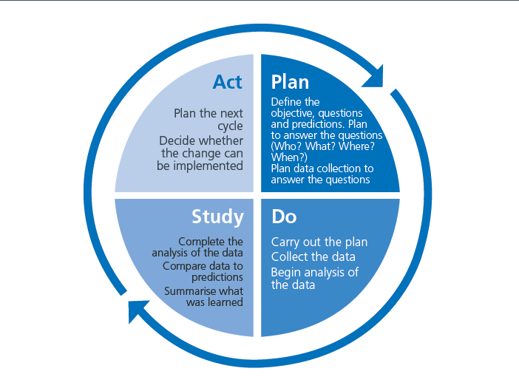

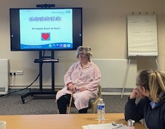
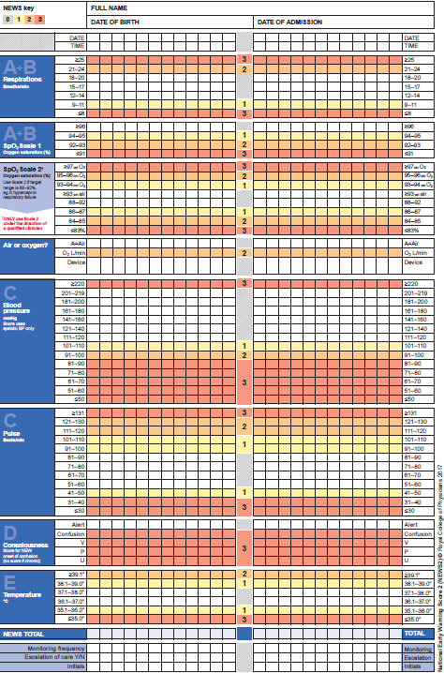
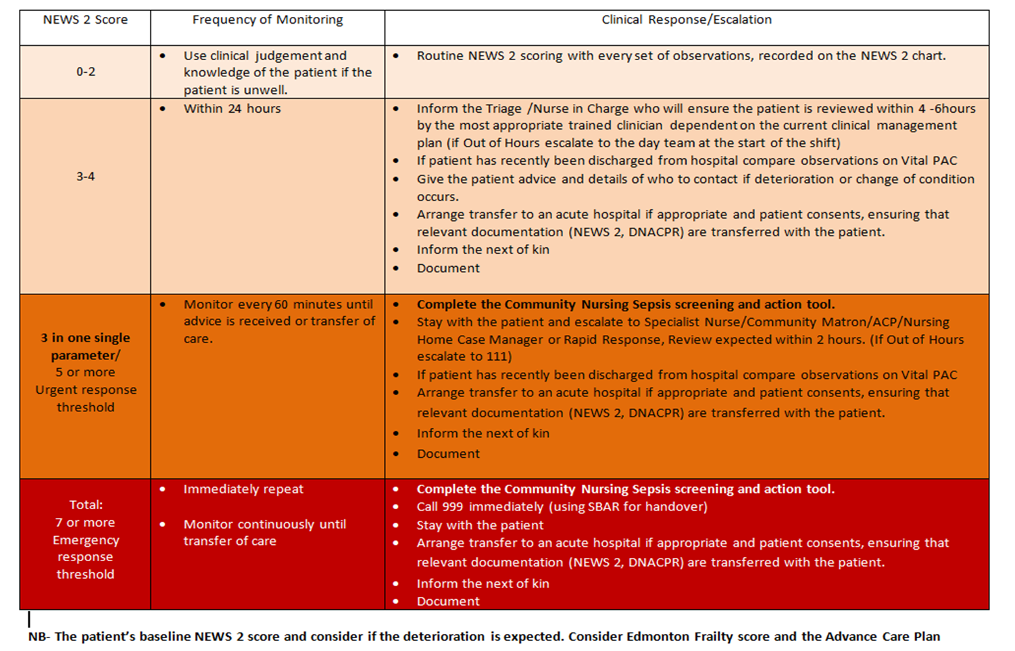
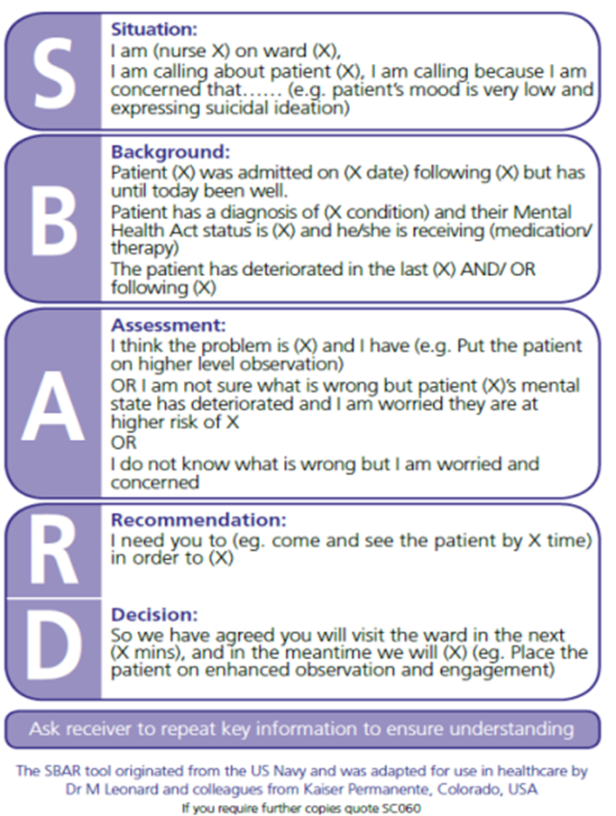

A24-063
Community Sepsis Escape Room
Community Professional Development Team
Rachel Willis, Laura Moore and Michele Willis
Introduction
Sepsis is a life-threatening condition, which is avoidable through early identification (UK Sepsis Trust, 2024).
With 70% of sepsis occurring within a primary care setting, Community Nurses play a key role to be knowledgeable and confident to escalate patients safely.
Aim
All Community Nursing New Starters will have improved knowledge and confidence in Community Sepsis Recognition and Escalation Process by engaging within a 1-hour immersive Sepsis Escape Room.
QI Methodology
Drivers for Change
All Community Nursing New Starters will have improved knowledge and confidence in Community Sepsis Recognition and Escalation Process by engaging within a 1-hour immersive Sepsis Escape Room.
To reduce unnecessary hospital avoidance
To ensure that patients are cared for at the right place, by the right clinician at the right time.
NHS Long Term Plan (2019)
The UK Sepsis Trust Guidance
To support nurses to build their confidence and skills in a range of situations, including some they may not encounter frequently in practice.
Nursing and Midwifery Council (2023) Simulated Practice Learning
PDSA Cycle (NHS England and NHS Improvement, 2021)
Plan:
Assess Community Nurse Sepsis education drivers for change
Research simulation and gamification escape rooms learning methodologies to create a fun and engaging way of learning to build confidence. This is a new methodology used in nurse education
Baseline audit for Community New Starter confidence and knowledge using pre and post questionnaire and create evaluation session QR Code to collate data
Create Sepsis Escape Room and all three PDU educators to participate: The patient (Mrs Willis), the niece and facilitator of the Sepsis Escape Room.
Create a teaching plan, immersive activities and collate equipment including lock box, nurses' case and prizes!
Plan to pilot Escape Room with a Community Nursing New Starter Group.
Do:
Ask to perform pre-questionnaire and post questionnaire (same as the prequestionnaire to ensure fair data comparison and to measure if confidence and knowledge have improved.
Undertake the Sepsis Escape Room using the lesson plan.
Staff were able to ask questions at every stage to understand and ensure correct understanding.
Ask Community Nursing New Starters to complete the QR Session Evaluation containing questionnaire
Study:
Comparing the data post collation measured the confidence and knowledge levels of staff. 100% knowledge and confidence improvement in every question was observed, which exceeded our expectations for the first pilot.
Act:
Changes made instead of facilitator being paramedic, the family member became this role. One unexpected find was that there were new starters that have never rang a paramedic before. By facilitating this change enabled the facilitator to support the staff member with how to do this element of the Sepsis Escape Room when repeating the next PDSA cycle.
This PDSA cycle has now repeated successfully performing this 9 more times successfully. 75 staff completing this Sepsis Escape Room all with 100% knowledge and confidence improvement scores and all excellent scores and feedback.
This effective nurse education methodology has been very effective to support recognition of sepsis, safe escalation of patients and improved staff confidence and knowledge within a safe, fun and engaging learning environment.
Pre learning responses suggest that there are areas that staff lack knowledge and confidence in. This was in line with our expectations.
Introducing Mrs Willis and The Community Sepsis Escape Room
Very interactive session which allowed me to have a greater knowledge into sepsis and how to manage and recognise a deterioration in a septic patient
Really useful session the as it reinforced the signs and symptoms and how to communicate with the patients and carers to gain information.
I am now able to spot the signs and symptoms of sepsis and can escalate appropriately
Can you help Mrs. Willis escape from The Community Sepsis Escape Room?
With special thanks and consent form the UK Sepsis Trust for sharing Sepsis Awareness Education Information with Walsall Healthcare NHS Trust.

