Slide 1
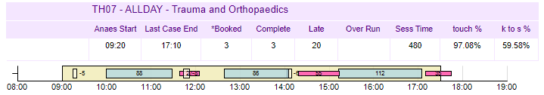
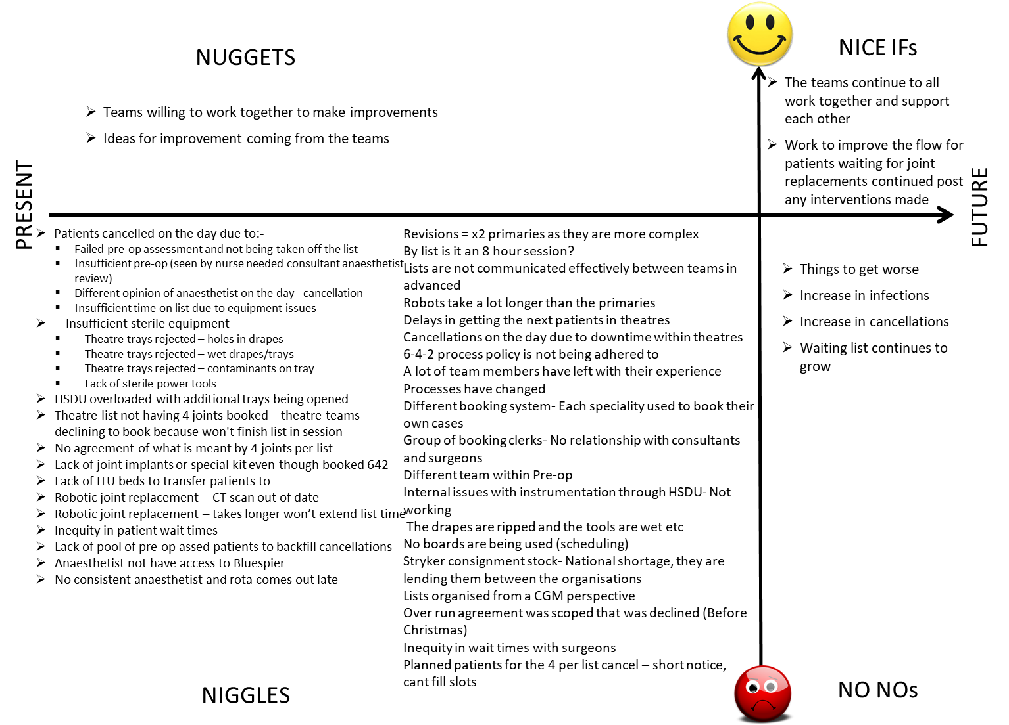
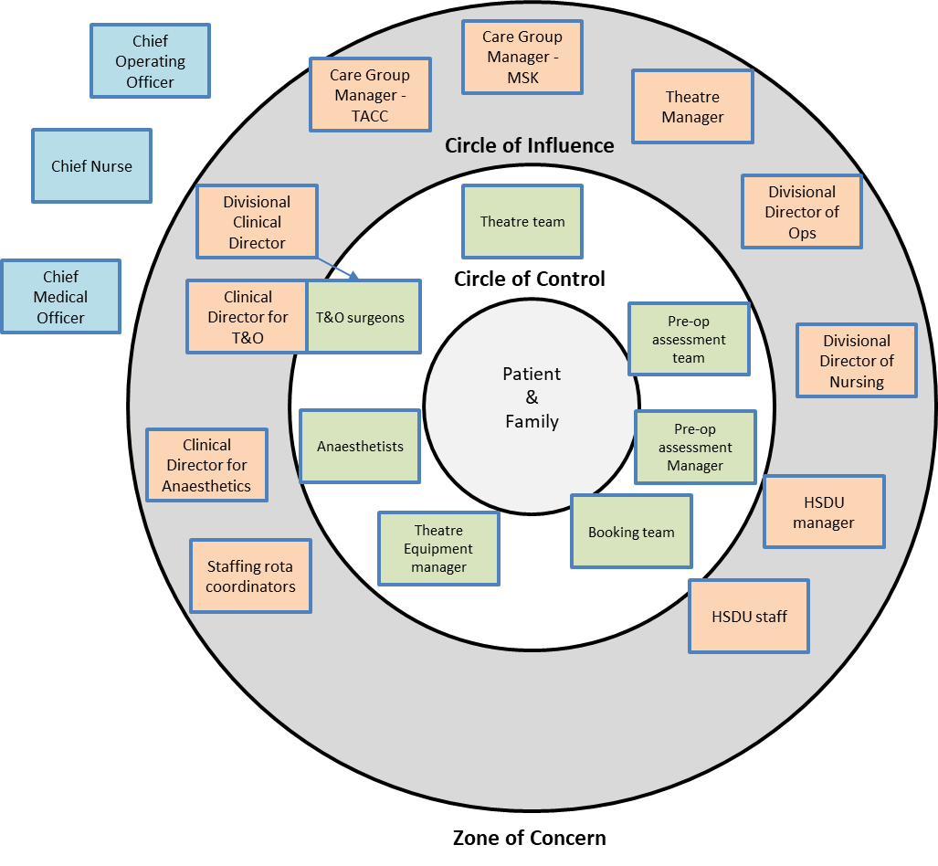
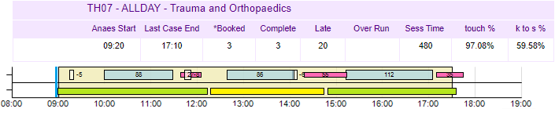
A24–062
Observations of an all-Day T&O Lower Limb
Replacement theatre List
Joyce Bradley,
Head of Quality Improvement
Aim: To consistently have 4 primary lower limb (hip or knee) replacements on an all day (8 hours) theatre session.
Background: Prior to COVID19 the Trauma & Orthopedic (T&O), elective lower limb replacement theatre sessions were gearing up to have 4 joints routinely listed. Work had been done to ensure that appropriate anesthetics were being used, physiotherapy post-operative support was available and Joint School had taken place in advance. During COVID19 elective surgery was significantly reduced and the teams of people who worked closely together on joint replacements were affected. Consistent team members make running theatre more efficient and safer.
In 2017 our current Head of QI was working on the Theatre Improvement Programme and helped to establish the theatre reports on the Information Hub. Figure 1 shows the data captured from the systems in theatres to show what work is being done during the sessions.
Figure 1:
Theatre List
Figure 1: Theatre List – Lower Limb replacement
Cream box – theatre session 09.00 – 17:30
White box – Anesthesia time (i.e. 5)
Blue box – Surgical time (i.e. 88)
Red box – time in recovery
Anaesthesia and Recovery are undertaken in different areas (anaesthetic room or the recovery ward) and can overlap with the previous patient because of that.
Process: The Head of QI was asked to support a QI project to increase the number of primary lower limb replacements on a T&O full day list to 4. The first thing that was undertaken was development of a Stakeholder map (Figure 2). Getting all of the stakeholders together in one room was initially difficult and separate conversations were had where a 4N chart was developed (Figure 3). This identified a lot of
areas which need to be improved and some key areas where the teams could and already did work together.
Figure 3:
4N Chart
4N Chart is a mechanism for gathering what currently isn’t working well (Niggles), what is currently working well, and you want to keep (Nuggets), what you do not want to have in the future (NoNos) and what you would like to have moving forwards (Nice Ifs).
As a QI tools it allows teams to air all the frustrations that they are experiencing and look at the positives. There were an extensive list of Niggles and some great “Nuggets” and “Nice Ifs”.
Figure 2:
Stakeholder
map
Nice Ifs (in the future):
Teams continue to all work together and support each other.
Work to improve the flow for patients waiting for joint replacements continue post any interventions made
Observation: The Head of QI was asked to come to theatre to see what happens. This was a first for them and they agreed to observe an all-day list. Three patients were listed, and 3 patients received their joint replacements. What became apparent was the amount of work that the Scrub nurse and the ODPs do to support the surgical team – activity which is not captured on the metrics being reported. Figure 4 shows the time that the Scrub Nurse and ODPs are undertaking activities. (Blue Line Team Brief, Green box Scrub Nurse 1, Yellow Scrub Nurse 2).
Nuggets (Now):
Teams are willing to work together to make Improvements
Ideas for improvement coming from the teams
Invisible activity:
“Not everything that counts can be counted”
Albert Einstein
The work that the Scrub Nurse and ODPs do is not
formally recorded on the theatre systems. When looking
to increase utilization of a theatre session all the work
undertaken within the session needs to be considered
and at the moment that work is invisible. The apparent
gaps between procedures includes time for cleaning
the theatre, removing the used theatre trays and bringing the kit required for the next patient through.
There is a lack of understanding across the full theatre team of what work is being done and arduous some of that is (the theatre kit trays are heavy and 9 - 11 were needed for each patient, plus a significant number of single use items.
Figure 4:
Showing Activity of Scrub Nurse & ODPs
Next Steps: In conversation with the different stakeholders a number of them were keen to say what other stakeholders should do to improve things. QI is about enabling the people within a service to make changes in their own area and the next step is to have a wider conversation where stakeholders identify what they can do with the elements within their remit to change.
Quality Improvement Team
Acknowledgements:
My thanks to the theatre team in Theatre 7 at Walsall Healthcare NHS Trust for allowing me to observe the astoundingly technical work that takes place in a T&O theatre – the sheer amount of things you know and have to do is awe inspiring.

