Slide 1
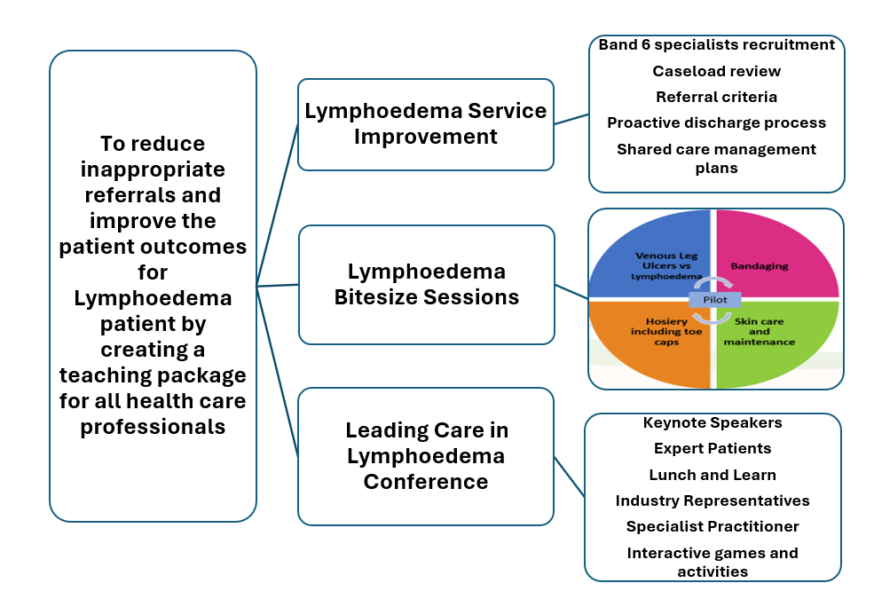
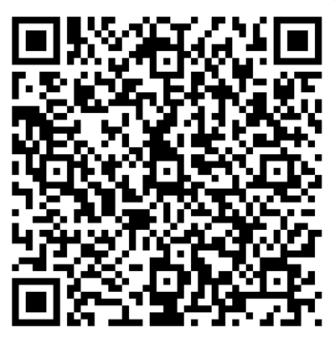
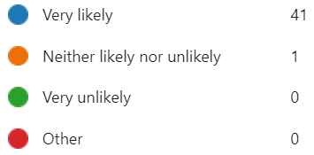
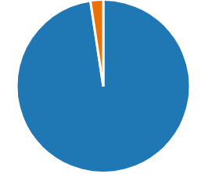
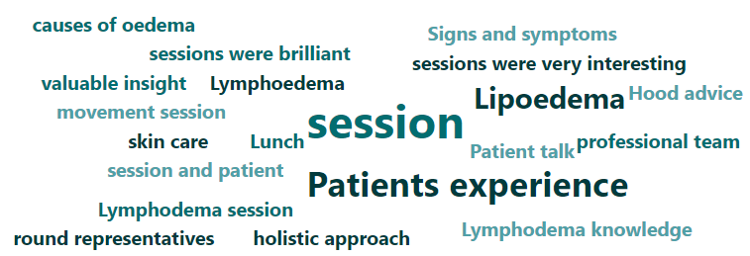

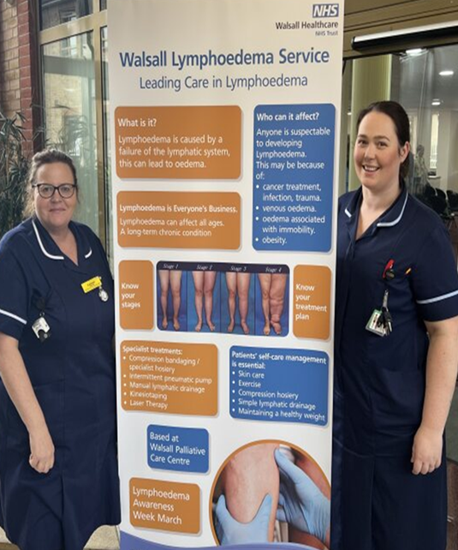
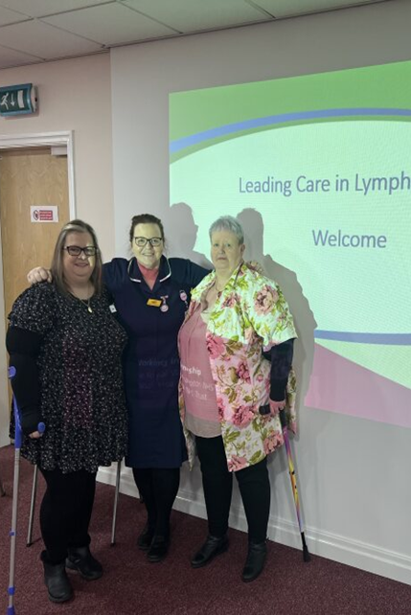
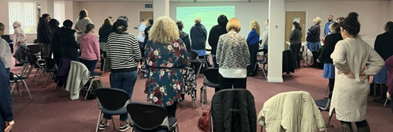
A24-061
Leading Care in Lymphoedema
Louise Rooney, Amy Bevan, Sylvia Ryder,
Rachel Willis and Laura Moore
“ Lymphoedema is a chronic inflammatory condition in which a part of the lymphatic drainage system fails to work effectively.” British Lymphology Society (2024)
Abstract
Walsall Lymphoedema Service was facing challenges to meet the increasing demands to provide high quality care. Demand and capacity was no longer equitable for the service needs, due to the increased referrals.
Wider knowledge and experience within the Community Division had also reduced, significantly impacting on staff’s understanding, confidence and management of Lymphoedema.
Stakeholder Engagement – Patient experts, community nurses, industry partners, community management team, neighbouring Trust:
Regular meetings were held to engage with proposed plan and at each stage of the PDSA Cycle.
Lymphoedema Service Improvement:
A task and finish group mapped the priorities to drive forward the service improvement. The initial focus was on MDT education to reduce inappropriate referrals and improve the patient outcomes for Lymphoedema.
Lymphoedema Bitesize Sessions:
The West community locality team were the pilot group for the bite sized education sessions focussing on four key areas. These 15-minute sessions were delivered every Thursday for four weeks. Quantitative and qualitative feedback was gathered post education.
Leading Care in Lymphoedema Conference:
This interactive conference was offered to all practitioners who wanted to improve understanding, confidence and management of Lymphoedema.
The content of the day included:-
What is Lymphoedema?
Benefit of Exercise and Movement
Lipoedema and Empowering Patients
How to recognise Lymphoedema and Bandages vs Wraps vs Hosiery
Complications in Lymphoedema: Cellulitis management and circulatory warning signs
Lymphoedema Patient Experiences
Lunch and Learn
Break out afternoon
Post Conference Feedback - was supplemented with qualitative data
Able to ask simple questions, answers were explained well
The bite size sessions were helpful because there was no information overload, and it will be helpful to have brochures to take home to read
Very Helpful, gave more insight into Lymphoedema
Very informative
It is always helpful
Future Steps and learning
Roll out bitesize sessions across all locality areas
Measure referral rates and appropriateness of referrals to the Walsall Lymphoedema Service.
To gather richer quantitative data for bitesize sessions and encourage feedback.
To create a digital Lymphoedema Education Toolkit
To replicate the Leading Care in Lymphoedema Conference
Leading Care in Lymphoedema Task and Finish Group would like to thank:
David Lloyd Jones (Midlands Partnership Trust), Kris Jones (Lymph Care UK), expert patients, Kitty Dhingra (Antimicrobial Stewardship Pharmacist), L&R, JOBST, Dermal, 3M. Fiona Smith (Vascular CNS), Annette Hayward (Podiatrist). Community wider management team -Kelly Geffen, Sally Killian, Sara Morley and Sindy Dhallu

