Slide 1
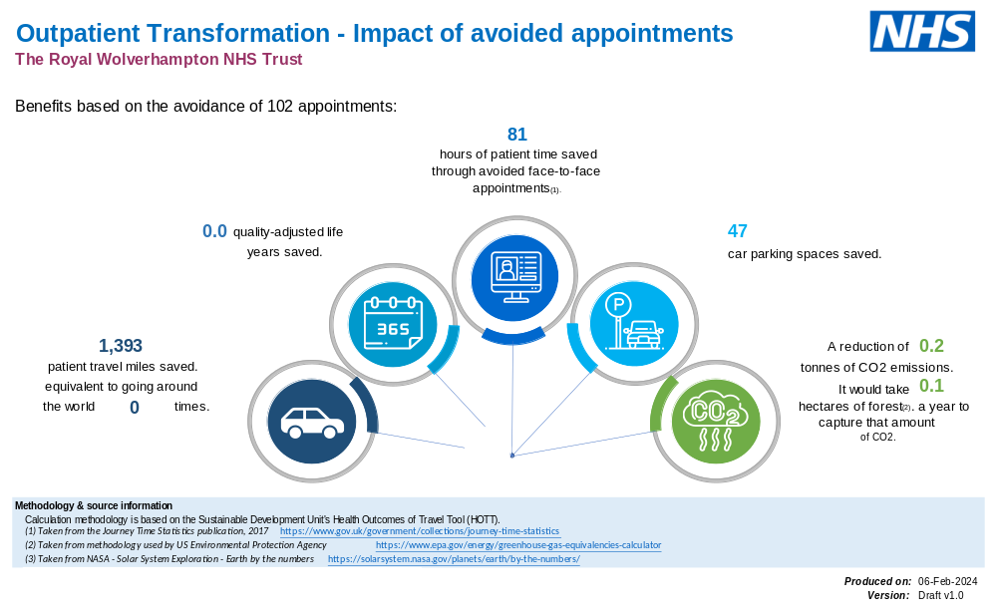
A24-060
The Environmental & Patient Care Impact of Telephone Consultations
Asad Atiq BMedSci / Highly Specialised Orthoptist
Introduction
Aims
In response to the NHS target of becoming carbon neutral by 2040, the orthoptic department initiated our sustainability drive. As part of this initiative, we introduced telephone consultations for all new referrals of children with special and complex needs.
To reduce hospital visits for children who are likely to have regular hospital visits.
To improve the parent/care giver experience.
To reduce our carbon footprint.
Method
The telephone consultation service started in May 2023. A retrospective evaluation of 206 patient records was carried out. Which consisted of:
119 patients who had a telephone consultation as their first appointment
87 patients who had an initial face-to-face appointment.
The data was from 01/05/2022 to the 30/10/2023.
Results
Discussion & Conclusion
The telephone consultation clinics were successfully implemented and made a positive impact on both the patient care and environment. Over the same period more patients were seen on telephone clinics as less time was needed to complete telephone consultation resulting in more patients being booked into each clinic.
There were fewer missed appointments as the telephone consultations took place from 16.30pm onwards resulting in more parents being home to answer calls. Also, telephone clinics were more convenient as no travel arrangements are required. There was a smaller length of time from referral to initial appointment for patients who had a telephone consultation as there was more capacity to schedule clinics in the evening then during the day when face-to-face clinics are usually scheduled. During the period of evaluation there has been a saving of 102 face-to-face appointments, equating to 81 hours of patient time saved, 47 car parking spaces saved and a reduction of 0.2 tonnes of CO2 emissions, it would take 0.1 hectares of forest to create that much CO2.
The response from care givers has also been positive according to a survey that was conducted. We will look to expand our telephone consultations to other suitable clinics as a result.
Orthoptic Department
Ophthalmology Directorate
New Cross Hospital

