Slide 1
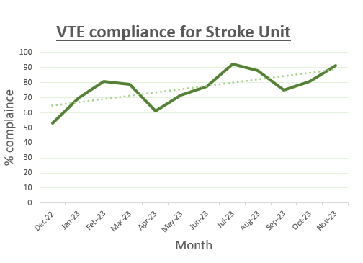
A24-059
Physician Associates in Stroke as Drivers of Local Quality Improvement
Sophie Lloyd (Physician Associate), Dr Saugata Das (Consultant Stroke Physician), Cymone Argent (Physician Associate), Tarasai Pongo (Physician Associate), Ramesh Ram (Physician Associate)
Background
Venous thromboembolism (VTE) is a preventable complication which can occur during hospital admission, in the presence of immobility, predisposing factors and thrombogenic diseases including COVID-19.¹
VTE includes deep vein thrombosis (DVT) and pulmonary embolism (PE).
VTE occurs in a triad of endothelial injury, stasis and hypercoagulability.
Early assessment of VTE risk is crucial in stroke patients due to their increased risk.¹
Timely preventative measures such as intermittent pneumatic compression device improve outcomes and reduce length of stay.²
Studies have showed that stroke patients with DVT have a poorer outcome than patients without DVT using mRS functional assessment.²
PDSA for QIP
Allocate a designated PA VTE champion weekly. Assess VTE compliance on the stroke ward 6 months prior to intervention (December 2022 - June 2023), to 6 months after intervention (June 2023 - November 2023).
To assess the VTE compliance following intervention of designated VTE champions and experienced PAs to supervise this for continuity and safety considering Stroke Directorate being flagged up as a unit with sub-optimal compliance.
To improve compliance of VTE assessment completion as part of local QI project in relation to service delivery following an earlier audit.
What previous survey information did we have?
  Among the doctors that responded, only half of doctors knew when to do the 2nd VTE assessment.
  Factors mitigating VTE assessment among the doctors included being busy and forgetfulness.
  15% of respondents felt lack of access/ inability to use VitalPac was a factor while another 15% did not prioritise it as
  being important.
VTE assessment guidance protocol for Stroke Unit
Patients must be assessed twice for VTE risk. Within 4 hours of admission and within 24 hours of admission (providing consultant has reviewed).
New admissions to the stroke unit should have 1st VTE done immediately after patient evaluation.
For admissions between 08:00-17:00 the 1st and 2nd VTE should be completed by 17:00 on the day of admission.
Prior to ward round VTE compliance should be checked or the day.
VTE champion should be allocated for the day and should supervise junior doctors for VTE assessment.
NICE guidelines ³
NICE recommends that for people who are immobile and admitted with acute stroke use of Intermittent Pneumatic Compression devices (IPCs) within the first three days.³
Methods
A weekly Physician Associate was assigned to ‘VTE Champion role’
in which the designated Physician Associate would arrive at 08:00
to check VTE compliance within the stroke ward and ensure any possible VTE assessments are completed.
VTE PA champion compiles a list of patients with no VTE prevention prescribed to ensure this is done within 24 hours of admission.
Mid-afternoon designated VTE PA Champion would check VTE compliance once again to do a ‘mop up’ round in which
outstanding VTE’s were completed.
Results
↑15%
Conclusions
Data suggests increase in average VTE compliance, between 6 months prior to intervention to 6 months after intervention of PA VTE champion, of ~ +15%.
Dip in VTE compliance in September 2023- VTE compliance was 75% corresponded to Junior Doctor and Consultant strike 19-September 2023 - 23 September 2023.
Recommendations
Responsible Doctor/ PA for patient ensures their VTE is complete – included as part of Directorate Junior Doctor champion induction by Education Lead.
VTE in morning huddle will announce outstanding VTEs so responsible doctor/PA can complete them at earliest convenience – already in practice.
VTE champion for the day will do VTE assessment prior to ward round, then continue to do a ‘mop-up’ round in the afternoon – to continue practice set up in QIP.
Increase in VTE compliance by ~+15% when designated PA VTE champion is allocated.
April 23 data suggested 60.9% compliance which had improved to 91.2% in July prompting an acknowledgement and complement from the Trust VTE Group.
References
Field, T.S. and Hill, M.D., 2012. Prevention of deep vein thrombosis and pulmonary embolism in patients with stroke. Clinical and Applied Thrombosis/Hemostasis, 18(1), pp.5-19.
De Silva, D.A., Pey, H.B., Wong, M.C., Chang, H.M. and Chen, C.P. (2006). Deep vein thrombosis following ischemic stroke among Asians. Cerebrovascular Diseases, 22(4), pp.245-250.
National Institute for Health and Care Excellence. (2019) Venous thromboembolism in over 16s: reducing the risk of hospital-acquired deep vein thrombosis or pulmonary embolism [NG89] https://www.nice.org.uk/guidance/ng89/chapter/Recommendations#interventions-for-people-with-acute-coronary-syndromes-or-acute-stroke-or-for-acutely-ill-patients

