Slide 1
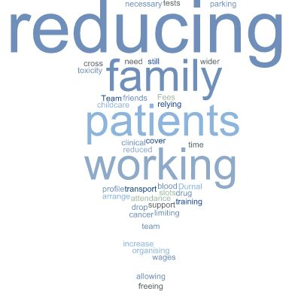
A24-058
Streamlining the Nursing Patient Pathway for Metastatic Breast Patients
Jamila Mohammed, Senior Advanced Nurse Practitioner Oncology
What Happened
In July/August 2022 the CNS team were receiving a number of phone calls from the metastatic breast patients expressing concern at the number of hospital appointments, in different oncology departments, and the added cost of parking and relying on others to bring them. During these calls they also expressed concern regarding the lack of communication between the two departments treating them (Durnall unit and Deanesly outpatients) causing unnecessary concern and delays in treatment.
Background and Research
I reviewed the pathway for metastatic breast patients undergoing dual treatment (IV/SC bisphosphonates and oral CDK46 inhibitors) and noticed:
patients were having to attend the hospital for several appointments throughout the day or week for treatment
patients were being asked to have repeated blood tests which was not required.
Implementing Changes and Outcomes
The team Identified which treatments patients were on so that their key oncology CNS visited at the same time of their Durnall appointment this would be patients having IV/SC bisphosphonates and CDK4/6 inhibitors. The teams came together and involved all stakeholders, including patients to draw a plan to reduce the number of appointments.
This was implemented on the 12th September 2022, which initially encompassed 20 patients, 7 which chose to not to change their day of treatment to be able to access their key oncology CNS specialist. Patient feedback questionnaires where completed to ensure the changes where having the desired impact and could be sustained.
By 2023 this patient cohort increase to 51 patients utilising this change in service. This service has now expanded to be over 100 patients, now attending 2 appointments instead of 4.
TOTAL NUMBER OF APPOINTMENTS SAVED SINCE 2022: 4104
Key Achievements
Saving patient attending 4 to 2 appointment per month saved:
Reducing necessary blood tests
Parking fees reduced
Reducing the organisation of transport
Relying on attendance support from family and friends
Limiting drop in wages for patients who are still working
Freeing clinical slots for other cancer patients
Reducing the need to arrange childcare and allowing more time with family
Cross cover working with Durnal Team
Increase in drug and toxicity profile training for the wider team
Oncology CNS Team
This collaborative way of working with the Durnal and CNS team has saved over 4104 appointments for metastatic breast patients on this treatment. This has also allowed the team to reinvest these appointments to supporting other cancer patients and worked towards making the service sustainable.

