Slide 1
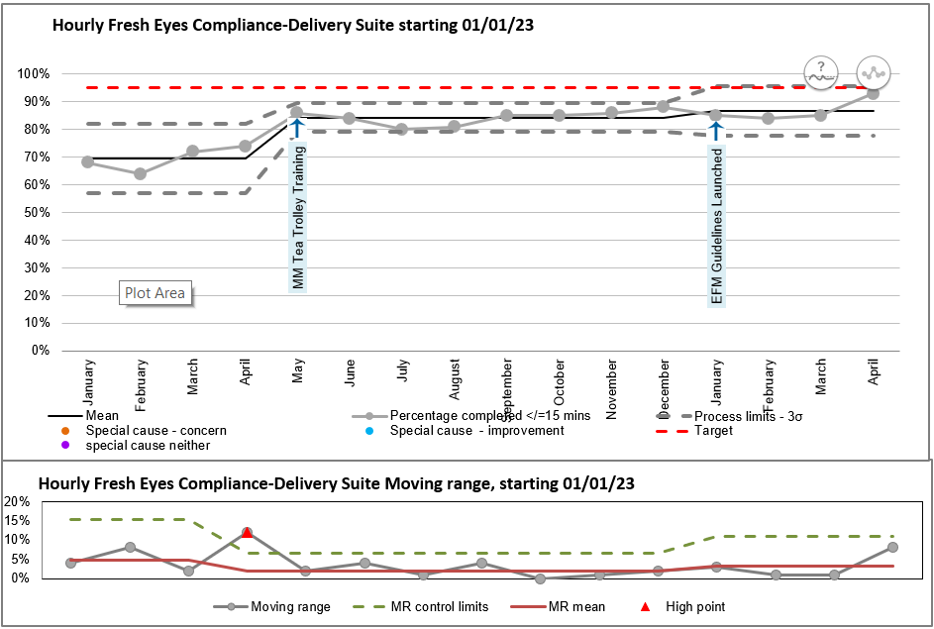
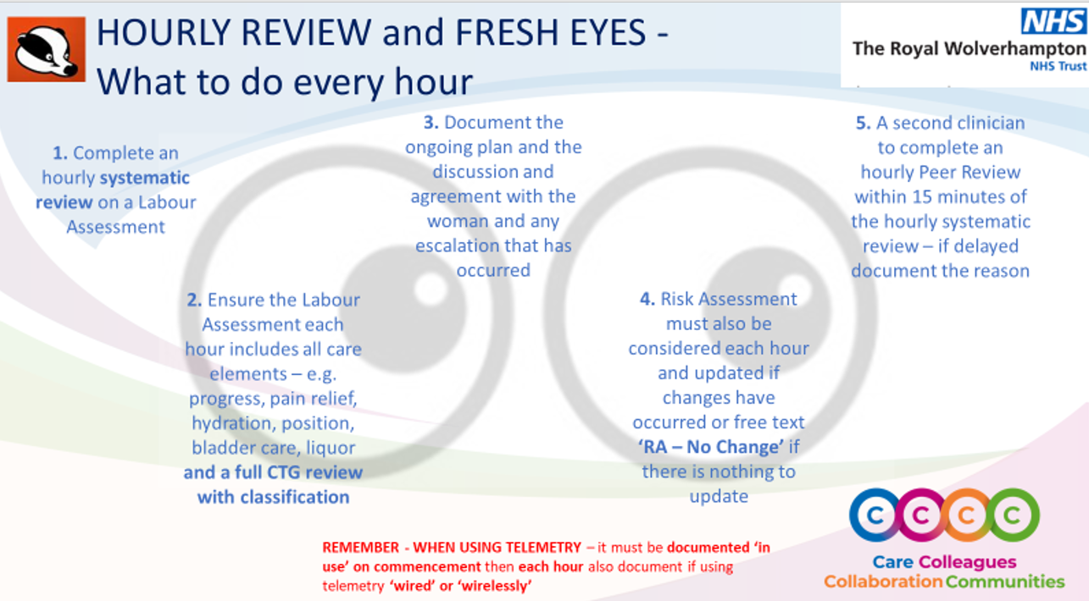
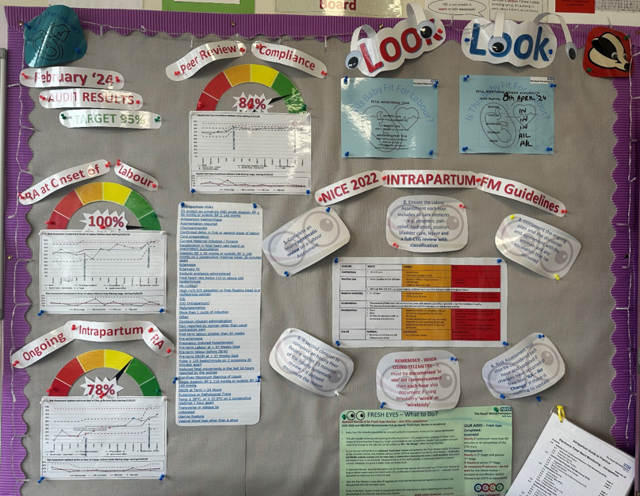
A24-056
To Improve Hourly ‘Fresh Eyes’ Compliance to 95% within 12 months as per SBLCBV3
Helen Stretton
Fetal Monitoring (FM) Lead Midwife
Summary
As part of Saving Babies Lives Care Bundle Version 3 we need to ensure a minimum standard of Hourly ‘Fresh Eyes’ reviews are maintained at a minimum standard of 80% and a stretch target of 95%
At the end of 2022 a clinical audit was commenced to assess our current situation
In January 2023 our compliance was 68% and in April 2024 our compliance has improved to 93%
1
Graphs / Charts to go here
Further Information
1
This was achieved through multiple teaching events across the intrapartum areas on what should be completed each hour to train all staff on the required standard.
Staff engagement was achieved through teaching on the monthly mandatory Fetal Monitoring study day and during tea trolley training brought to the working areas, simple tools available in all monitoring machines and a FM Board which is updated regularly.
Rotational staff have a teaching session with the FM Lead Midwife in order for them to know the standards as soon as they arrive in the intrapartum work areas.
Next Steps
Each month an MS Teams meeting is attended by the FM Midwife with all the FM Midwives nationally. Ideas are pooled together and we share good practice so we are all continuously improving our standards of care.
We are making steps to collaborate the audit process to create a standardised approach to enable benchmarking across the Trusts.
2
3
2
Photo to go here
3
Maternity Delivery Suite

