Slide 1
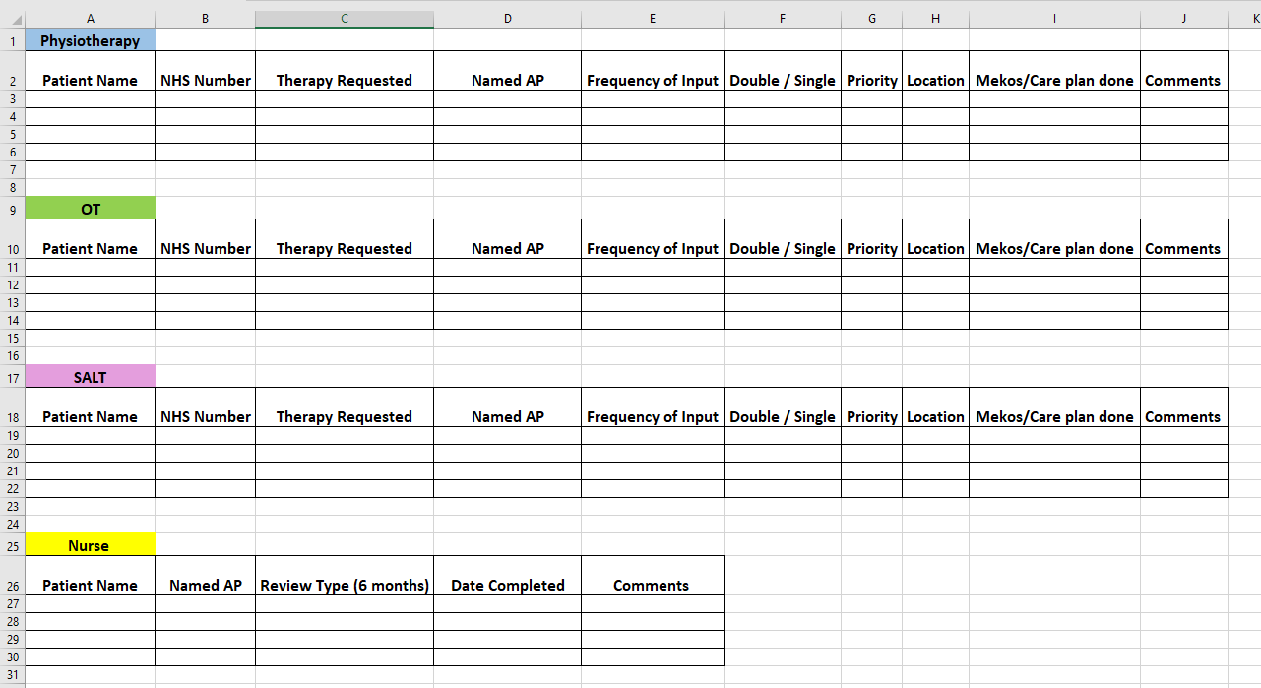
A24-053
Streamlining and standardising the AP handover process to create a more reliable system whereby competencies and confidence are supported to grow in all areas of the service.
Laura Jones (Speech and Language Therapist)
Julie Connolly (Occupational Therapist)
Clare Taylor (Stroke Liaison Nurse)
Background
Cannock Community Stroke Team identified the need to streamline and standardise the handover process from clinicians (Physio, OT, SALT, Nurse) to assistant practitioners (AP). It was recognised that staff were handing care plans over to AP’s differently, and we had no way of tracking the AP caseload as a whole. This meant tasks were at times vulnerable to being missed. We also found there was often an uneven division of support for the different disciplines, which over time could impact their competencies and confidence to support each of the disciplines.
Actions for Change
We created an AP database which allows us to track the AP caseload as a whole. This allows us to try and ensure they are supporting each discipline equally in order to keep their competencies up-to-date.
This database is brought to our weekly diary meetings to make sure service-users are appropriately prioritised and patients that require AP input are not missed. In these meetings, we discuss each service-user individually starting from high to low priority – AP’s and qualified clinicians liaise to make sure each patient is seen as per their care plan.
We also found this process to be invaluable to staff understanding of one another’s caseloads. By making this process more visible, qualified clinicians can be more mindful when they hand things over to the AP’s – taking into consideration the workload they already have.
We will be monitoring this process over the coming months and continue to collect data.
Cannock Community Stroke Team
Streamline AP caseload management.

