Slide 1

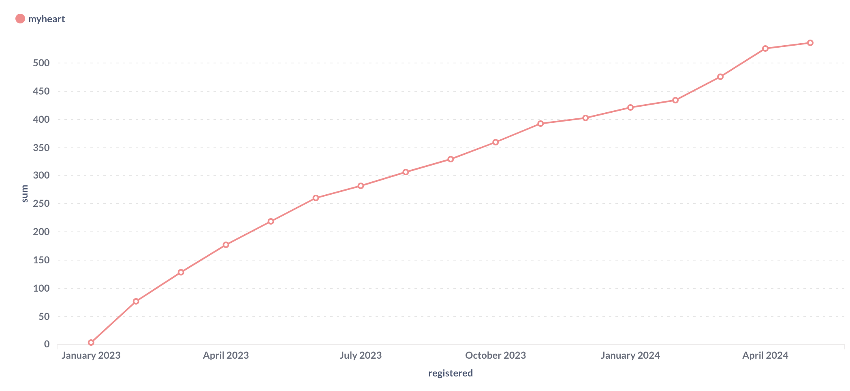

Enhancing Cardiac Rehabilitation Through Digital Innovation: A Quality Improvement Project
Maria Glover & Chris Scordis
Joint Cardiac Rehabilitation Leads
“DIGITAL THERAPEUTICS FOR LONG-TERM CONDITIONS”
Join our mission to change healthcare forever
Abstract: This quality improvement [QI] project introduces a novel mobile app aimed at increasing patient uptake and enhancing digital solutions in cardiac rehabilitation [CR]. Utilising the Plan-Do-Study-Act [PDSA] cycle, the project involved the implementation of an app, integrating features like real-time health monitoring, personalised exercise programs, and direct patient-provider communication. Initial findings indicate significant improvements in patient engagement and adherence, with high satisfaction and usage rates reported. The introduction of digital technology in CR represents a transformative approach, providing more accessible and personalised patient care. This project underscores the potential of mobile apps to improve health outcomes in CR.
QI Project Design: PDSA Cycle
PLAN: Identify a mobile app integrating real-time health tracking, personalised exercise programmes, and direct communication with CR team > Introducing My mHealth
DO: Implement My Heart app with an initial pilot group of 500 patients enrolled in CR.
STUDY: Monitor patient engagement metrics, adherence rates, and collect feedback through surveys and app analytics
ACT: Refine app features based on feedback and data analysis to enhance user experience and effectiveness
537 patients registered
81% activation rate
Over 2,700 education videos viewed
Over 6,900 activity diary entries
The introduction of My Heart within the CR service as part of a QI initiative has demonstrated a promising increase in patient uptake and engagement. This project showcases the potential of digital solutions to transform traditional healthcare delivery models, making them more accessible, personalised and efficient. NEXT STEPS… To examine the effectiveness of physical activity outcomes using a web-based CR application compared with conventional programme or a combination of both.
CR is vital for patients recovering from cardiac events, yet patient uptake remains suboptimal due to accessibility challenges and engagement issues. This QI project introduces a novel mobile app designed to increase patient uptake and integrate digital solutions into CR programmes.

