Slide 1
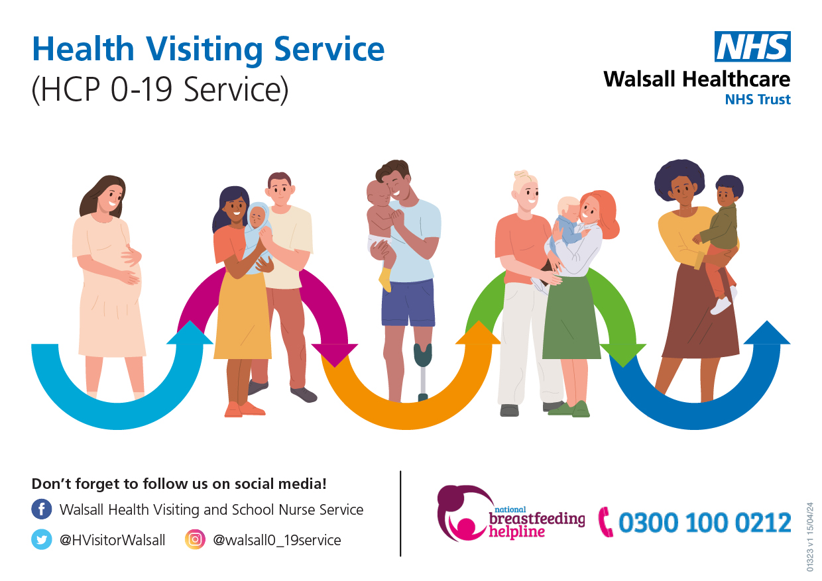
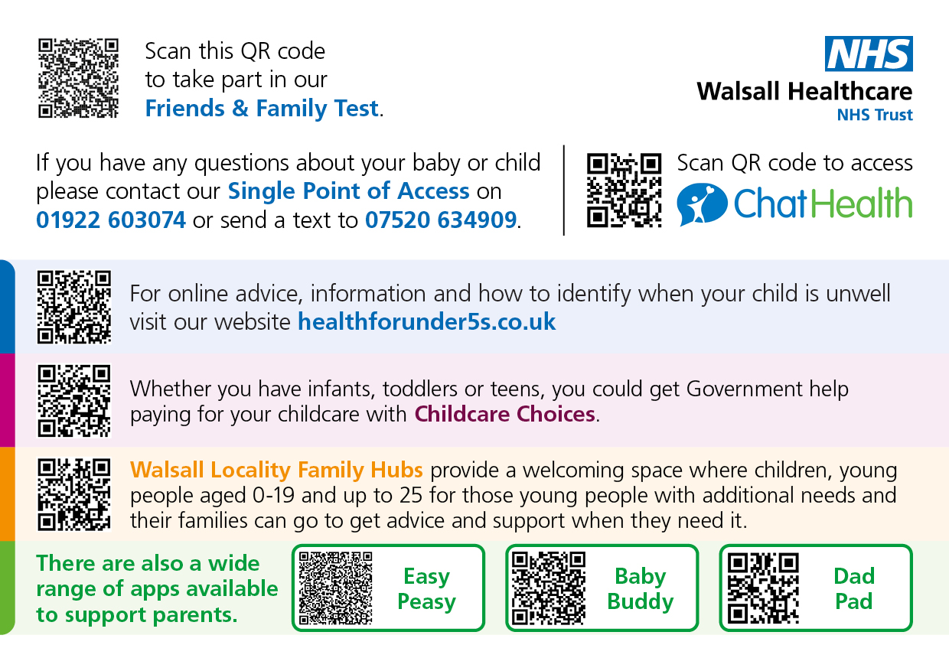
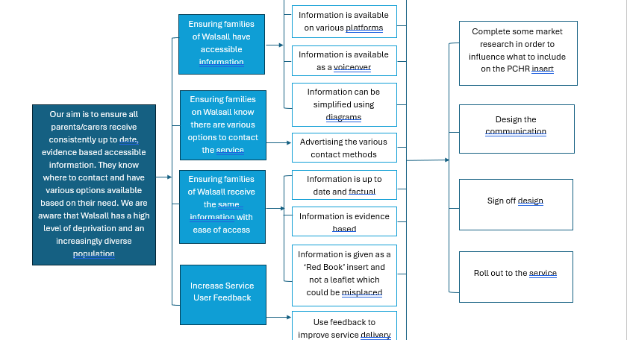
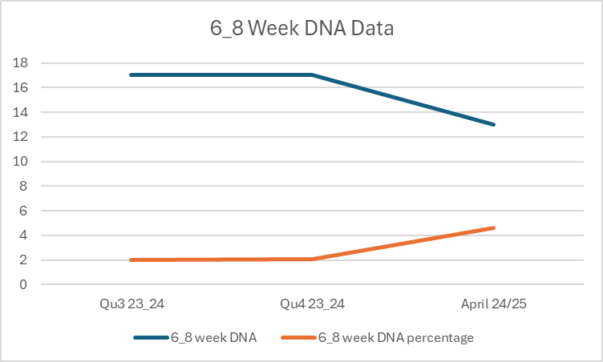
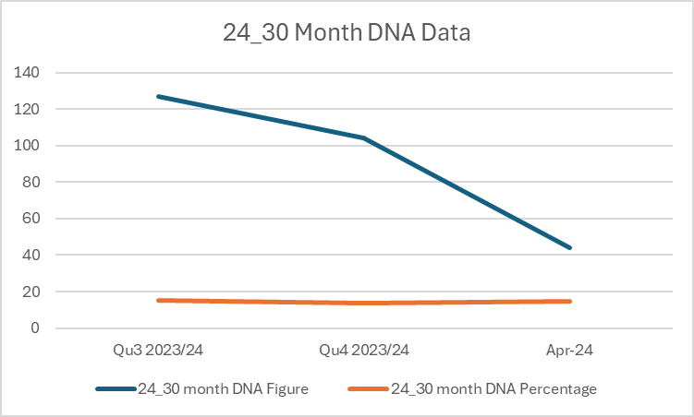
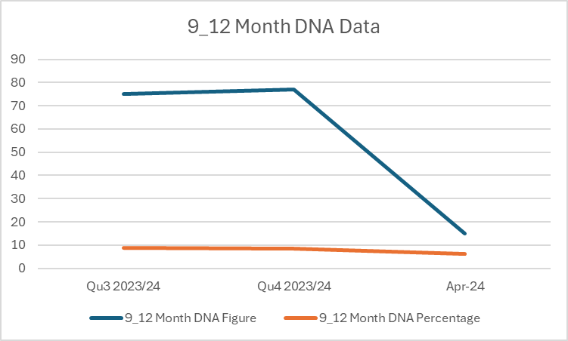
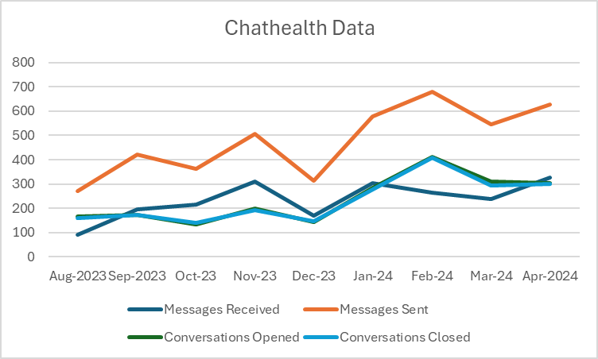
A24-051
Personal Child Health Record (red book) insert
Sue Hems-Digital lead
Vicky Bailey-Quality Lead
Abstract
When giving information about postnatal care, clear language , content and delivery of information should be shared. Information should support shared decision making and be:
provided face-to-face and include holistic verbal discussions
Should come in a range of formats, including digital, printed, braille or Easy Read
individualised and sensitive
supportive and respectful
evidence based and consistent
translated by an appropriate interpreter to overcome language barriers.
Issues/Actions Identified:
As there is a lot of information and advice provided and advice given at a time when parents are very tired, it is important to ensure parents are provided with information that they can refer to post visit. For most staff, this information was multiple leaflets or links shown to websites or digital online content. This was not consistent and depended upon information available or practitioner completing the visit. Therefore, as a service we looked at how we could do this better.
We designed a Personal Child Health Record (PCHR) insert with information for parents/carers to refer to in their baby’s book(see images above). We added QR codes for ease of access and our contact details including ChatHealth information for parents/carers to text any concerns at any time.
Due to the diverse population in Walsall and to ensure health literacy, the use of inclusive imagery was added in our Social Media handles.
Our Health for under 5's website (healthforunder5s.co.uk) is translatable and has voice over options for over 30 languages. Many articles use words as well as links to ensure the same information is available for all families. There is also an option to use images instead of text, enlarge text and simplify the information provided. The information we provide is evidence based and up to date. In addition to the primary objectives of the project, the proposed benefits also include increased service user engagement, including feedback and a reduction in children not being brought to other mandated contacts.
As part of the Healthy Child Programme (OHID, 2023), Health visitors carry out a new birth visit at a baby's home, with baby and their parents. During this visit, the health visitor assesses the physical and emotional health needs of the baby and family. The baby's health, growth and development is reviewed, supporting parents with their informed choice of infant feeding. Safe sleep, vaccinations, minor illnesses are also discussed. Emotional well-being of the family and transition to parenthood is explored, including mental health, domestic abuse, tips on baby bonding and what to do when baby is crying.
Many parents can struggle with this transition to parenthood, and it is important that they can have timely access to support form the health visiting service if required.
Changes already implemented:
ChatHealth text number was added to some appointment letters in September 2023 as a convenient way to rearrange appointments for Walsall families and all letters by November 2023. Which led the way for this project.
By completing this action our DNA figures for our Mandated contacts reduced (apart from 6-8 week due to a process change which has now been resolved).
Our Chathealth usage has increased
PDSA Summary:
PLAN- we have reviewed what is available to parents, reviewed partner agency resources, spoke to partners and created a resource which will be useful to parents.
The aim will reduce DNA's further, reduce emergency situations, increase ChatHealth messaging usage, increase contact with our Single Point of Access, by ensuring Parents/Carers know how and who to contact first.
DO- We are introducing this from June 2024 at the 0-19 service meeting.
STUDY- This will be reviewed in January 2024, having collated 6 months of data on a SPC Chart.
ACT- changes from study will be implemented.
Health Visiting Service / HCP0-19 Service
The Health visiting service is part of the HCP 0-19 service, delivering the Healthy Child Programme to children and their families across Walsall. The Healthy Child Programme aims to ensure all children receive the best start in life by having universal, targeted or specialist care and support.

