Slide 1
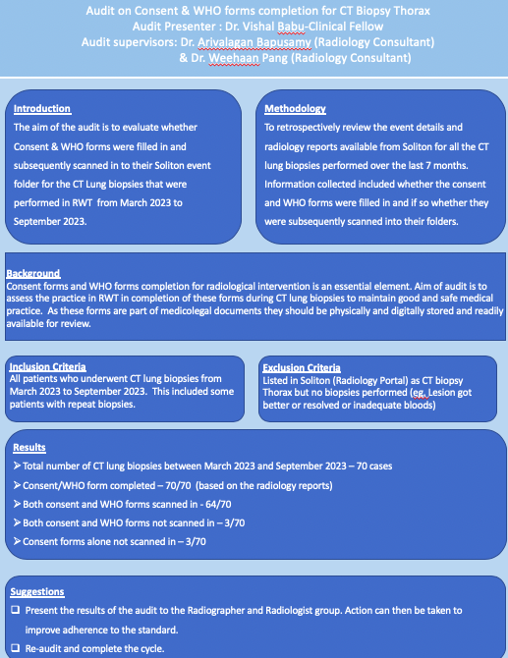
A Quality Improvement Project on Consent & WHO forms completion for CT Biopsy Thorax
Authors: Dr. Vishal Babu (Clinical Fellow), Dr. Arivalagan Bapusamy (Radiology Consultant) & Dr. Weehaan Pang (Radiology Consultant)
Introduction
The aim of the QIP is to evaluate whether Consent & WHO forms were filled in and subsequently scanned in to their Soliton event folder for the CT Lung biopsies that were performed in RWT from March 2023 to April 2024
Background
Consent forms and WHO forms completion for radiological intervention is an essential element. Aim of audit is to assess the practice in RWT in completion of these forms during CT lung biopsies to maintain good and safe medical practice. As these forms are part of medicolegal documents they should be physically and digitally stored and readily available for review.
Methodology
To retrospectively review the event details and radiology reports available from Soliton for all the CT lung biopsies performed over the 1 year. Information collected included whether the consent and WHO forms were filled in and if so whether they were subsequently scanned into their folders.
Inclusion Criteria
All patients who underwent CT lung biopsies from March 2023 to April 2024. This included some patients with repeat biopsies.
Exclusion Criteria
Listed in Soliton (Radiology Portal) as CT biopsy Thorax but no biopsies performed (eg. Lesion got better or resolved or inadequate bloods)
First Cycle Outcome
Total number of CT lung biopsies between March 2023 and September 2023 – 70 cases
Consent/WHO form completed – 70/70 (based on the radiology reports)
Both consent and WHO forms scanned in - 64/70
Both consent and WHO forms not scanned in – 3/70
Consent forms alone not scanned in – 3/70
Suggestions
Present the results of the QIP to the Radiographer and Radiologist group. Action can then be taken to improve adherence to the standard.
Second Cycle Outcome
Date collected from October – December 2023
24 cases in total 100% compliance
Third Cycle Outcome
Data collected from January – April 2024
36 in total 100% compliance
1 patient did not have consent form
www.rcr.ac.uk. (n.d.). Information offered to patients after consent for radiological procedures [QSI Ref: XR-502] | The Royal College of Radiologists. [online] Available at: https://www.rcr.ac.uk/career-development/audit-quality-improvement/auditlive-radiology/information-offered-to-patients-after-consent-for-radiological-procedures-qsi-ref-xr-502/ [Accessed 22 Apr. 2024].
‌Ariyanayagam, T., Drinkwater, K., Cozens, N., Howlett, D. and Malcolm, P. (2019). UK national audit of safety checks for radiology interventions. The British Journal of Radiology, 92(1094), p.20180637. doi:https://doi.org/10.1259/bjr.20180637.
‌Koetser, I.C.J., de Vries, E.N., van Delden, O.M., Smorenburg, S.M., Boermeester, M.A. and van Lienden, K.P. (2012). A Checklist to Improve Patient Safety in Interventional Radiology. CardioVascular and Interventional Radiology, [online] 36(2), pp.312–319. doi:https://doi.org/10.1007/s00270-012-0395-z.

