Slide 1
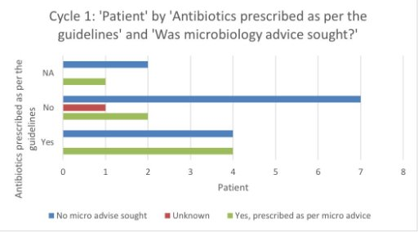
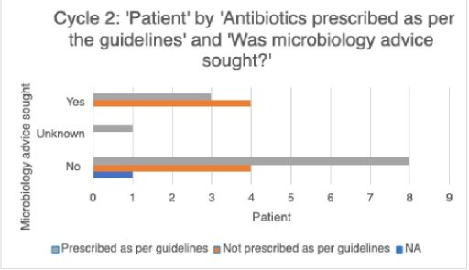
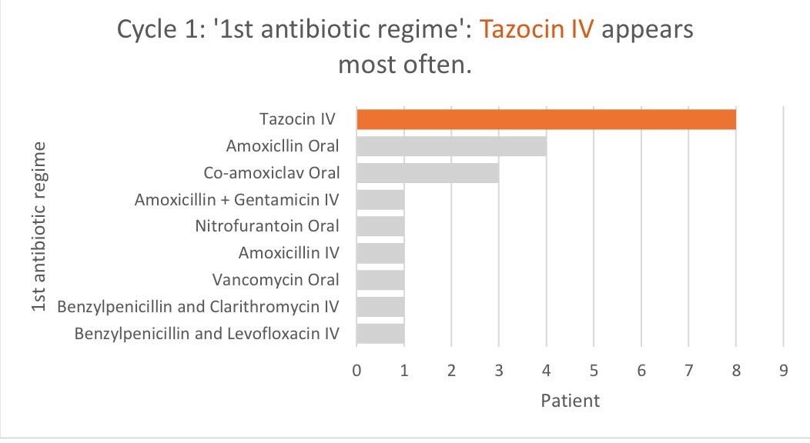
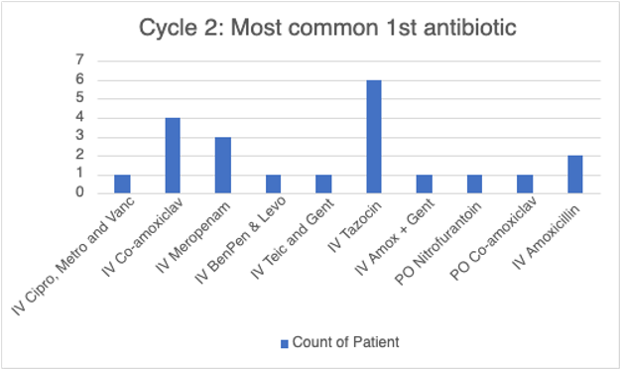
A24-041
Antibiotic stewardship on Deanesly Ward 2023​
Dr James Smith / SHO​
Dr Talitha Jackson / SHO​
Supervisor – Dr Pek Koh / Consultant oncologist
Abstract
Antibiotics are a vital component in the management of oncology inpatients. It is therefore important that antibiotic prescribing is appropriate, and if guidelines are followed as much as possible. ​
This QIP studied antibiotic prescribing over 2 cycles of 2 weeks each to determine if the choice of antibiotic was appropriate given the clinical scenario, as well as the length of the courses and whether discussion with microbiology took place when warranted. ​
The first cycle concluded that broad-spectrum antibiotics such as Tazocin were often overprescribed in non-neutropaenic patients and that a significant number of courses exceeded the recommended length.​
After an educational poster and teaching session were delivered, a second cycle was completed which showed improvements in both antibiotic choice and course length. It is recommended this audit is continued to identify areas for improvement in antibiotic prescribing amongst oncology inpatients.
Further information
Methodology​
Retrospective data was collected from oncology inpatients treated for infection who were admitted between 1-14th January 2023 for cycle 1 (n=21) and 1-14th July 2023 for cycle 2 (n=21). We collected data on their infective diagnosis, antibiotic choice (2nd and 3rd choices if applicable), length of course, neutropaenic status, and what the guideline suggested based on their diagnosis for comparison. Data was collected from review of their scanned inpatient notes and ePMA records. ​
​
Results​
In cycle 1, the first-choice antibiotic matched the microbiology guideline 38% of the time. In cycle 2, this improved to 57%.​
In cycle 1, Tazocin was the first choice in 8 occasions, only 1 of these patients was neutropaenic. Compared to cycle 2, in 6 occasions Tazocin was the first choice and 5 patients were neutropaenic. The modal infection in cycle 1 was community acquired pneumonia whereas in cycle 2 it was neutropaenic sepsis. ​
In cycle 1, where there was a clear guideline on treatment duration, the prescribed duration matched in 50% of cases. In cycle 2, it matched the duration 63% of the time. ​
In cases where prescribing deviated from the guidelines, microbiology were contacted in 20% of cases in cycle 1 and in 50% of cases in cycle 2. ​
​
Conclusions​
There is a significant percentage of patients receiving an incorrect first-choice antibiotic when compared to the guidelines, particularly Tazocin. ​
Microbiology are not contacted frequently enough when prescribing deviates from the guidelines.​
The length of the prescribed course often exceeded the recommended length.​
​
Recommendations​
When oncology patients do not have neutropaenia, antibiotic prescribing should be guided by regular guidelines, this prevents the over-prescribing of broad-spectrum antibiotics and helps reduce antibiotic resistance. ​
End dates should be part of the initial prescription, if not, then diligent and frequent reviews of the prescription should occur. The course length should ideally match the guidelines. ​
When alternative antibiotic options are to be considered, or if blood cultures are positive, the microbiology team should be consulted, and this should be documented in the notes.
Oncology Department
Royal Wolverhampton NHS Trust​
​
Poster made May 2024

