Slide 1
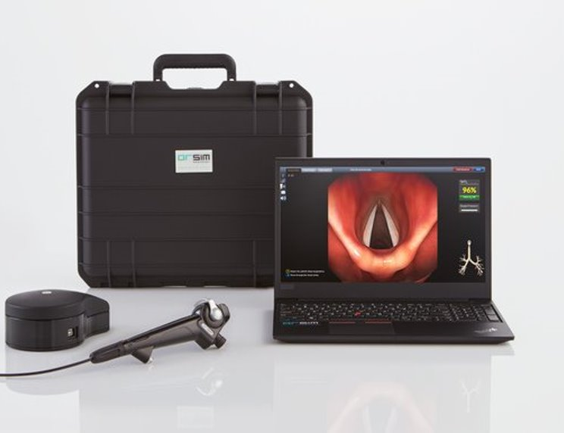
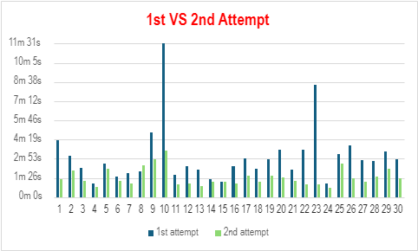
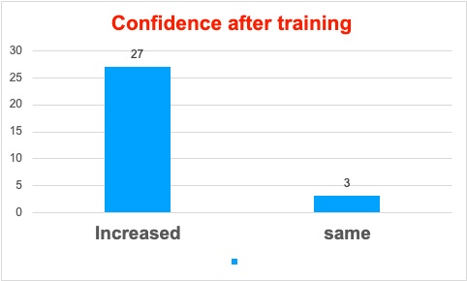
A24-034
Mastering the Fiberscopy Skills in Anaesthetists and Intensivists
Dr Ojaswani Rai Sood (Reg Anaes.) Dr Mukesh Sharma (Cons. Anaes.) Dr Sadhna Sapra (Cons. Anaes.)
BACKGROUND
Difficult intubation is reported in 1.6-10% patients. Fiberscopic intubation is useful aid in these scenarios. DAS guidelines and NAP4 emphasise the importance of acquiring skills in handling and maintaining fiberoptic equipment, as well as proficiency in performing fiberoptic intubations in both elective and emergency situations.
AIM
To enhance procedural skills training through hands-on simulation, focusing on improving time efficiency, technical proficiency, and instrument handling.
METHOD
Participant Recruitment: Personally approached all participants ans provided detailed instrument education.
Initial Assessment by the Gopher game for baseline dexterity and timing assessment.
Practice Sessions on normal and difficult airways scenarios for 20 minutes.
Reassessment by repeating the Gopher game and improvement measurement.
RESULT
Procedure Time Improvement: 100% of the participants average improvement of 44.7%
Increased Confidence in 90% of the participants
Repeat the training every two months.
TAKE HOME MESSAGE!!
Regular practice and workshops, self-performance maintenance and tracking MUST for fibrescope skills.
Reference:
RCoA The NAP4 report: major complications of airway management in the
United Kingdom

