Slide 1
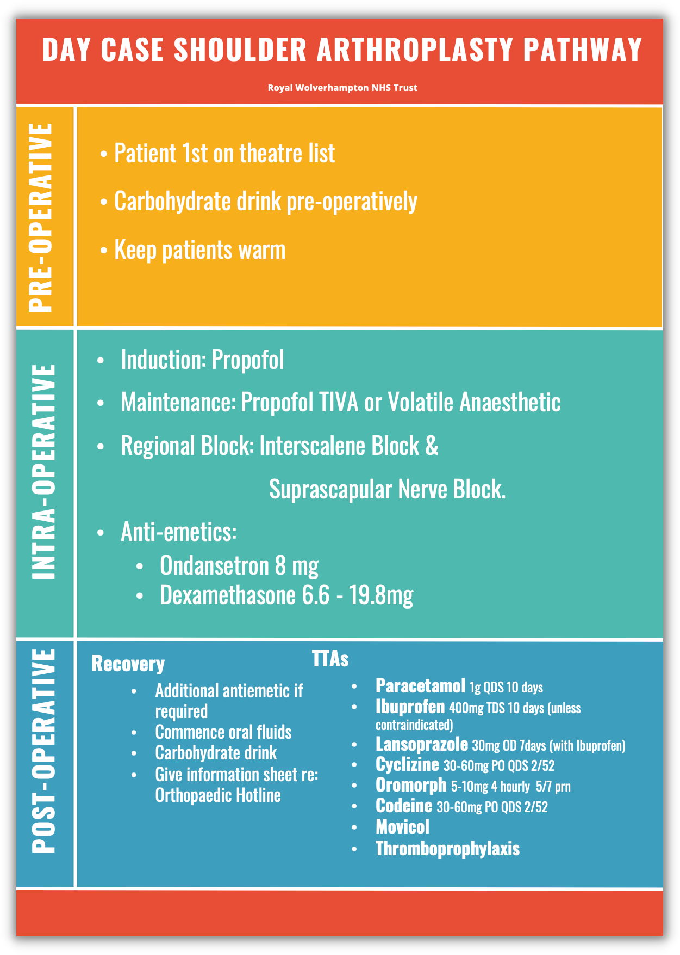
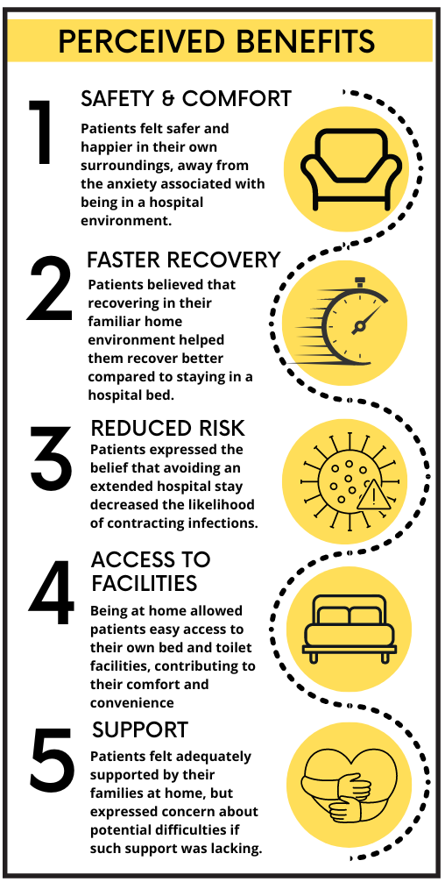
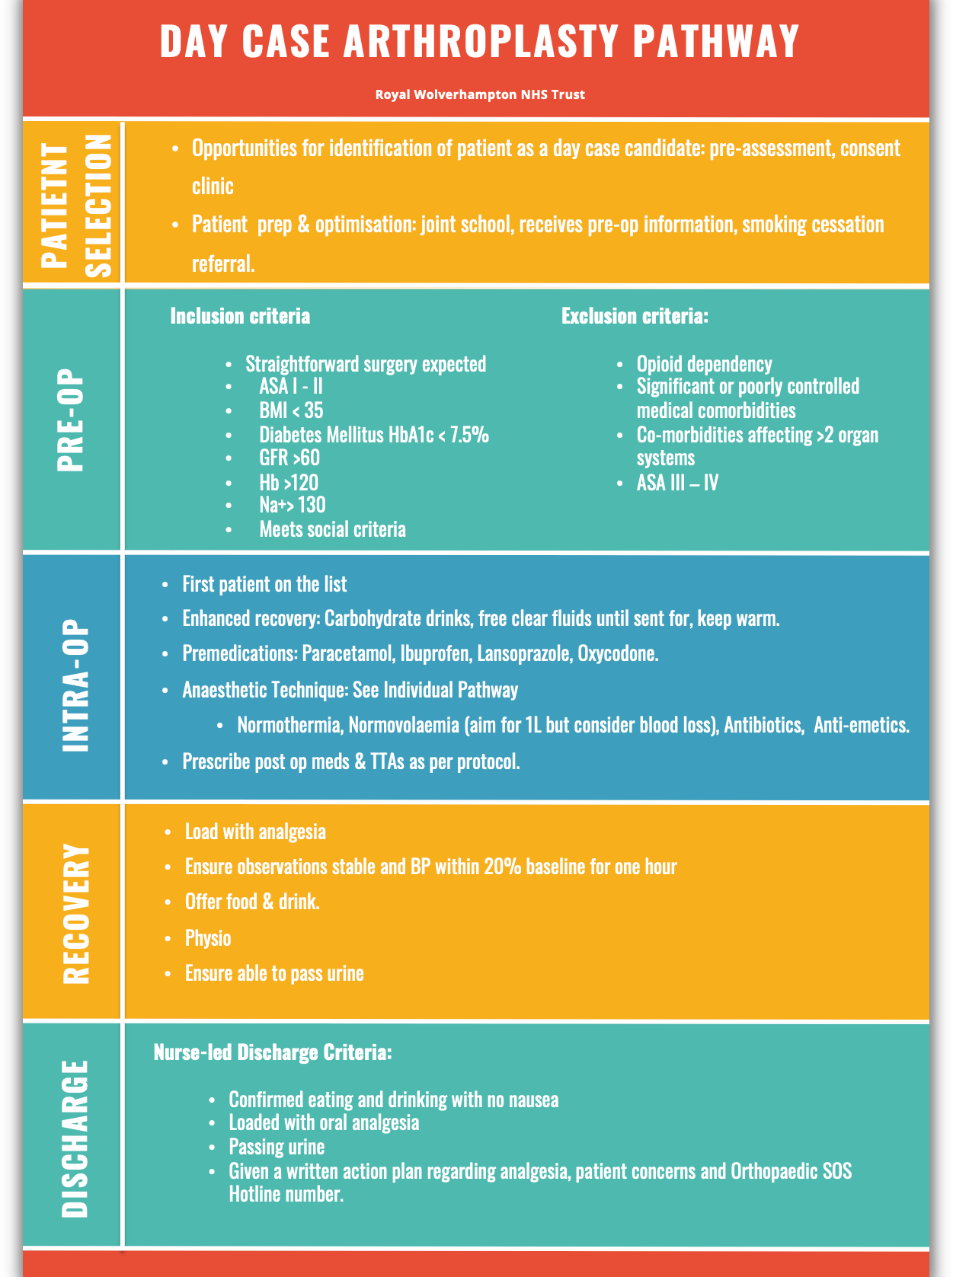
A24-029
‘Sleeping in your own bed’ –Day Case Shoulder Arthroplasty (Replacement)
SJ Dunn, Registrar, Anaesthetics. N Joshi,. SAS, T&O. B Williams, Registrar, Anaesthetics, A Simons, Consultant, T&O. A Singh, Consultant, Anaesthetics
INTRODUCTION
PATIENT SATISFACTION
Recently there has been a shift towards shoulder arthroplasty being performed as a day-case procedure instead of the traditional approach of undergoing general anaesthesia with an overnight stay. This transition has numerous benefits, including enhanced patient experiences, optimized resource management, and cost savings.
In 2020, a new day-case care pathway for shoulder arthroplasty was introduced at Cannock Chase Hospital- an elective orthopaedic centre part of The Royal Wolverhampton Hospitals NHS Trust. We have conducted a retrospective service evaluation audit focusing on
patient satisfaction.
Overall patient satisfaction was extremely high, with an average score of 4.8 out of 5. The patients unanimously stated that it was beneficial to undergo procedures as day- case and that they would choose a day-case procedure if they needed the other side done. They all would recommend day-case shoulder replacement to friends and family, with the condition of having adequate family support.
OVERVIEW
METHOD
An overview of the Day-case Arthroplasty Pathway is provided in figure below
All patients selected as eligible for the day- case pathway had their notes reviewed and were followed up by telephone using a structured questionnaire.
RESULTS
15 patients followed-up. No re-admissions. No complications. Two patients had the procedure on both sides.
ANAESTHETIC TECHNIQUE
General anaesthesia with regional nerve block.
PAIN
Immediately following the operation, patients reported a pain score of 0/10 in recovery. The average pain score within 24 hours was 3.2/10, which remained consistent after 24 hours. Most patients effectively managed their pain with simple analgesics. One had pain after the block wore off.
CONCLUSION
The introduction of day-case pathway for shoulder arthroplasty has been successful, with high patient satisfaction rates. Also, this allowed hospital beds to be freed up and a better use of resources.
Anaesthetics and Trauma and Orthopaedics

