Slide 1
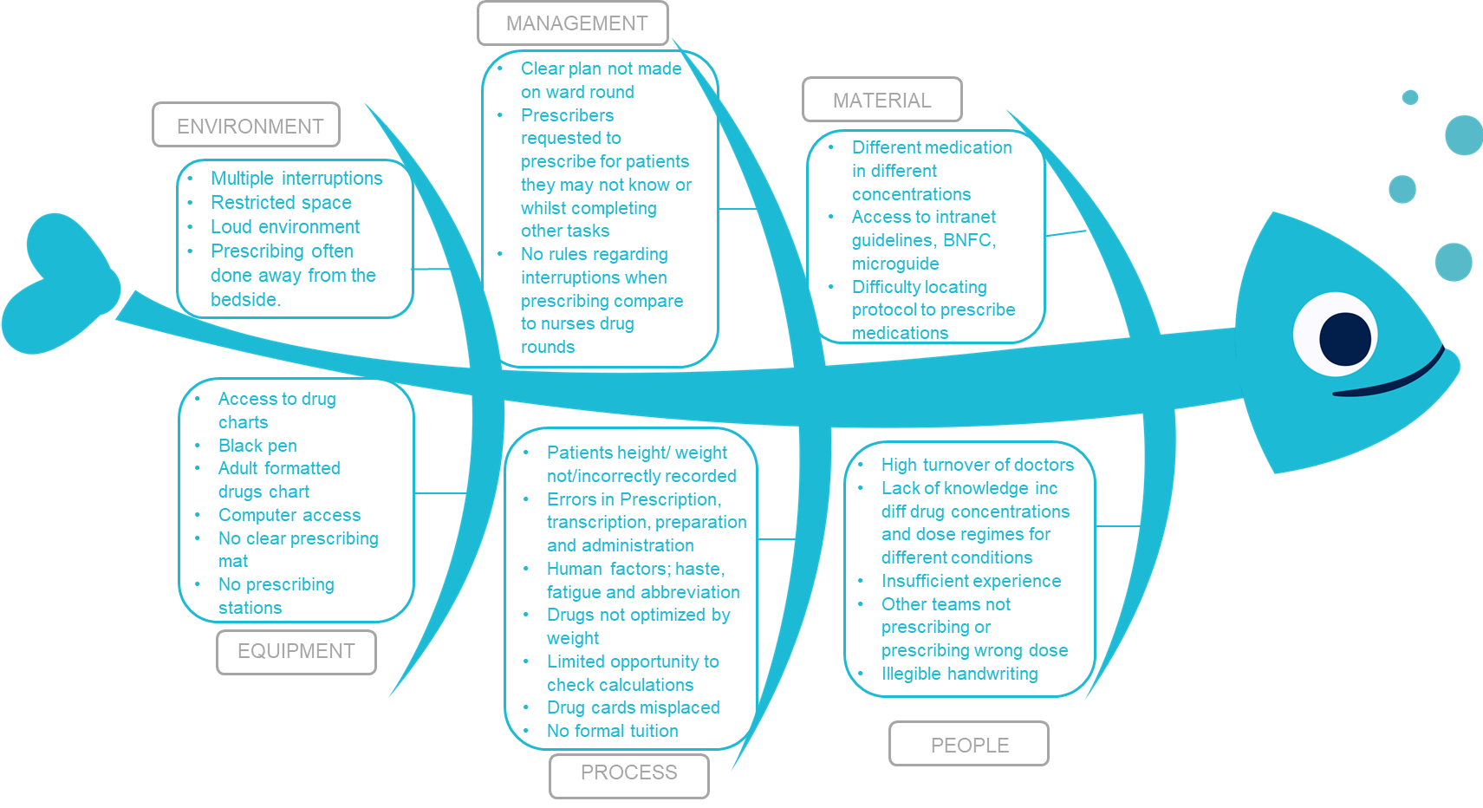
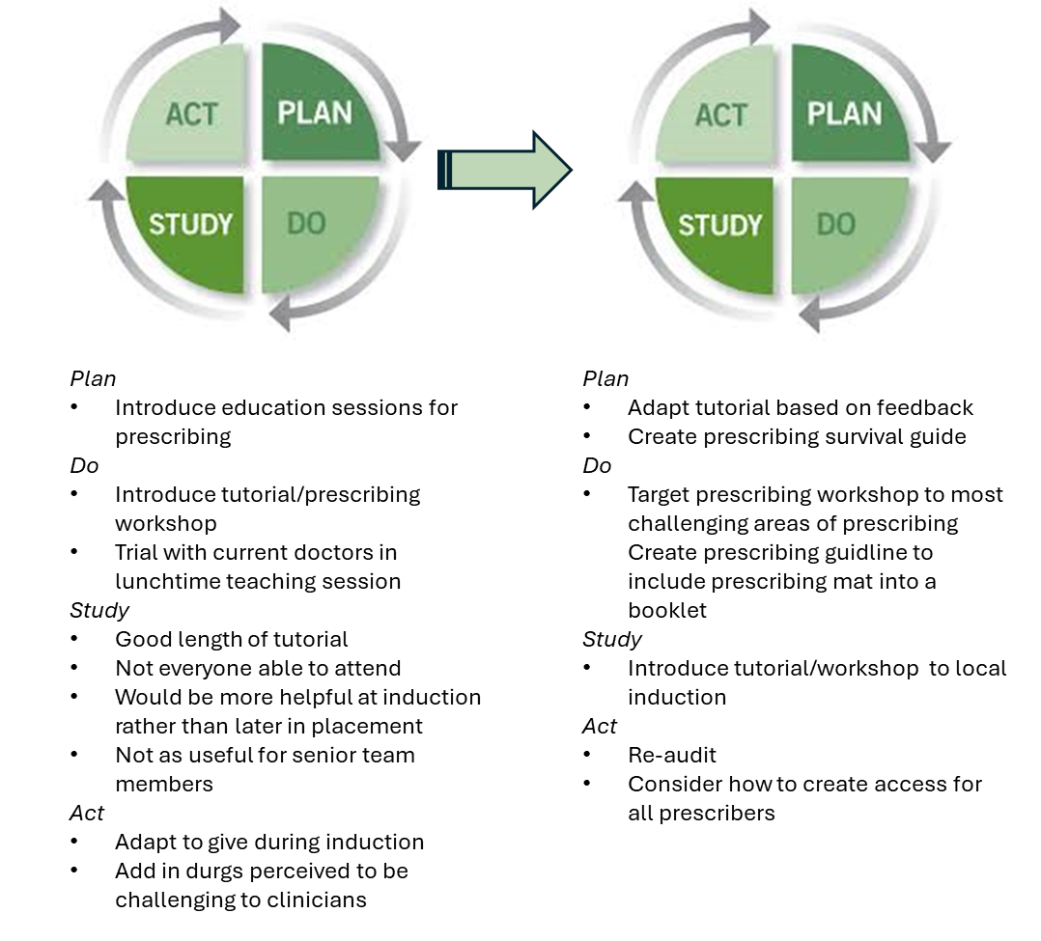
A24 - 015
Improving Paediatric Prescribing- New Cross Hospital
Dr Rachel Neal Paediatric Clinical Fellow,
Dr Jayabarathi Sakamudi Paediatric Consultant,
Dr Abrar Mahbub Dr Moussa Al- Kurdi Clinical fellows.
Introduction
Medication errors are the single most preventable cause of patient harm. 237 million medication errors are estimated to occur annually within the NHS in England alone. The financial burden to the NHS is impactful, but more costly is the significant morbidity and mortality of patients. Multiple patient safety issues around prescribing were highlighted by the submission of over 100 Datix within a 12 month period. Our project, inspired by other similar projects, aimed to highlight areas within our own department that we could address and implement change.
Further info
Aims
90% of drug charts to meet prescribing standards and to improve confidence of prescribers by September 2024 and reduce the number of medication error related Datix
Method
Our audit looked at prescribing standards of drug charts in paediatrics. We sampled 50 charts in a retrospective audit (25 before doctor changeover and 25 after) during the period Nov 2023- Jan 2024, against 4 sets of criteria based on national prescribing guidelines and Trust guidelines.
Results
Our study showed that in all cases prescribing standards were below expected. There was no significant impact of the changeover although standards did slightly worsen.
Improvement
Following on from this we have instigated remedial actions to improve the prescribing. These include;
Providing a training tutorial and prescribing workshop for all junior doctors, face to face and regular virtual sessions.
Creating and distributing a prescribing handbook.
Working towards collaborating a paediatric drug chart.
Initial feedback from the team suggests this has helped to clarify requirements and improve prescribing and created our second PDSA cycle. We aim to re-audit in Q4 2024.
LEARNING AND REFLECTION AND NEXT STEPS
Our project was data driven incorporating evidence from a departmental audit and a review of submitted Datix. With our literature search we were able to increase not only our own knowledge but share this with our colleagues through raising awareness, providing education and focussing on change in attitudes towards prescribing. Additionally, it helped us to develop new leadership skills. It has been really fulfilling to watch my colleagues who are new to the NHS develop into prescribing champions in a situation they once found difficult. One of the most challenging aspects was to give all prescribers access to attend the workshop due to shift patterns. Introducing regular quarterly virtual session may overcome this and, working towards a paediatric drug chart which is already practised in many NHS Trusts and aiming for zero tolerance for prescribing errors.
Paediatrics

