Slide 1
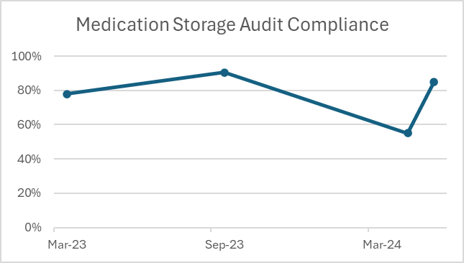
A24 014
Improving Medication Storage on C35
Kayleigh Morgan-Guest Senior Sister, Clare Banks, Matron,
Monica Chohan, Junior Sister, Emmah Simbabure Junior Sister,
Katie Simkiss, Junior Sister, Mayowa Adebayo, Staff Nurse.
Background
In April 24, the medication storage audit was undertaken on C35, with a score of 55% with multiple issues highlighted.
Actions taken:
A small project group was formed including ‘medication champions’ to work on ideas for improving the storage compliance. The SMART aim was agreed:
To be fully compliant in medicines storage on C35 by the next audit (July2024)
An action plan was created, and meetings were held to review progress:
New fridge for clean utility to be ordered
Trolleys to be deep cleaned once a week (night shift)
Checklist for front of the trolley to be implemented
Extra medication trolleys are to be ordered, and 3 nursing teams to each have their own allocated medication trolley
NIC to complete spot checks on medication storage
Stock list to be compiled and displayed clearly on the front of each cupboard door to ensure stock is stored correctly
Work with Pharmacy team to re-evaluate the stock
New fridge temperature checklist to be used
Copies of the medication policy were sent to all staff to read.
Progress:
Once all of the above actions were in place, a practice audit was undertaken on 23 May 2024, ahead of the formal pharmacy audit, which is due in July.
Outcome:
The practice audit scored 85%. The team have one or two points to improve on but are well on their way to achieving 100% compliance at the formal audit due in July 2024.
Failures on April’s audit:
No clear audit trail for the delivery and receipt of medicines
Medications left on the side in treatment room
Medication fridge broken
Drugs trolley not chained to the wall
Medications opened, expiry dates on boxes removed, opened bottles not labelled with date, and strips loose in the medication trolley.
May 24 practice audit
Acute Chemotherapy Unit, Oncology and Haematology, Division 2

