Slide 1
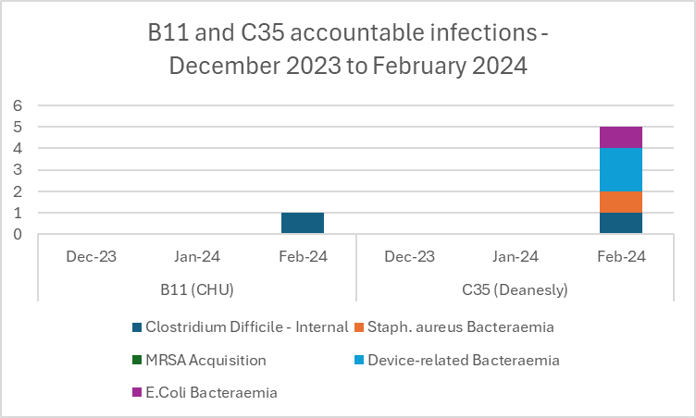
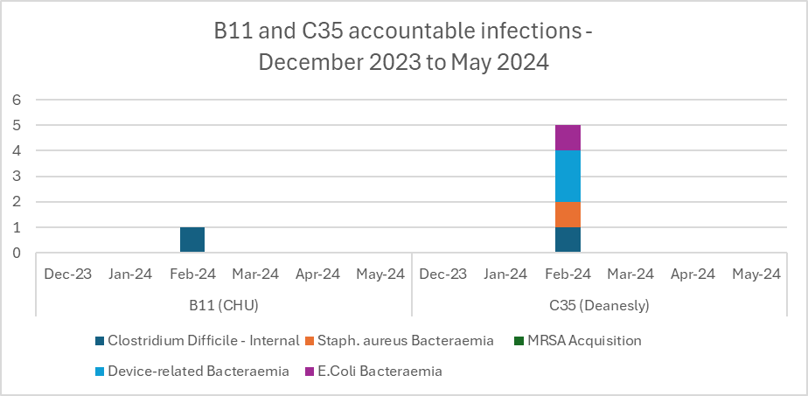
A24 - 008
Reducing the number of accountable infections on C35
Kayleigh Morgan-Guest, Senior Sister, Clare Banks, Matron,
Mayowa Adebayo, Staff Nurse, Ruth Obodo, Sister,
Ken Arum, Healthcare Assistant
Background
A number of accountable infections were recorded on B11 (Clinical Haematology Unit) and C35 (Deanesly ward) between December 2023 and February 2024.
A number of risks were found to be contributing factors:
Patients with a pick line are sometimes becoming infected whilst at home, resulting in a hospital admission
Handwash basins are sometimes being used for teeth brushing
Pillows are sometimes being used for both feet and head
Bed sheets are sometimes returning from laundry stained
Project Aim:
To reduce accountable infections on B11 and C35 by 60% by October, and 80% by March 2025.
What did we do?
A small project group was formed to including ‘IP champions’ to work on ideas for reducing the number of accountable infections.
An action plan was created, and meetings held to review progress:
Two nurses to attend when PICC line is being inserted
Posters above wash hand basins to reinforce handwashing only
Biopatch dressings to be utilised
Daily HCA checklist to be produced and used
Room orientation document to be updated
Fortnightly training from IP team
Teams to complete Datix/report to Laundry when ‘clean’ sheets are returned stained
What was the outcome?
Following implementation of the above actions, there have been no further accountable infections on both B11 and C35 since the beginning of March 2024.
Reducing the number of accountable infections on C35
Clinical Haematology Unit team (C35)

